Slide 1

Involving the citizens into participatory budget
Gdański Zarząd Dróg i Zieleni

Slide 2


Gdański Zarząd Dróg i Zieleni
Involving the citizens into participatory budget
Eleven editions of the Citizens' Budget have resulted in 933 projects that have been implemented for a total amount of PLN 177 million.
Thanks to the ideas and involvement of residents, we can all benefit from new recreational areas, playgrounds, sports fields, outdoor gyms, and skate parks in our districts.

Slide 3
Gdański Zarząd Dróg i Zieleni
The Civic Budget procedure in Gdańsk is a participatory budgeting process that allows residents to propose and vote on projects to improve their city. Here is a step-by-step description of the process:
Submission of Project Proposals: Residents of Gdańsk can submit their project ideas for the Civic Budget. These can range from small local initiatives to city-wide projects. Projects can be submitted online via a designated platform
Verification and Review: Once submitted, all proposals are reviewed by the city’s administrative units to check feasibility, cost estimates, and whether they fall within the legal and technical scope of city competencies. The project must also comply with Gdańsk’s urban plans and regulations. After this review, some projects may need adjustments or be disqualified if they don’t meet the criteria.
Public Voting: All residents of Gdańsk can vote on the projects they find most beneficial.
Announcement of Results: After the voting period ends, the results are tallied, and the winning projects are announced. The projects with the most votes within the available budget are selected for implementation. These results are publicly available on the city's Civic Budget website.
Involving the citizens into participatory budget

Slide 4
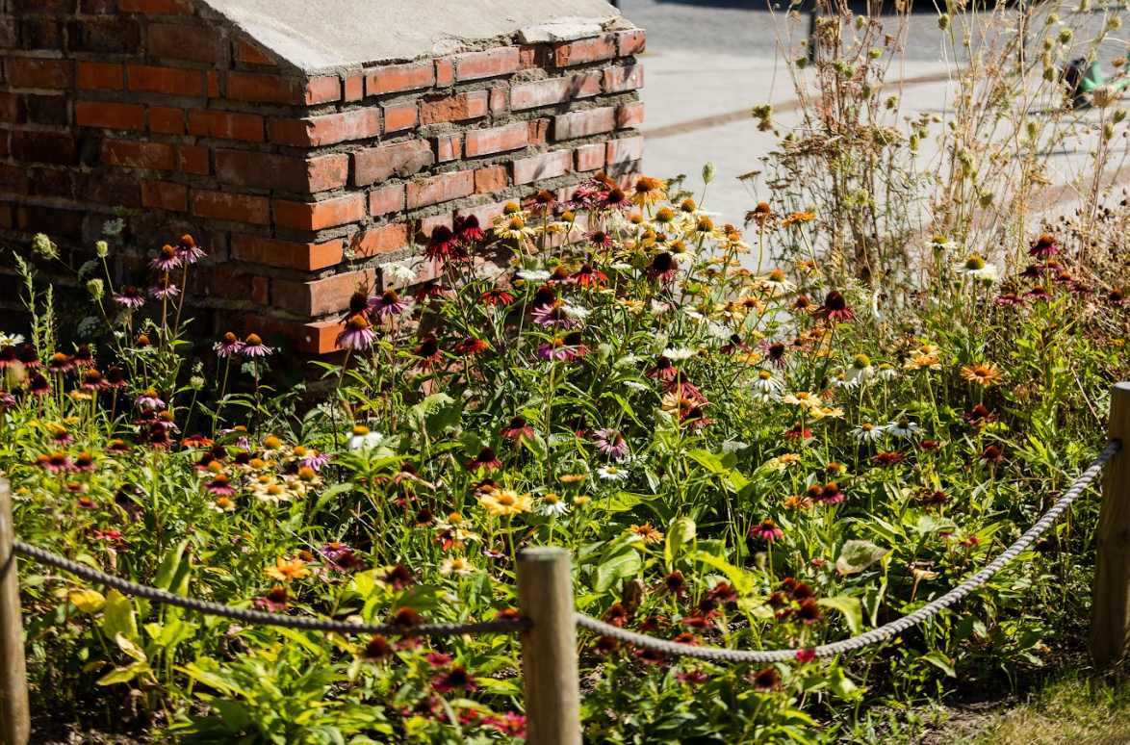
Gdański Zarząd Dróg i Zieleni
The Green Citizens’ Budget
The Green Citizens’ Budget in Gdańsk is a form of social consultation aimed at diagnosing the needs of residents in the field of broadly understood environmental protection and ecology, and consequently the implementation of public tasks.
In 2024, more than 4 million PLN, which is nearly 20% of the total Citizens’ Budget, has been allocated to the Green Citizens’ Budget
Zbytki/ Za Murami

Slide 5
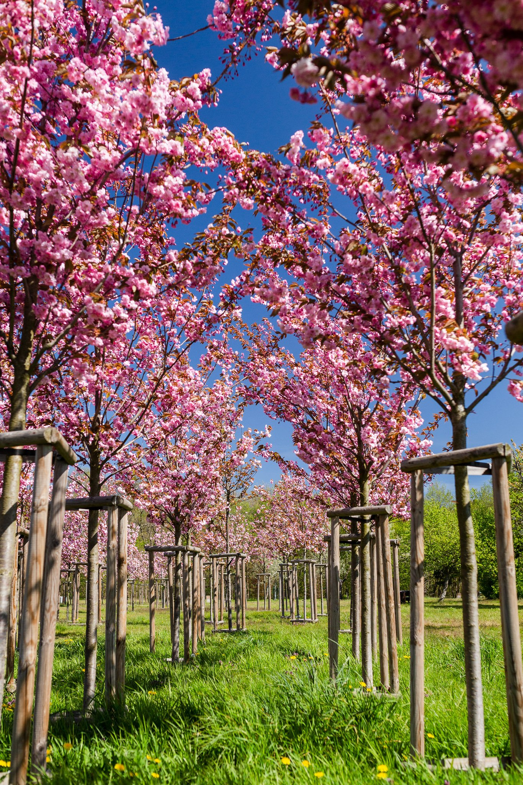
Gdański Zarząd Dróg i Zieleni
The Green Citizens’ Budget
The Green Citizens' Budget, since 2021, assumes:
the development of public, generally accessible urban green areas through the construction of new green spaces and the renovation and modernization of the development of existing ones.
This is a response to the needs of residents expressed in the form of submitted projects.

Slide 6
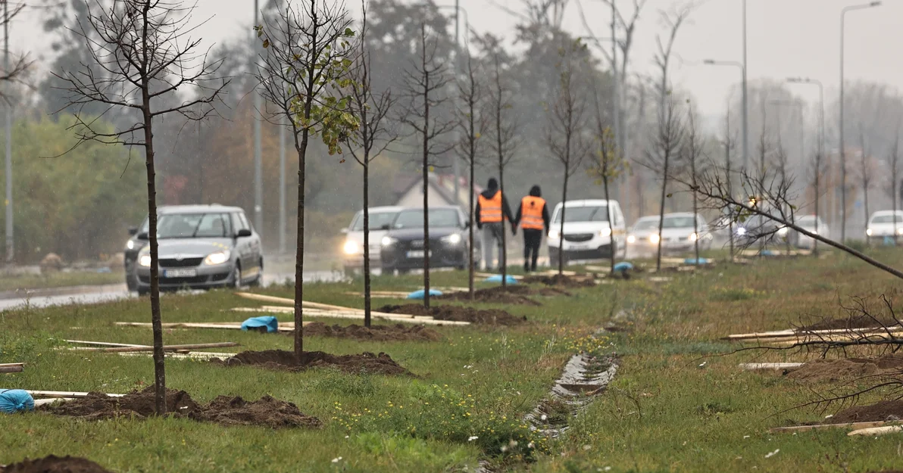
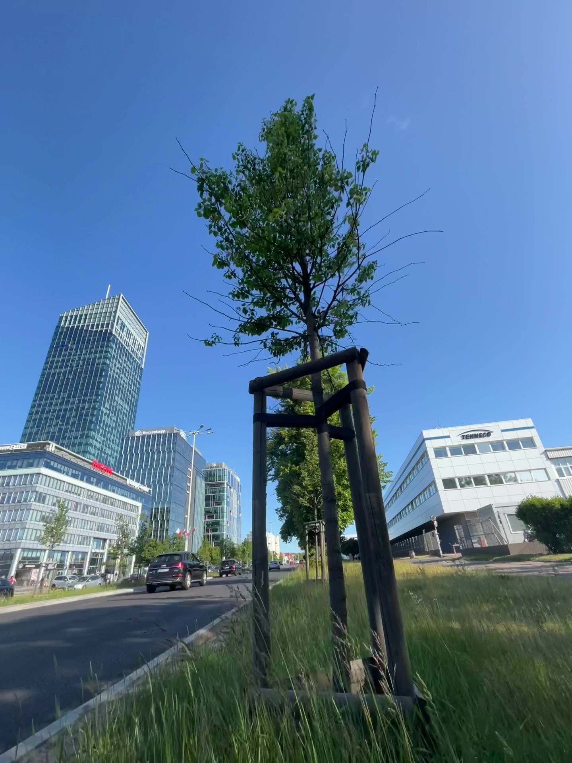
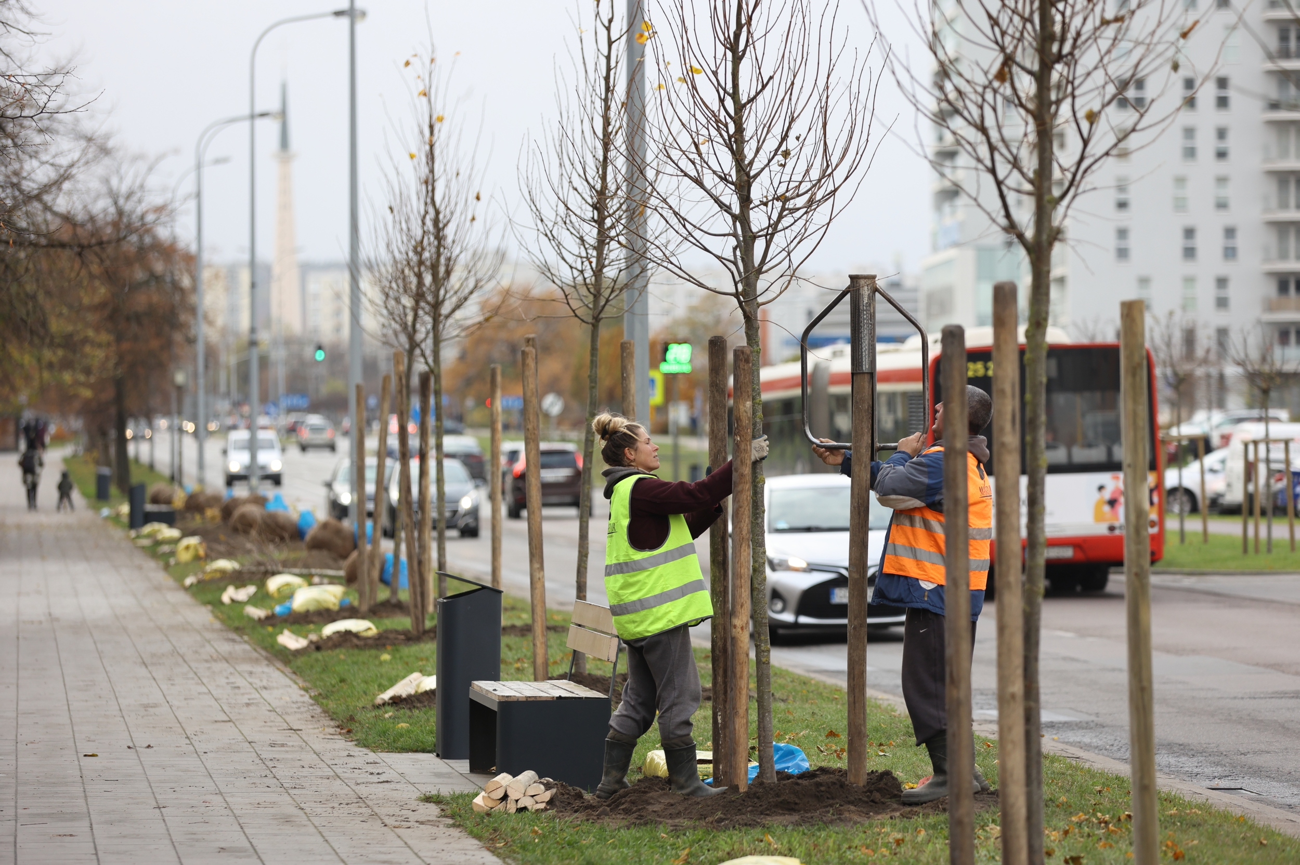
Gdański Zarząd Dróg i Zieleni
Objectives of the Green Citizen’s Budget
Planting and maintenance of vegetation in urban green areas
planting vegetation in parks, green areas, squares, municipal housing areas and as part of street greenery
planting new vegetation or supplementing existing vegetation in municipal green areas
establishing and maintaining flower meadows and flower beds with plants that are conducive to insects
maintenance of planted vegetation and maintenance of existing tree stands in municipal areas
Aleja Grunwaldzka

Slide 7
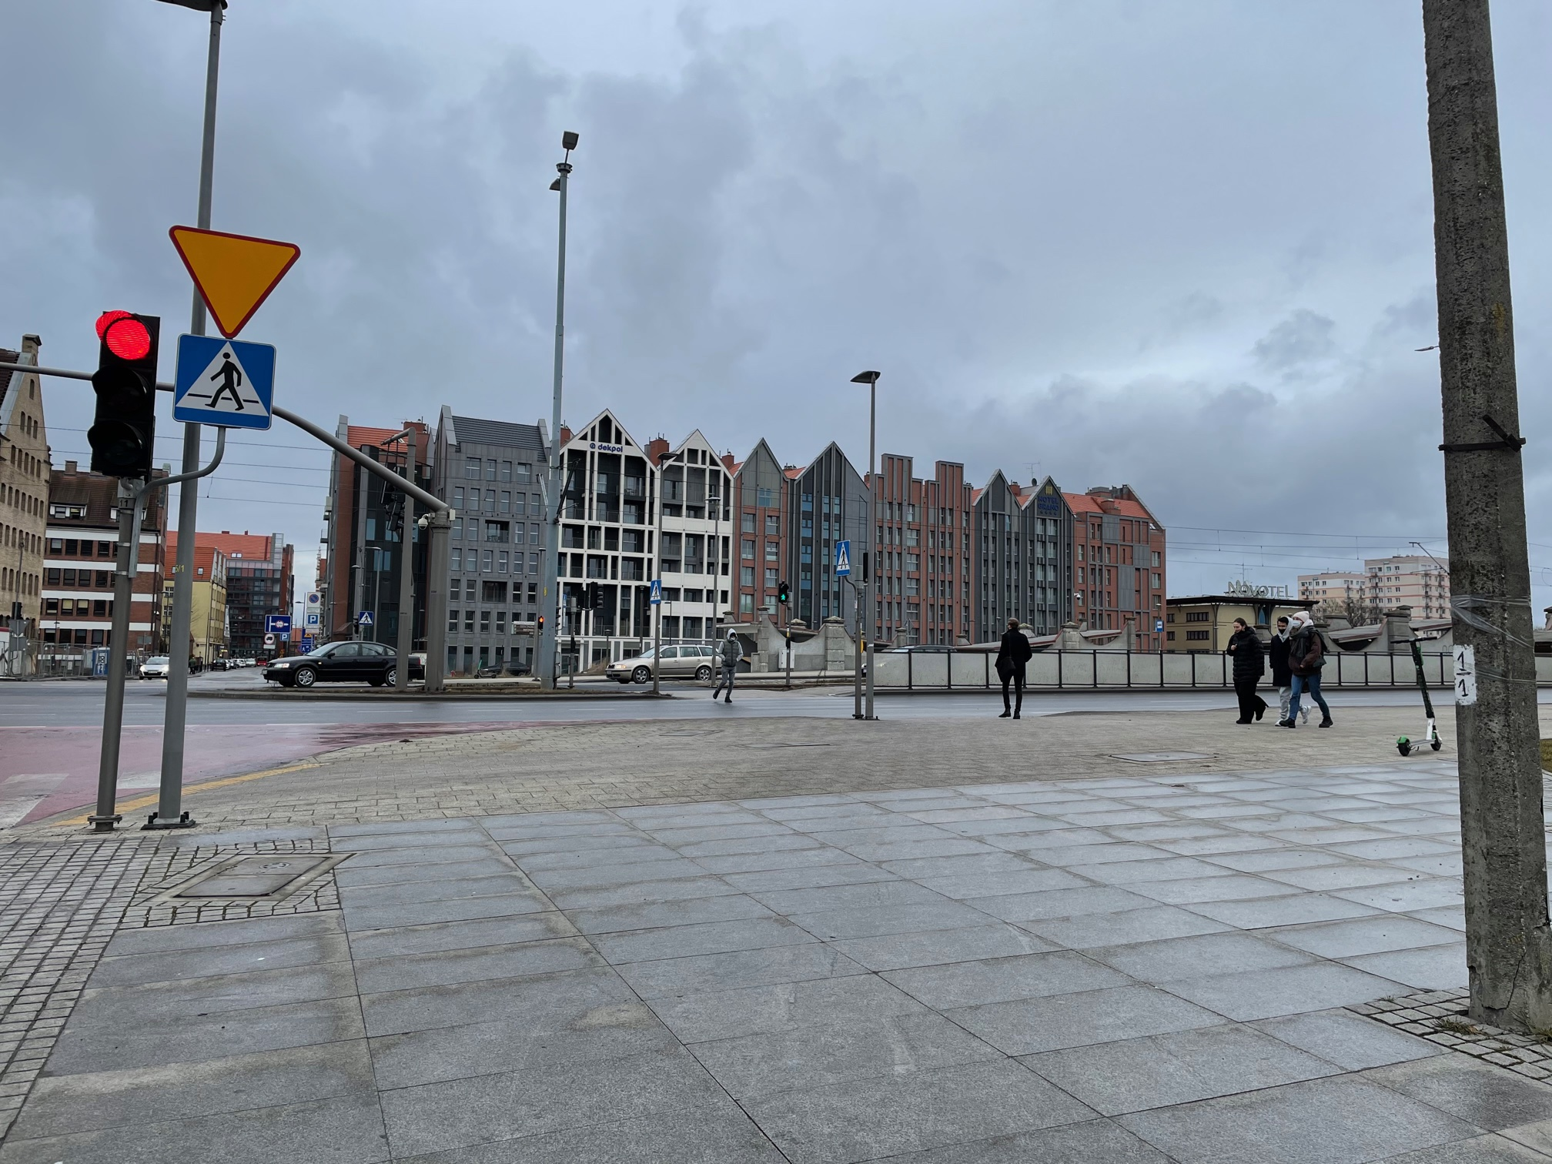
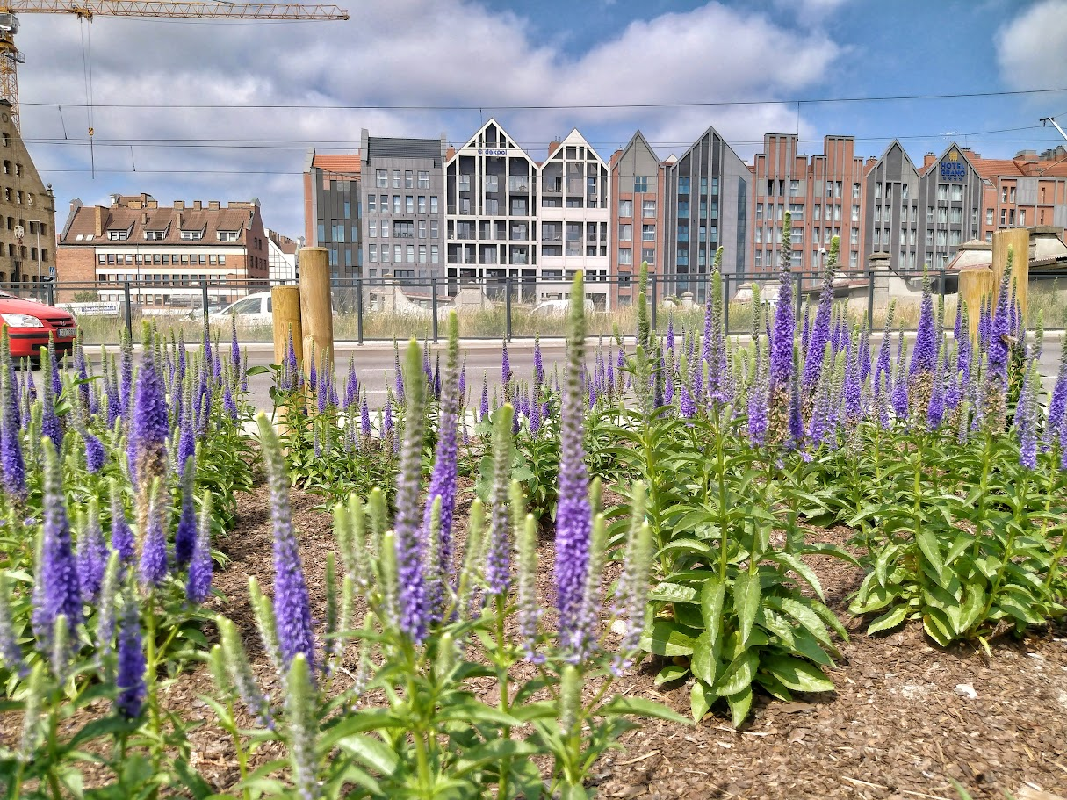
Gdański Zarząd Dróg i Zieleni
Objectives of the Green Citizen’s Budget
New green spaces
Zielona Aleja na Wyspie Spichrzów

Slide 8
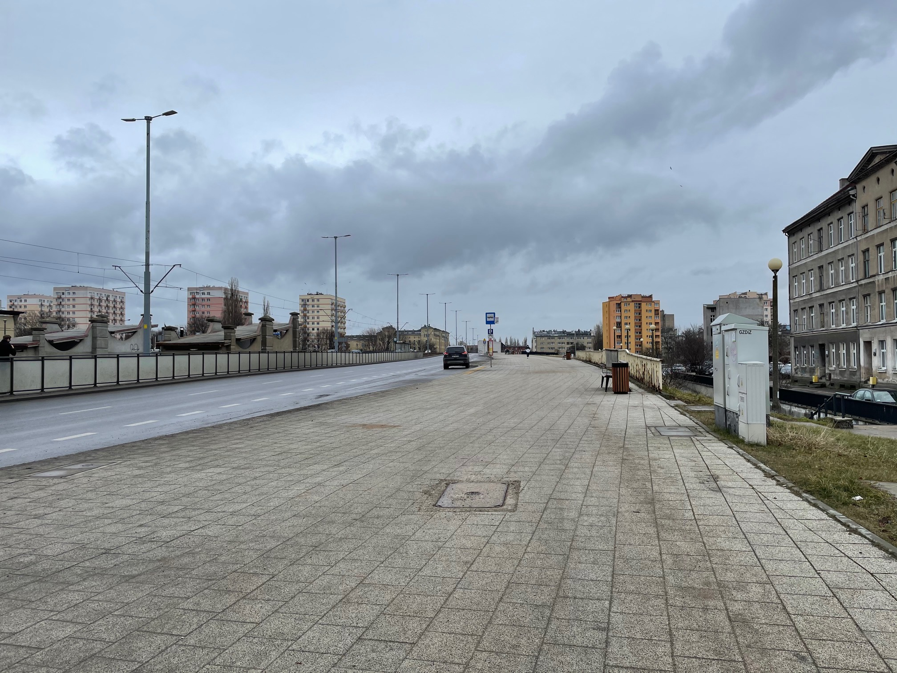
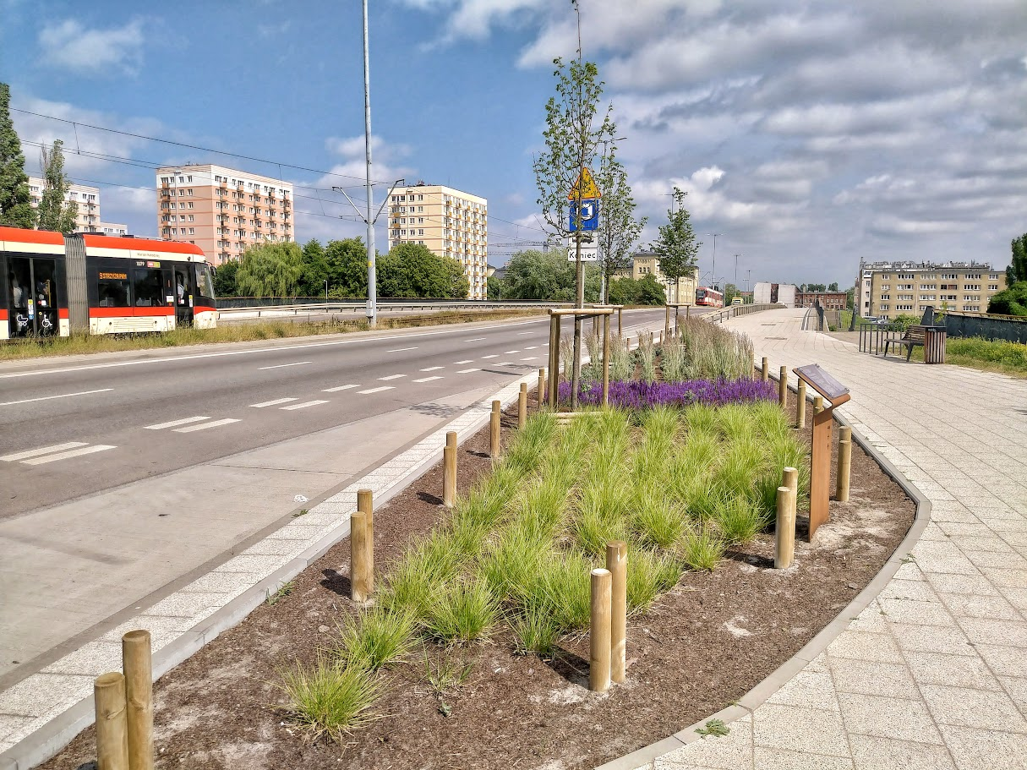
Gdański Zarząd Dróg i Zieleni
Objectives of the Green Citizen’s Budget
New green spaces
Zielona Aleja na Wyspie Spichrzów

Slide 9
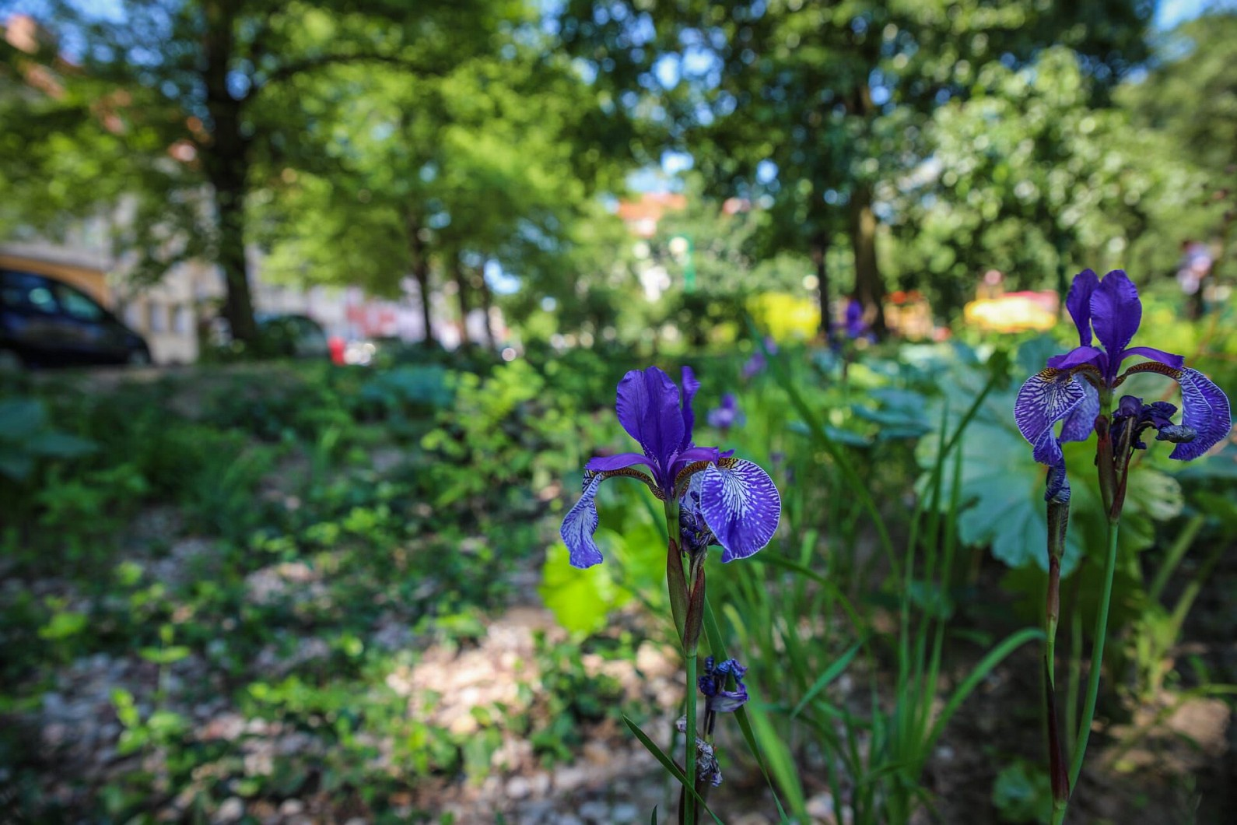
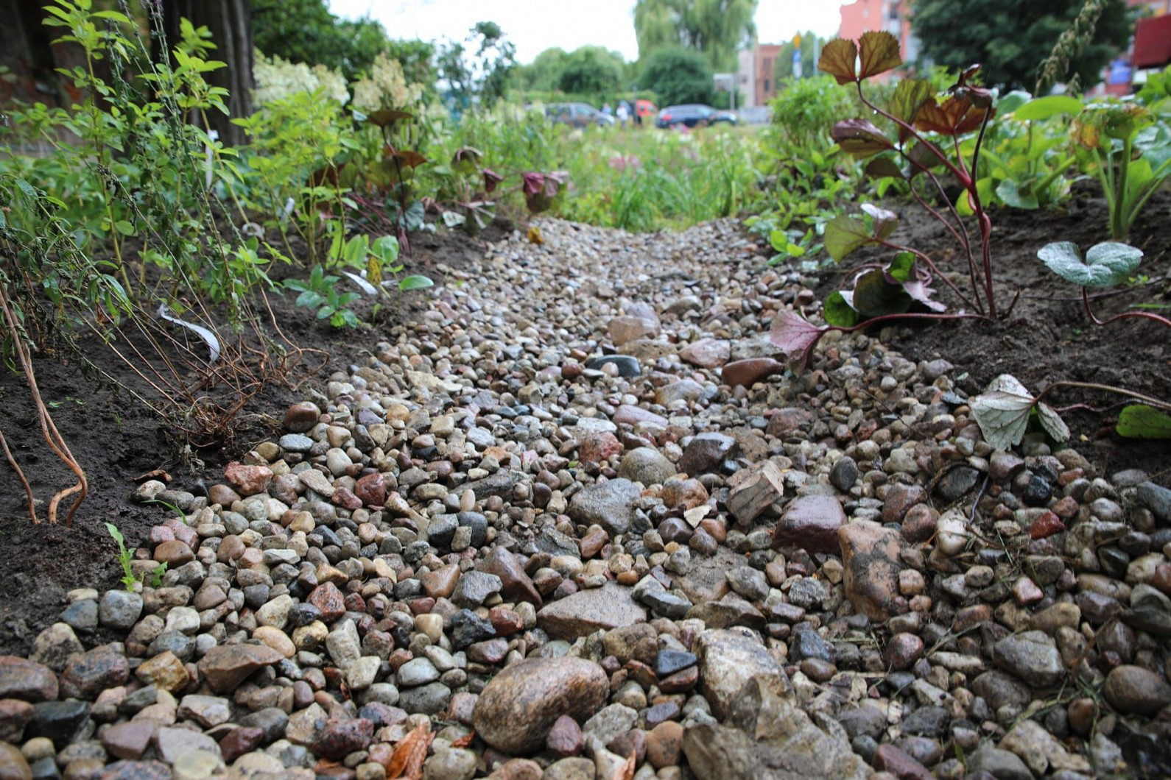
Gdański Zarząd Dróg i Zieleni
Objectives of the Green Citizen’s Budget
Rain gardens
micro-retention facilities – rain gardens, retention basins, retention greenery – utilising rainwater from nearby paved surfaces, established with a dominant share of vegetation in the ground or in containers, and their basic function is the infiltration of water into the ground
Plac Bpa O’Rourke
Area: 200 m²
Capacity: 56 m³
ul. Sołecka
Area: 450 m²
Capacity: 145 m³

Slide 10
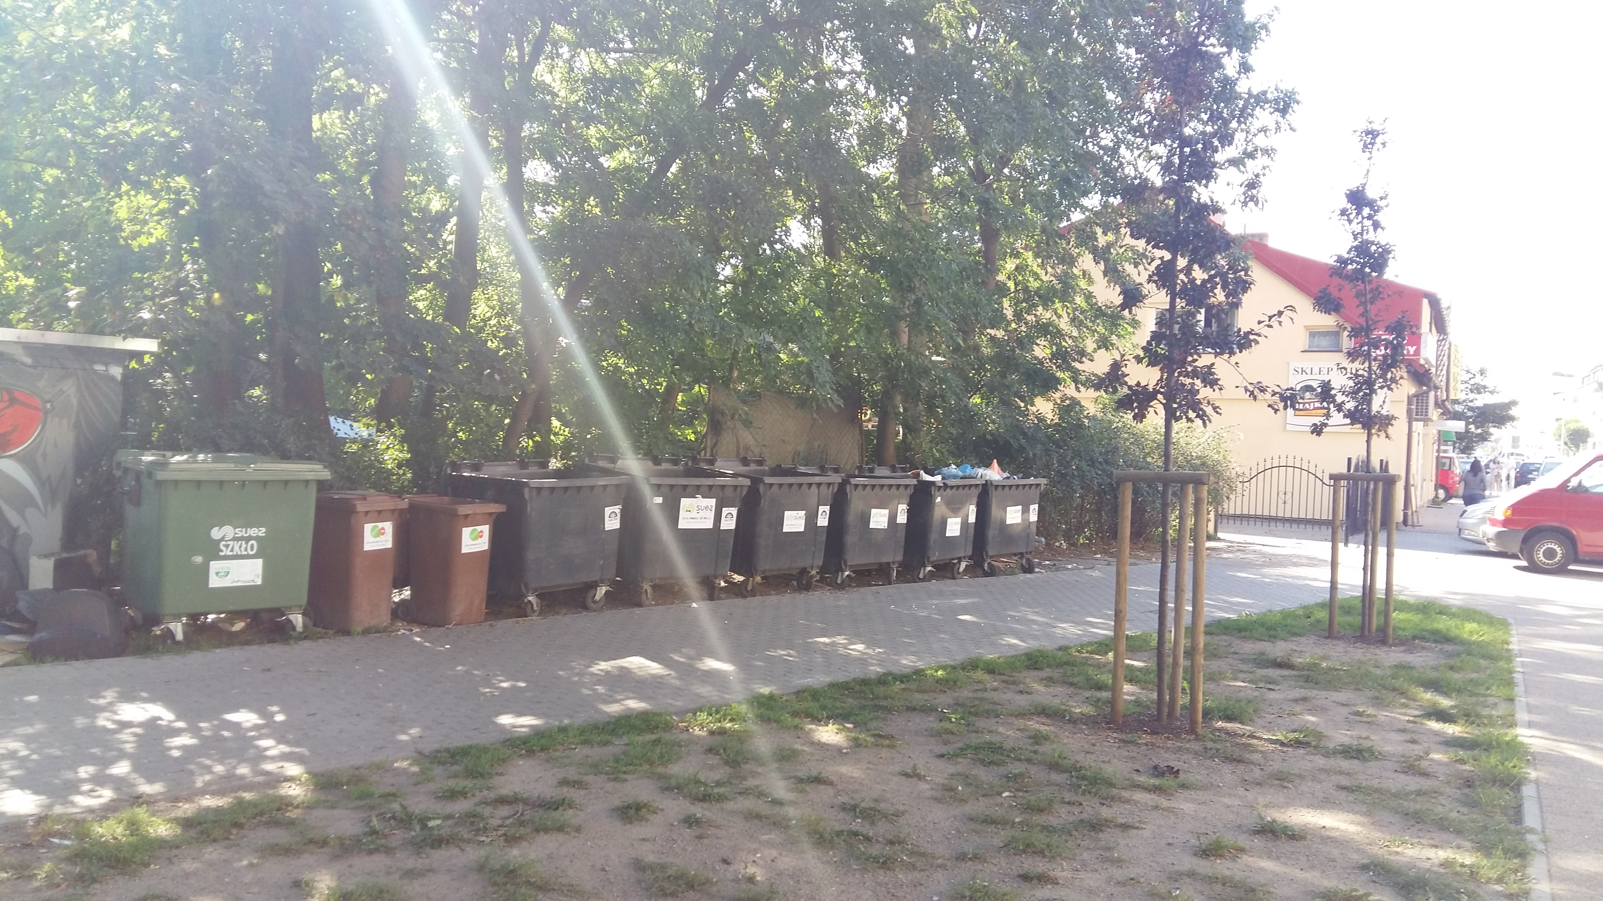
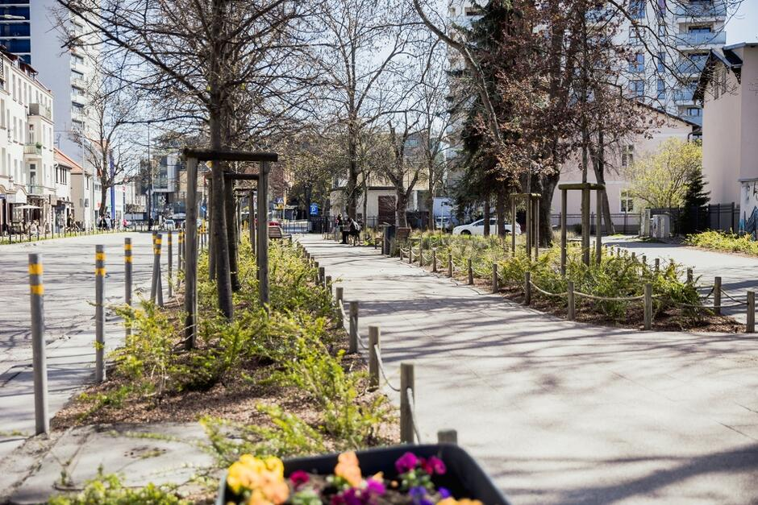
Gdański Zarząd Dróg i Zieleni
Objectives of the Green Citizen’s Budget
Renovation and modernization of the development of existing green areas
Skwer Bohaterskiego Mariupola

Slide 11
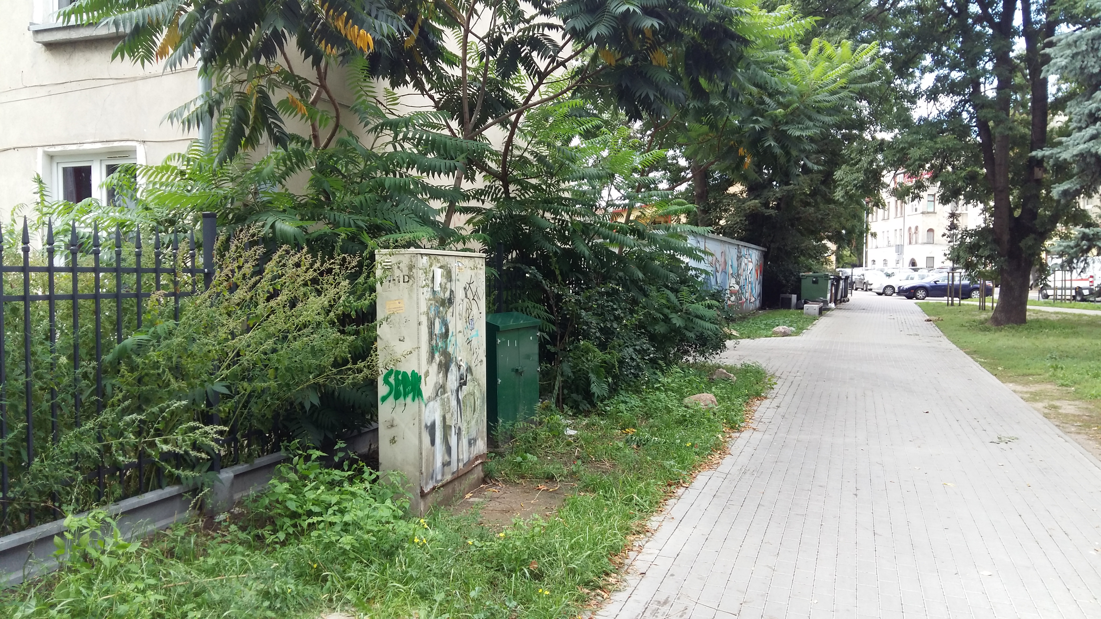
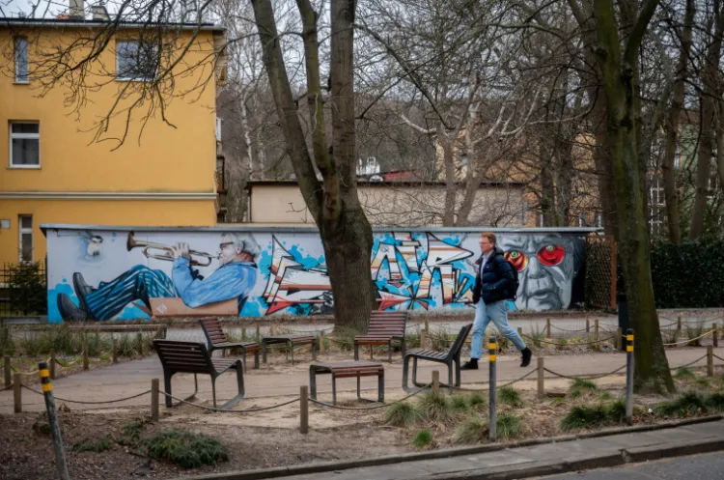
Gdański Zarząd Dróg i Zieleni
Objectives of the Green Citizen’s Budget
Renovation and modernization of the development of existing green areas
Skwer Bohaterskiego Mariupola

Slide 12
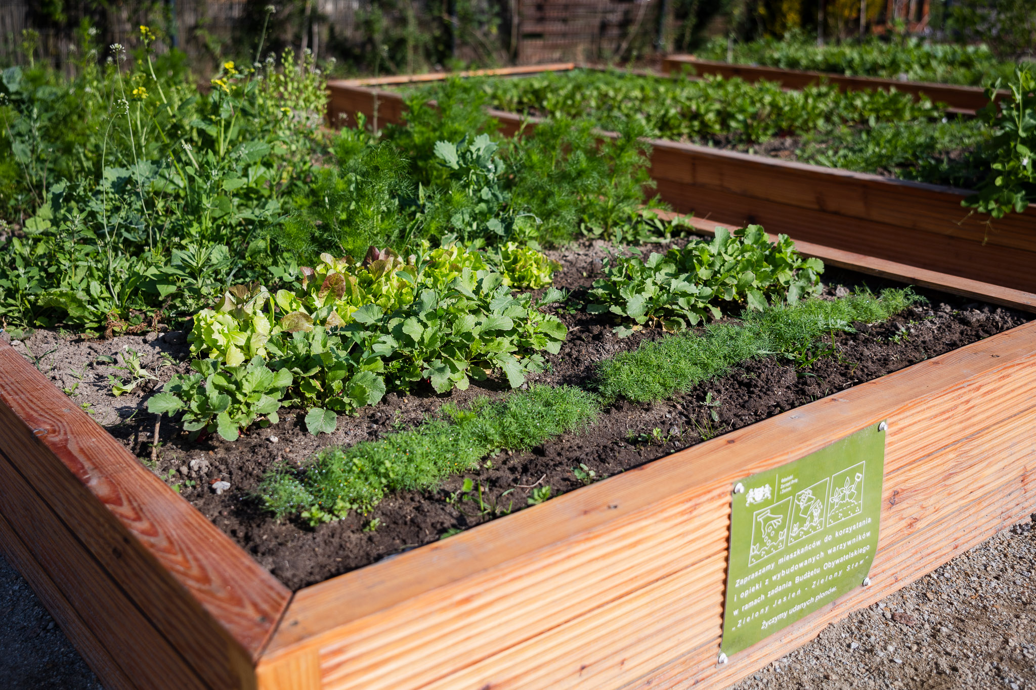
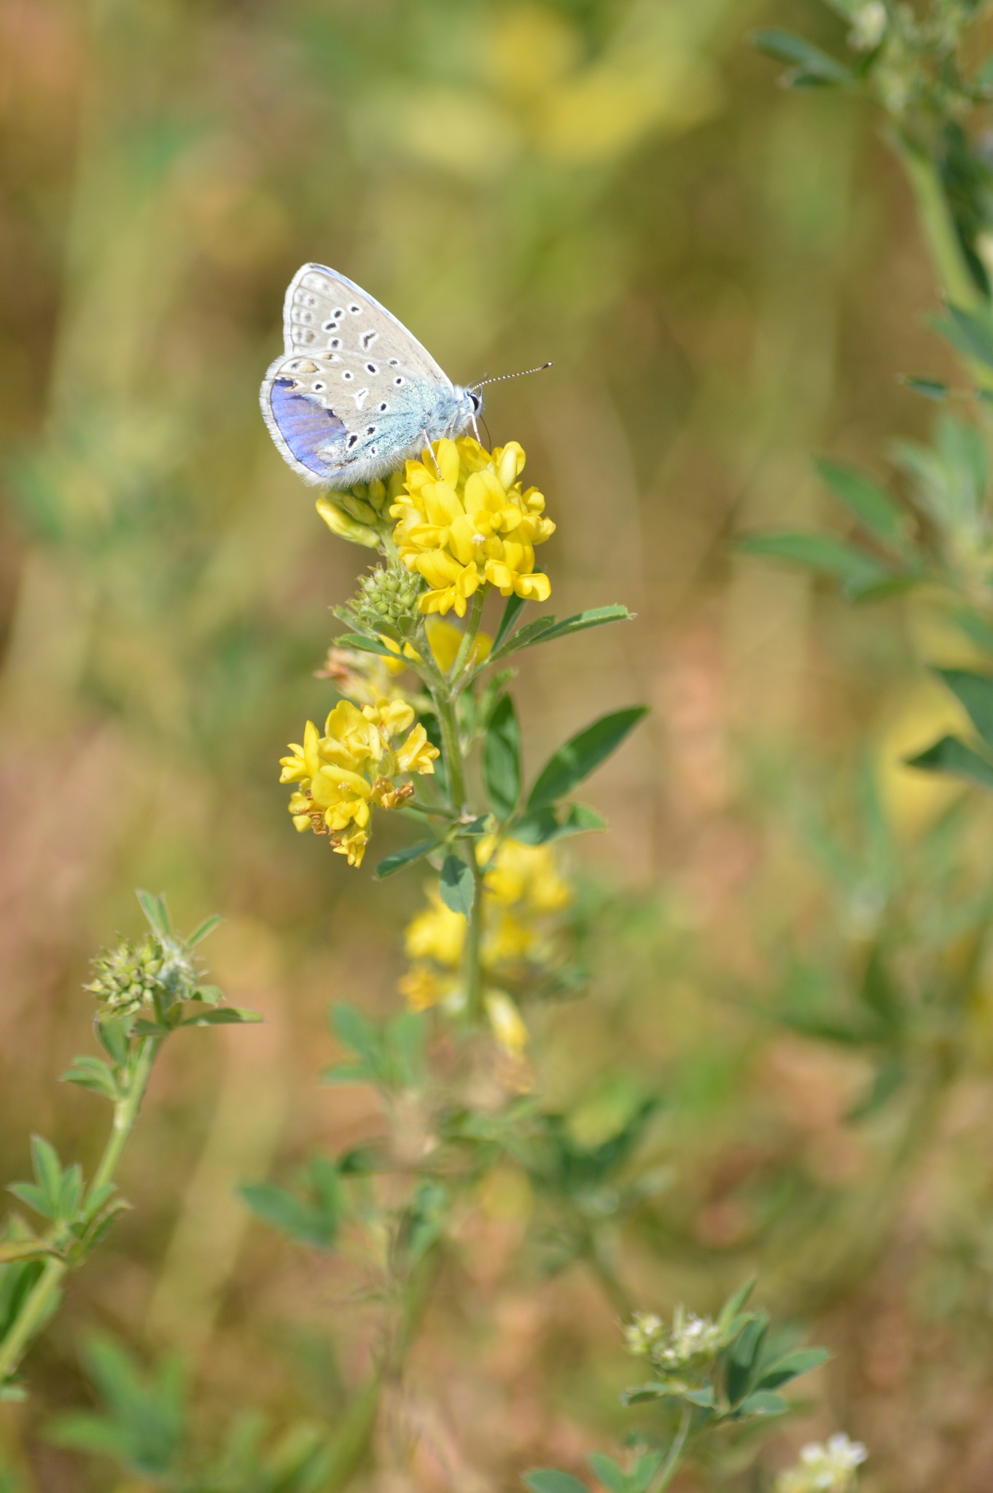
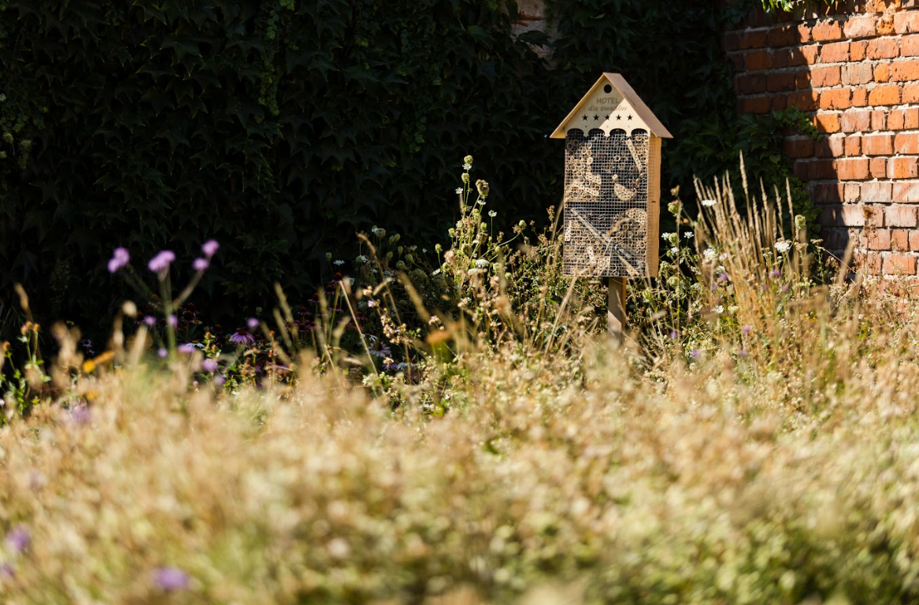
Gdański Zarząd Dróg i Zieleni
Objectives of the Green Citizen’s Budget
Ecological activities
Community gardens
Butterfly gardens

