Slide 1
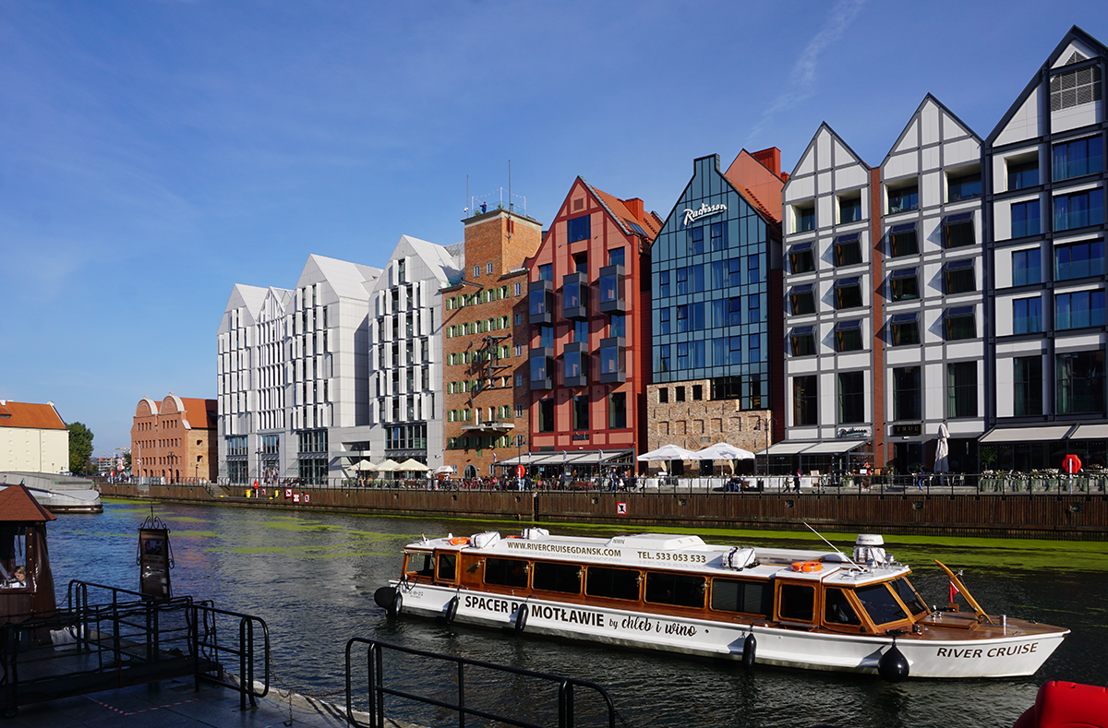

LIVING SPACES | PEER-LEARNING VISIT IN GDAŃSK | 23-25 October 2024
THE SECOND DAY | 10:25
Introduction to the Granary Island Project & Site Visit

Slide 2

LIVING SPACES | PEER-LEARNING VISIT IN GDAŃSK | 23-25 October 2024

Slide 3
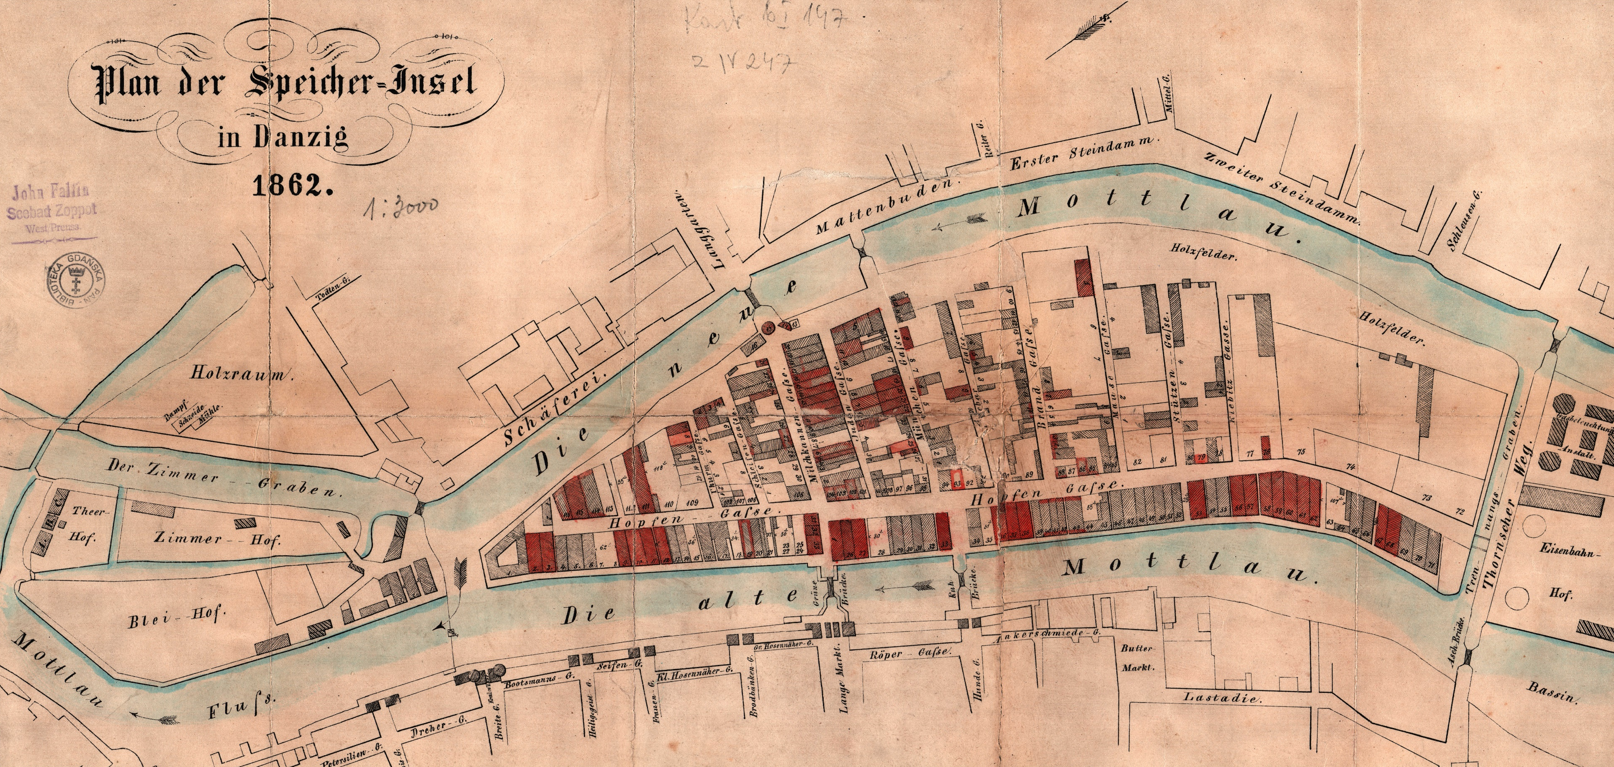
LIVING SPACES | PEER-LEARNING VISIT IN GDAŃSK | 23-25 October 2024

Slide 4
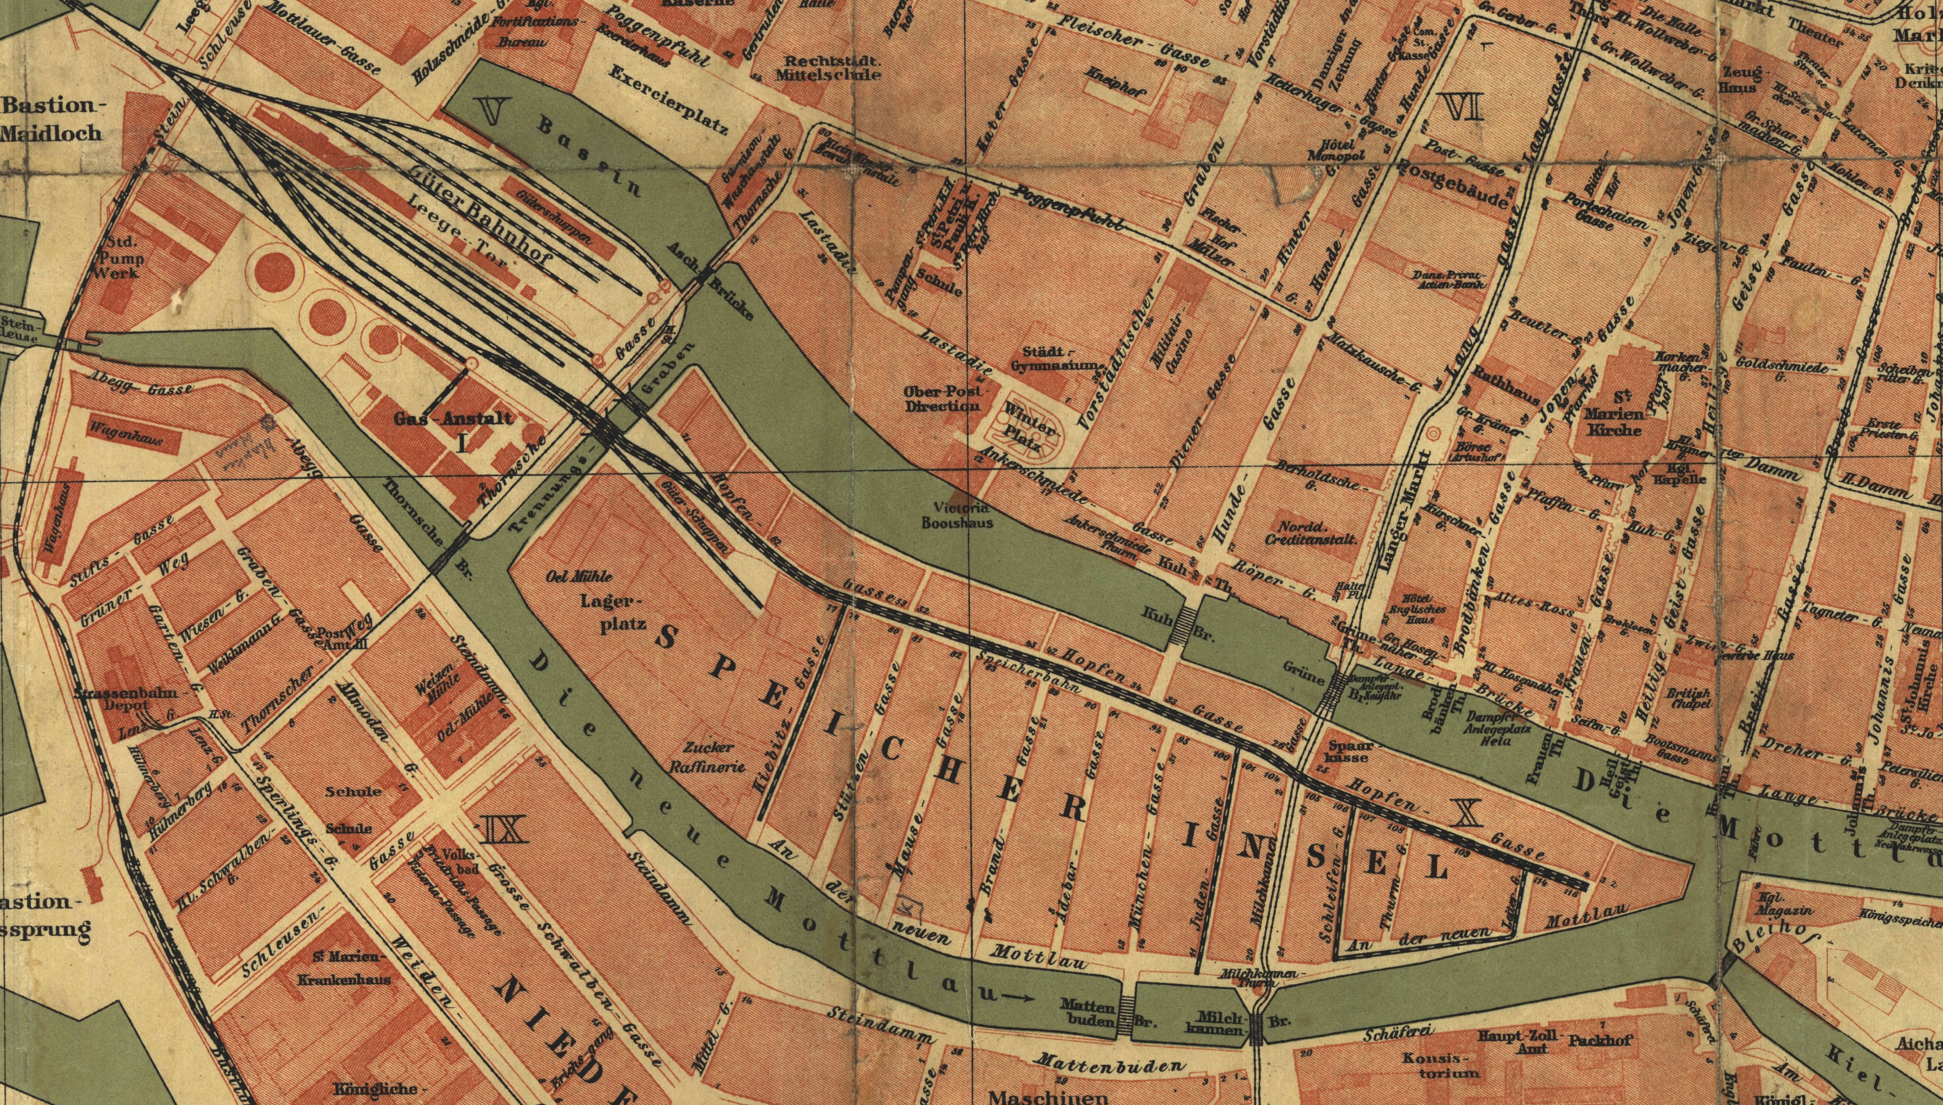
LIVING SPACES | PEER-LEARNING VISIT IN GDAŃSK | 23-25 October 2024

Slide 5
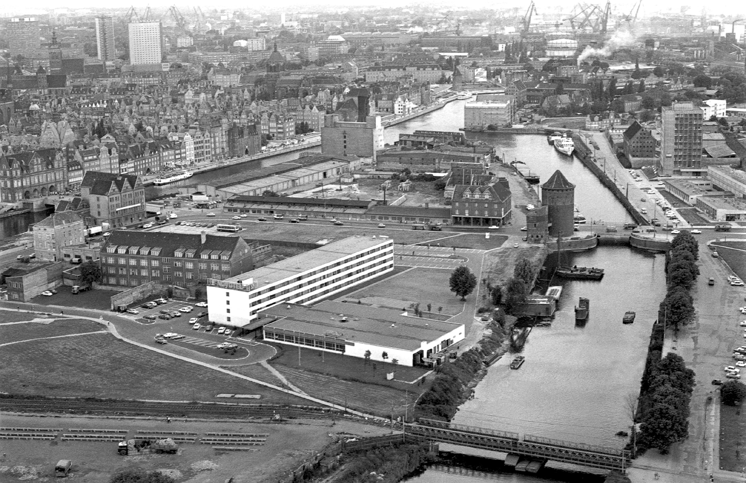
LIVING SPACES | PEER-LEARNING VISIT IN GDAŃSK | 23-25 October 2024

Slide 6
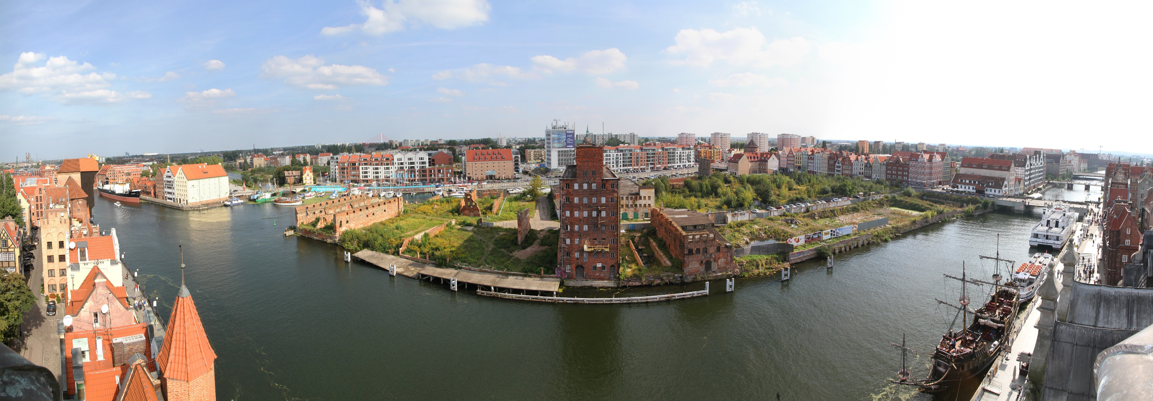
LIVING SPACES | PEER-LEARNING VISIT IN GDAŃSK | 23-25 October 2024

Slide 7
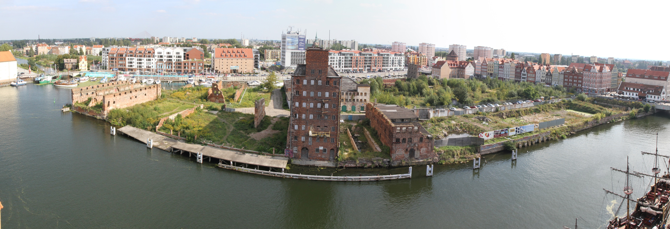
LIVING SPACES | PEER-LEARNING VISIT IN GDAŃSK | 23-25 October 2024

Slide 8
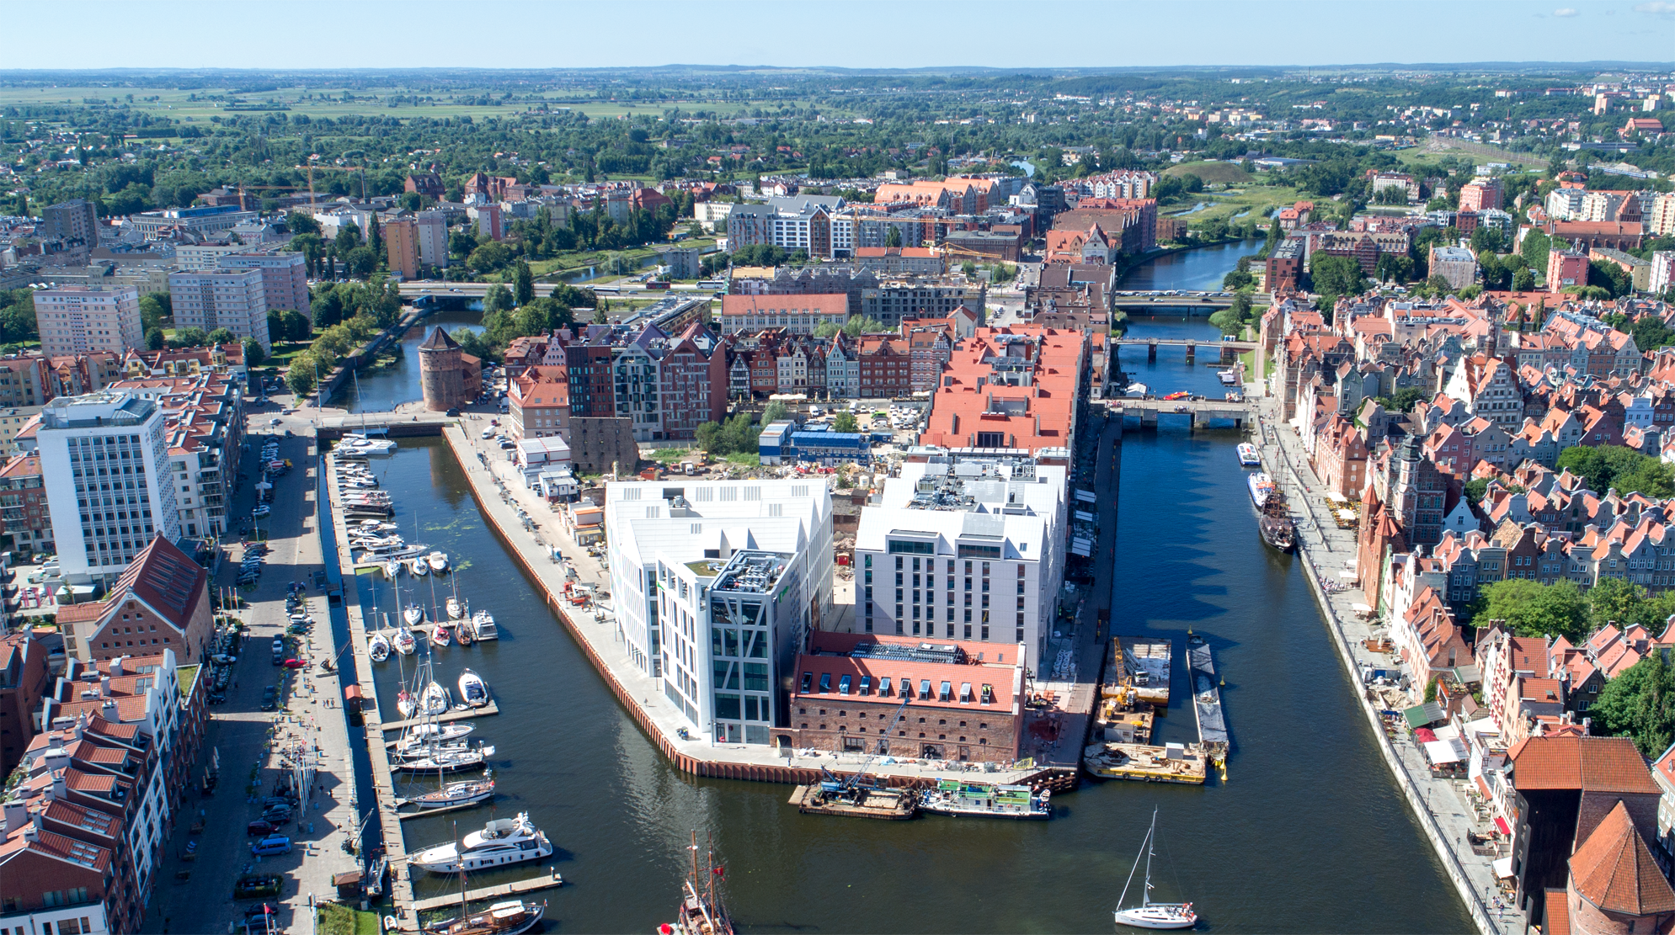
LIVING SPACES | PEER-LEARNING VISIT IN GDAŃSK | 23-25 October 2024

Slide 9
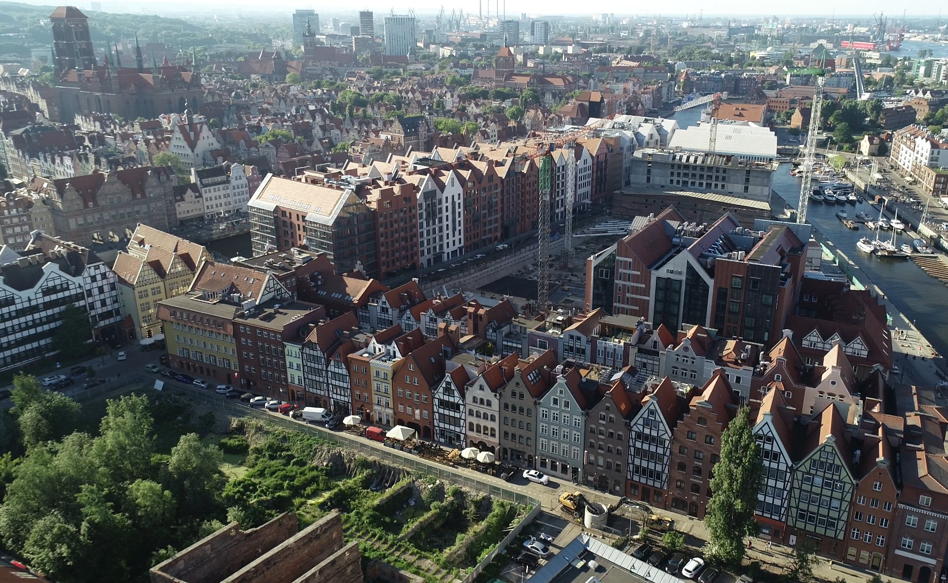
LIVING SPACES | PEER-LEARNING VISIT IN GDAŃSK | 23-25 October 2024

Slide 10
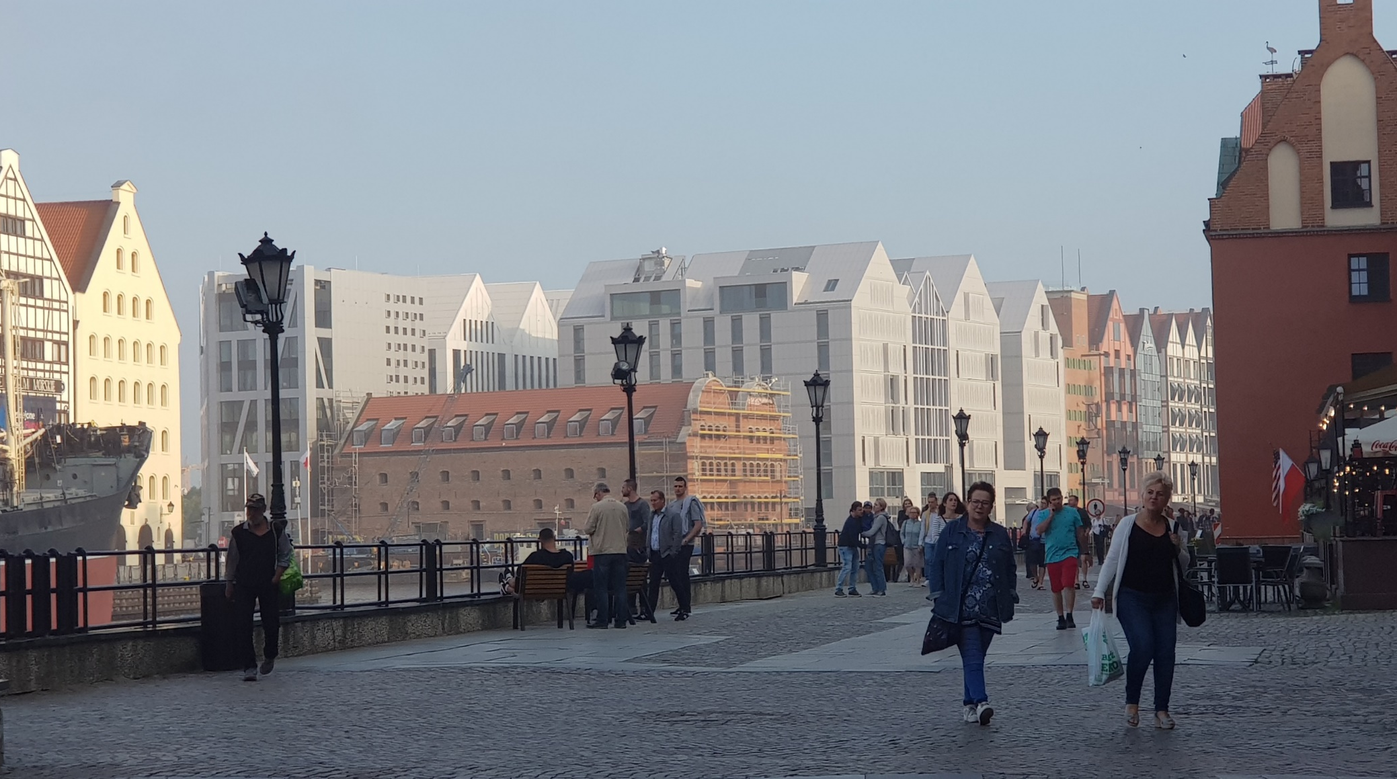
LIVING SPACES | PEER-LEARNING VISIT IN GDAŃSK | 23-25 October 2024

Slide 11
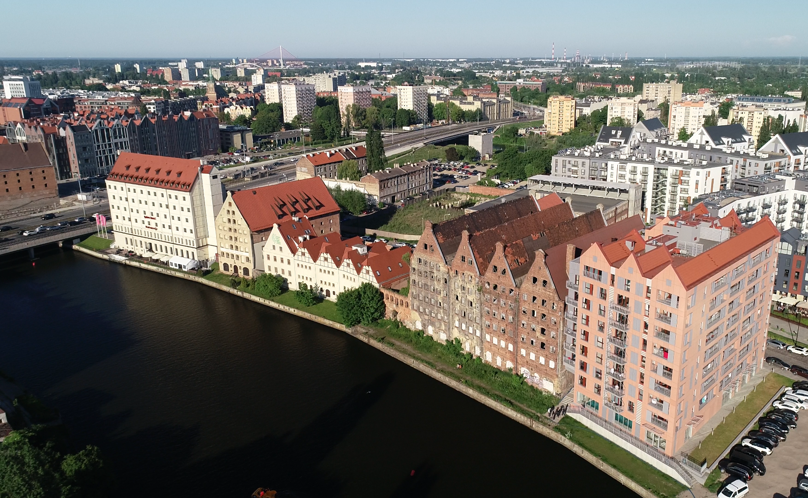
LIVING SPACES | PEER-LEARNING VISIT IN GDAŃSK | 23-25 October 2024

Slide 12
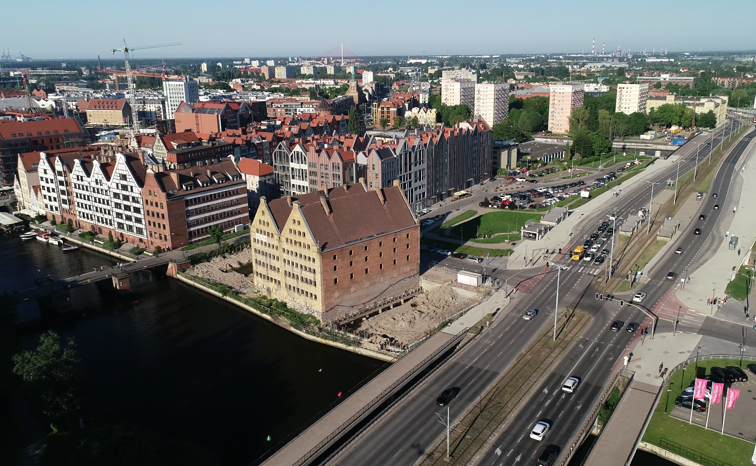
LIVING SPACES | PEER-LEARNING VISIT IN GDAŃSK | 23-25 October 2024

