Slide 1
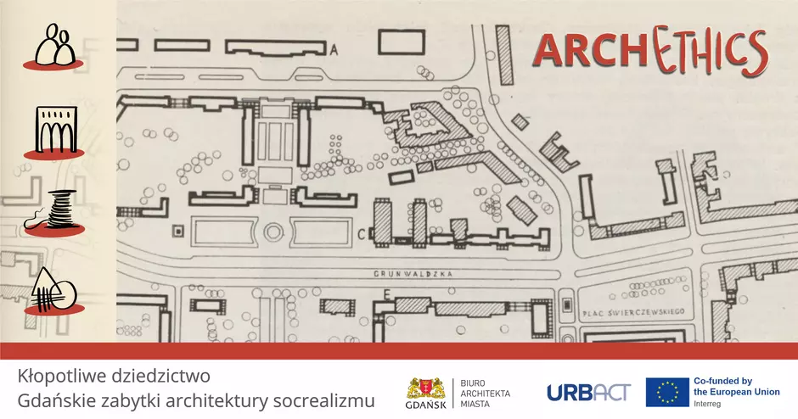


Slide 2
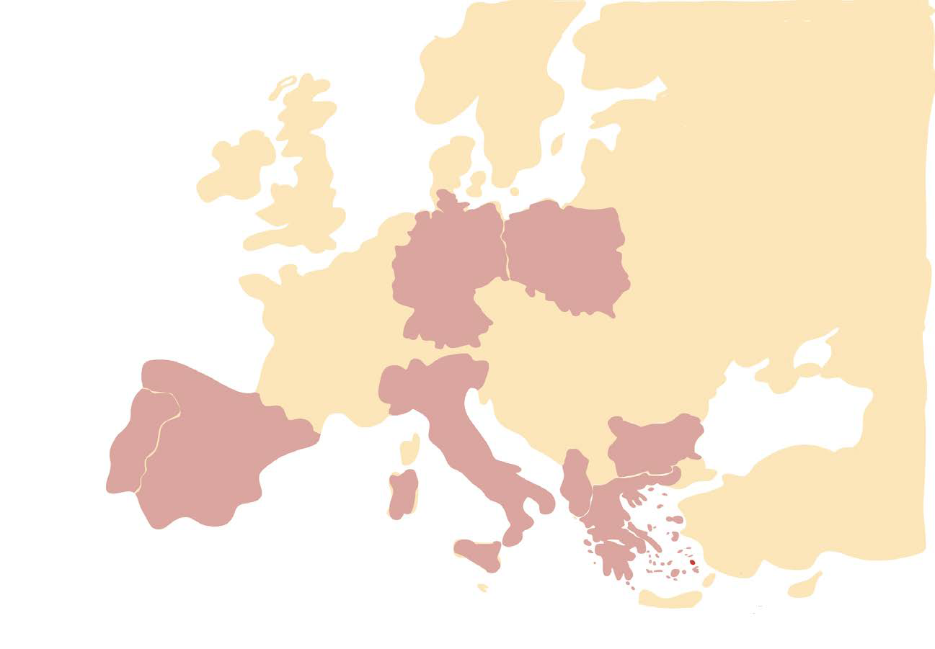
URBACT is a European Territorial Cooperation program fostering sustainable integrated urban development in cities across Europe
ARCHETHICS brings together nine cities:
Cesena in Italy; Permet in Albania; Kazanlak in Bulgaria; Krakow in Poland; Gdansk in Poland; Leipzig in Germany; Betera in Spain; Vila Nova de Cerveira in Portugal.

Slide 3
ARCHETHICS puts Dissonant Heritage
and its complex histories at the
centre of the urban local development
agenda to make cities more attractive
and inclusive.
Architecture, People, History and
Ethics are the four project dimensions
to explore the potential of dissonant
heritage.

Slide 4
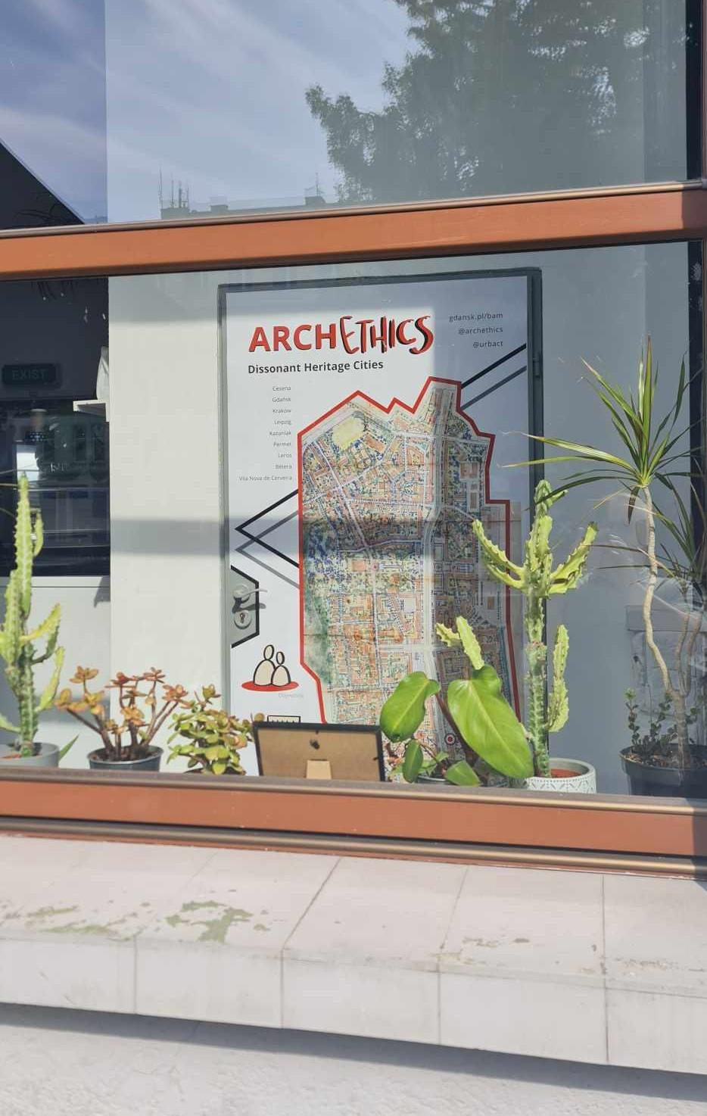
In the context of ARCHETHICS,
dissonant heritage has been referred
to the architectural and cultural
heritage that evokes unpleasant
memories due to war or political
propaganda of totalitarian regimes
or controversial borders that society
suffered

Slide 5



Aim of the project
Integrated Action Plan

Slide 6
Grunwald Residential District

Slide 7
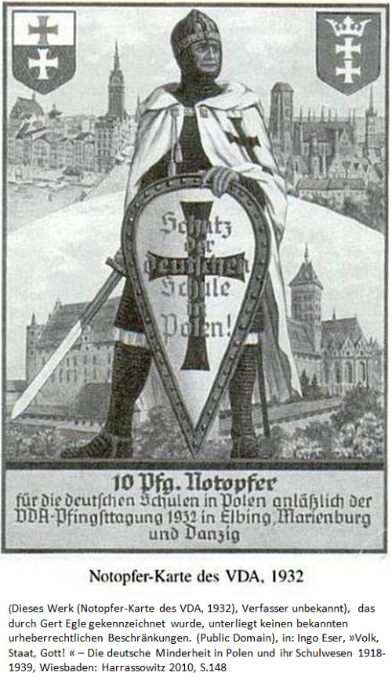
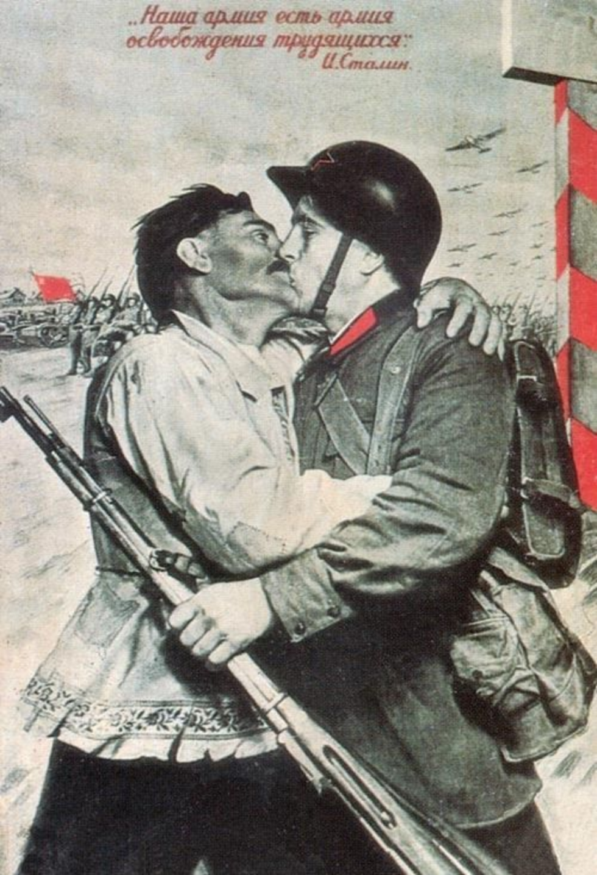
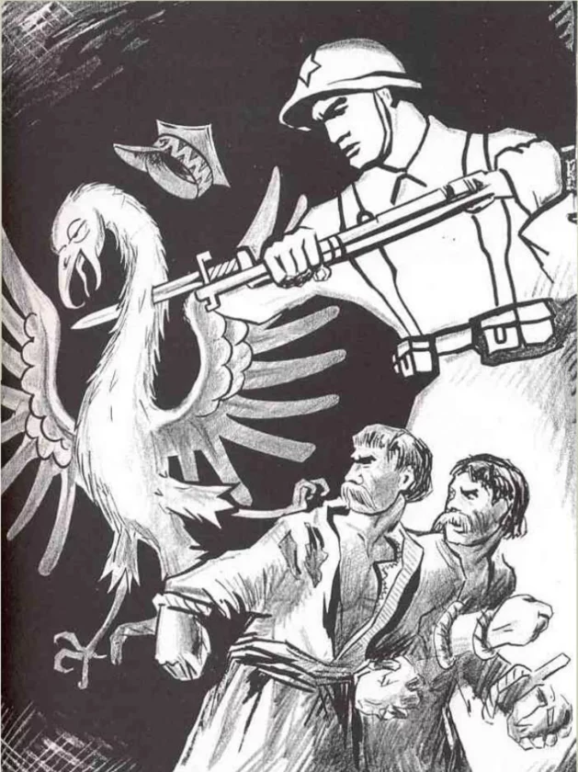
Political and historical background

Slide 8
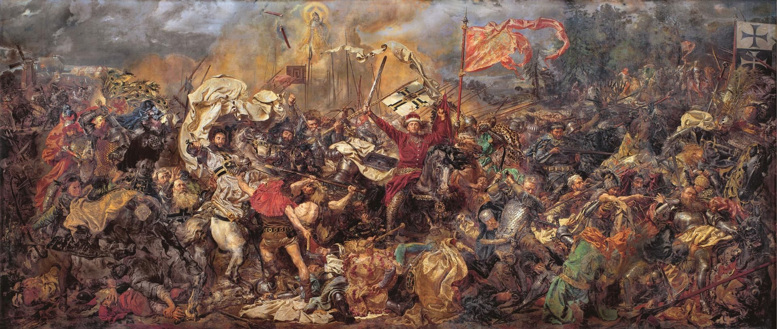
'The Battle of Grunwald' by Jan Matejko, 1878, oil on canvas,

Slide 9
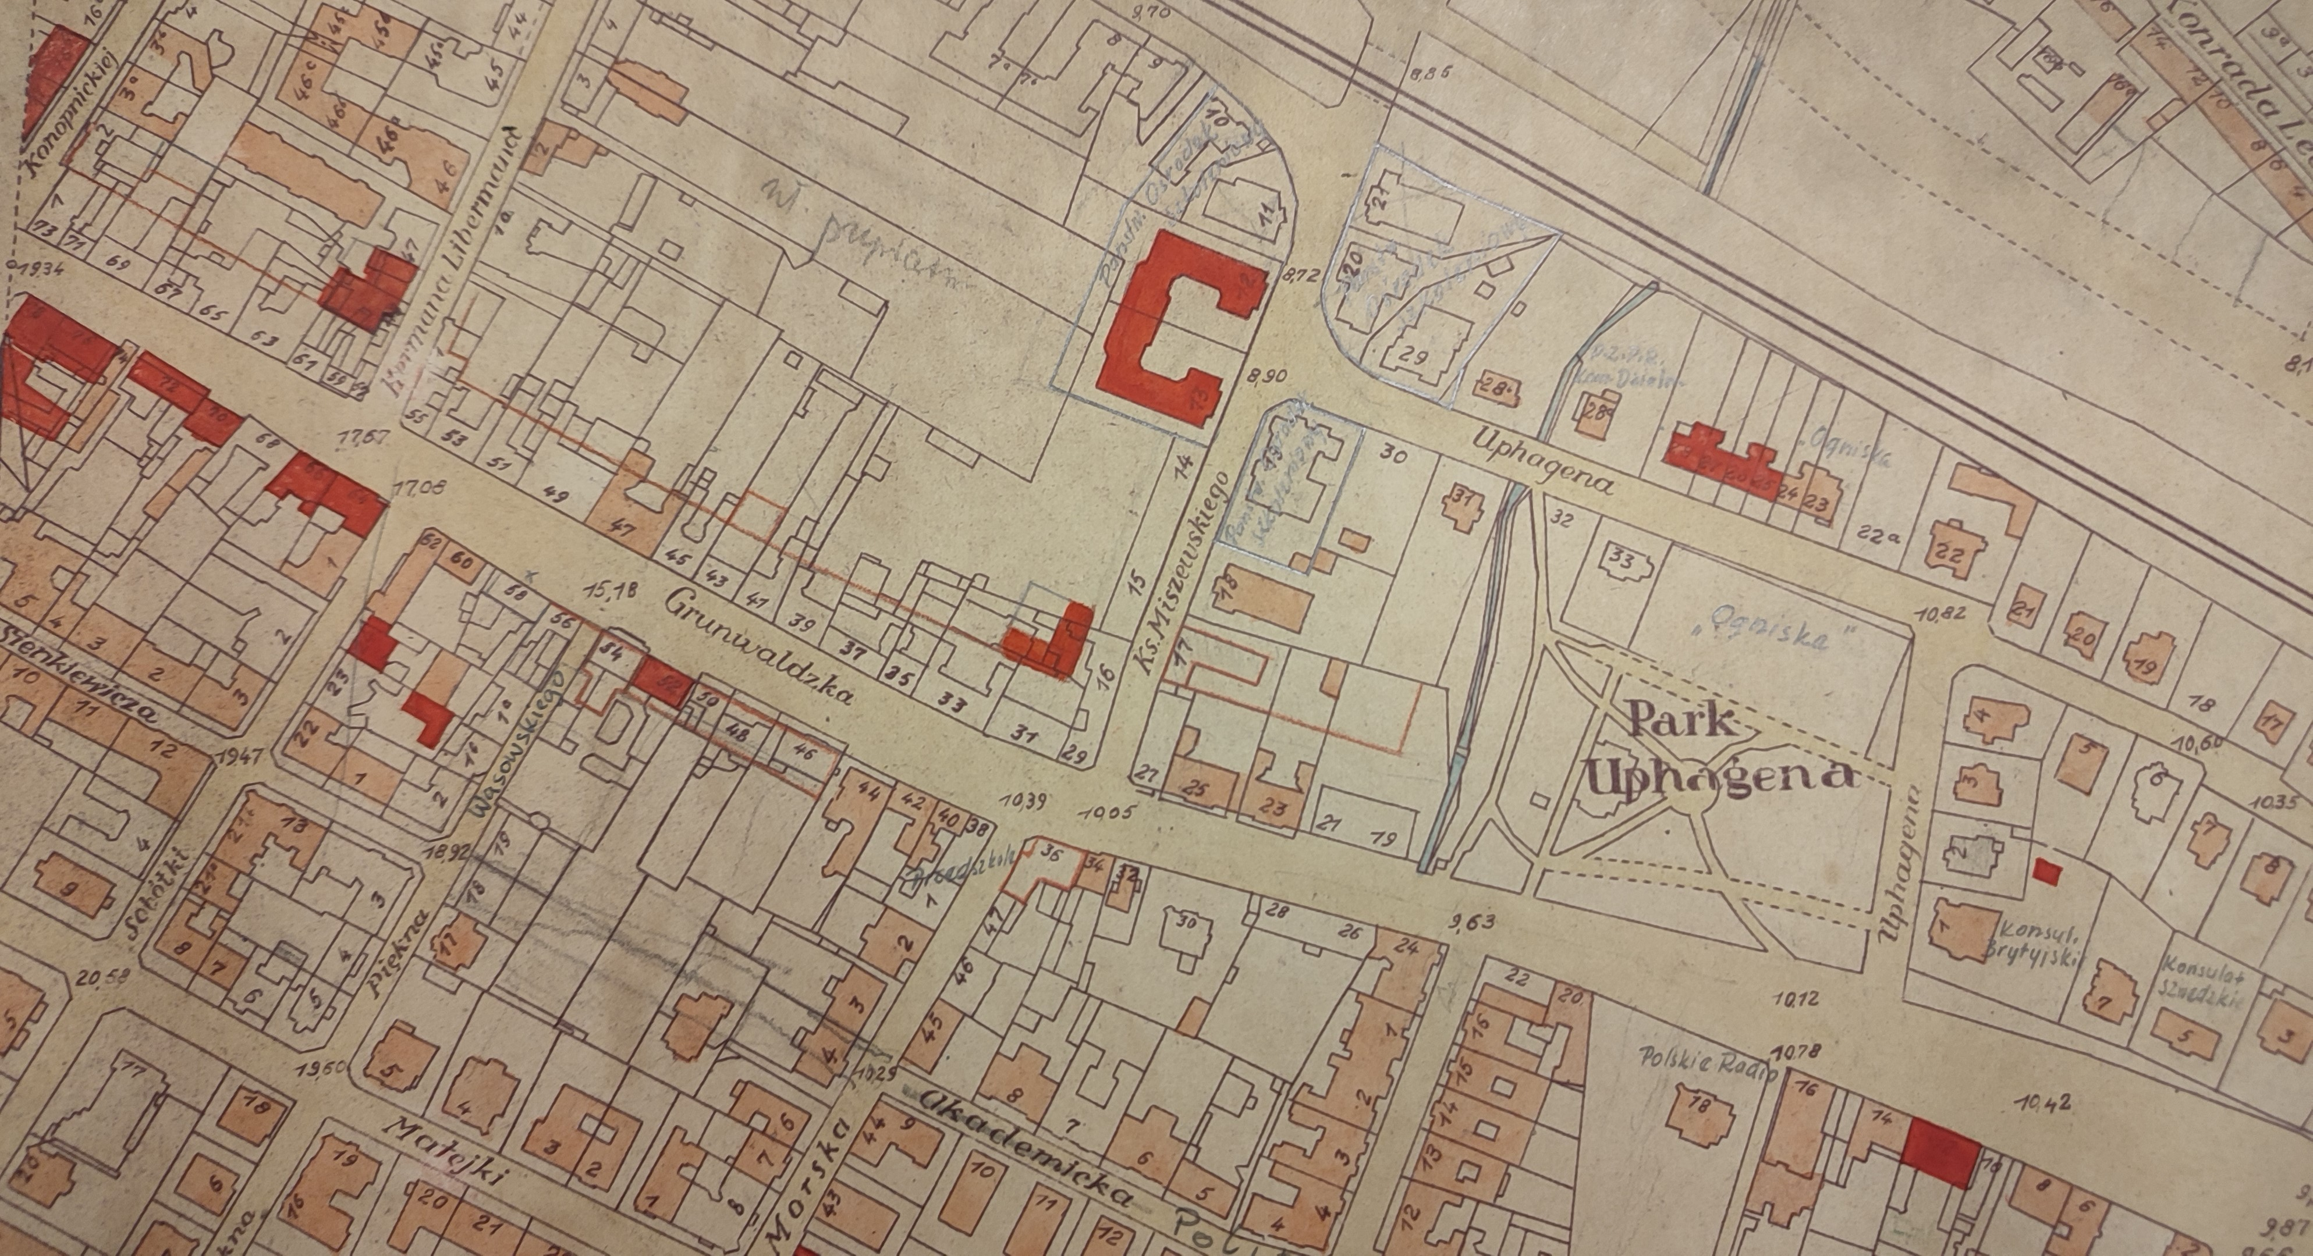
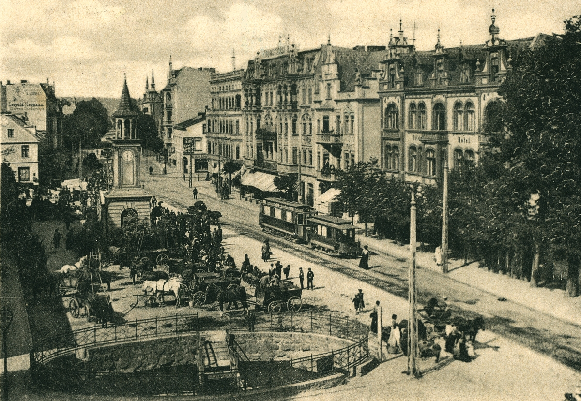
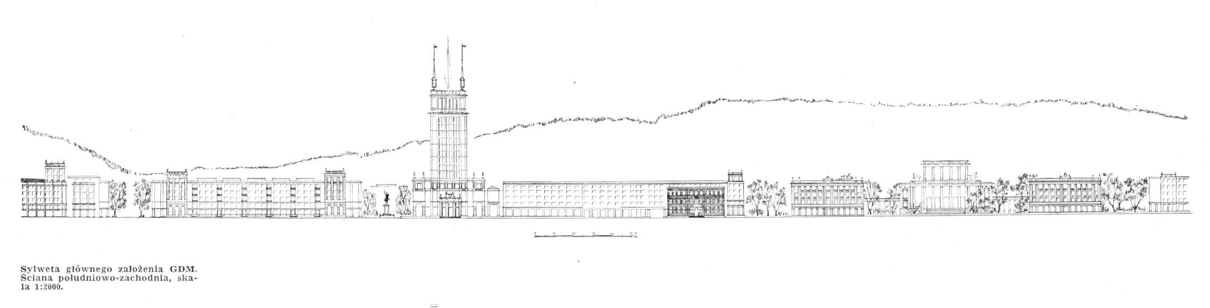

Slide 10
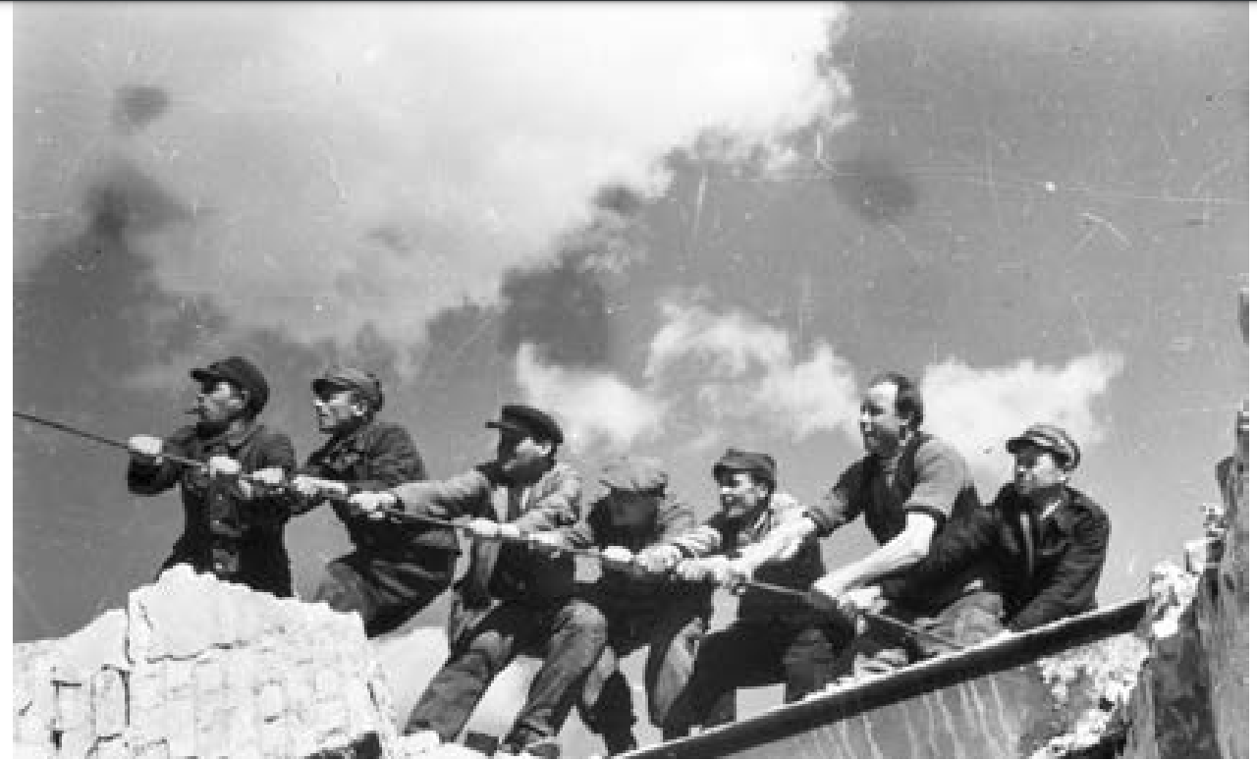
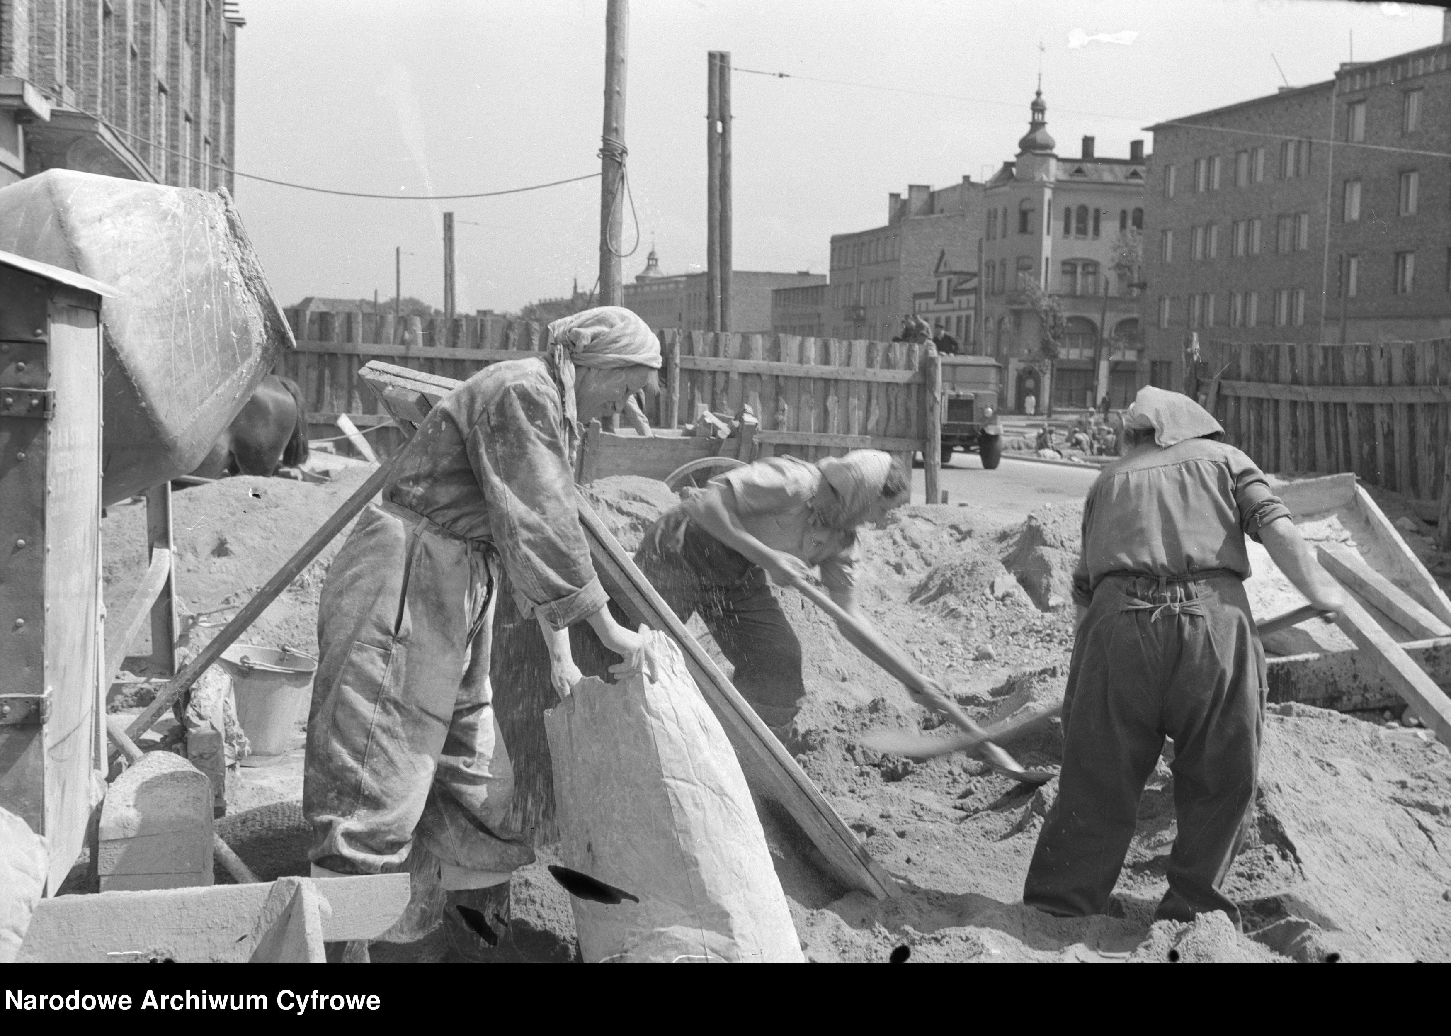
in 1947 the demolition of capitalist tenement houses began

Slide 11
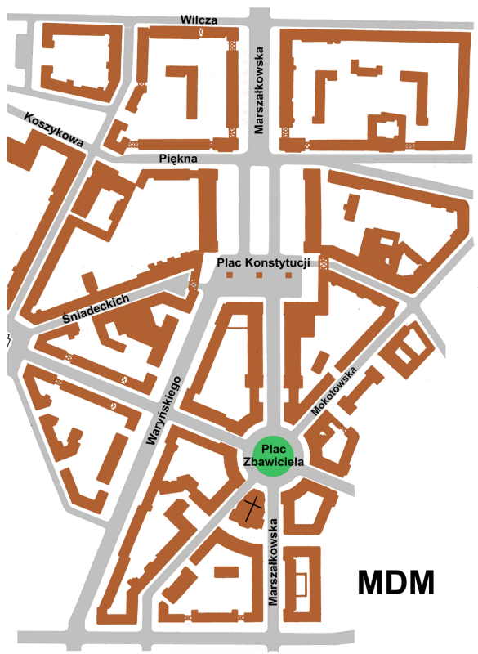
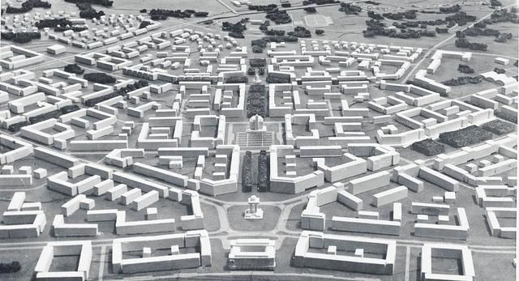
Nowa Huta - Cracow
- Warsaw

Slide 12
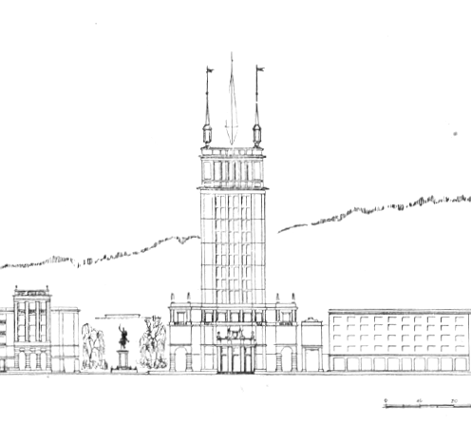
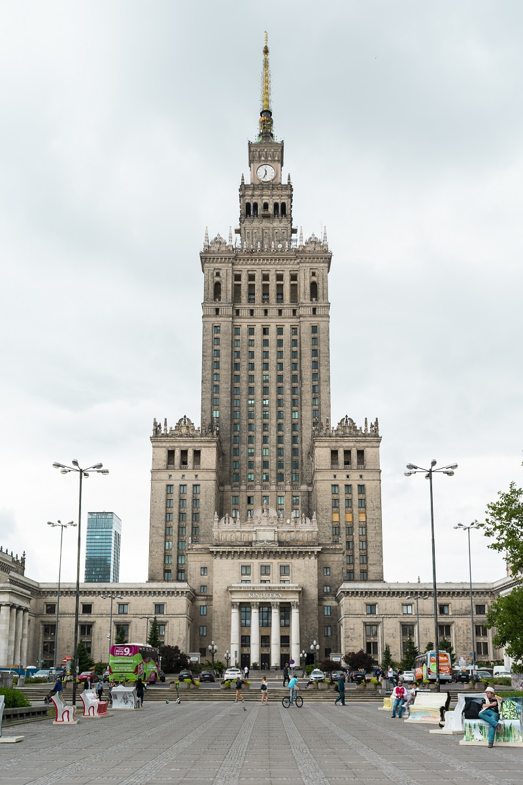
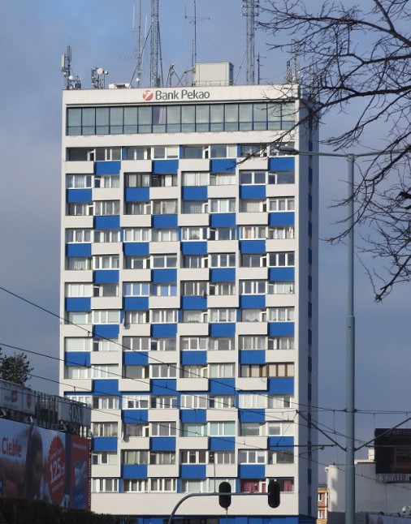

Slide 13
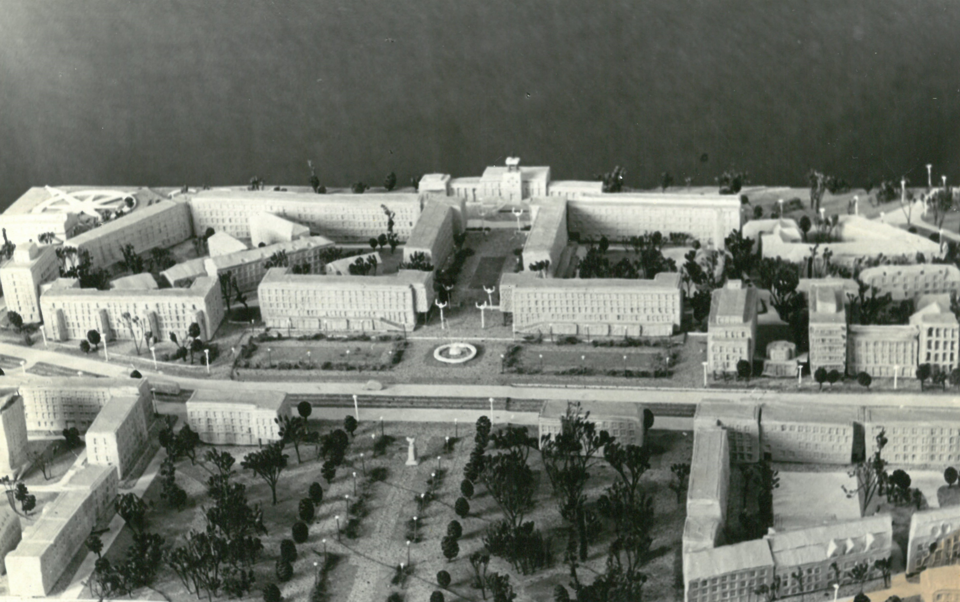
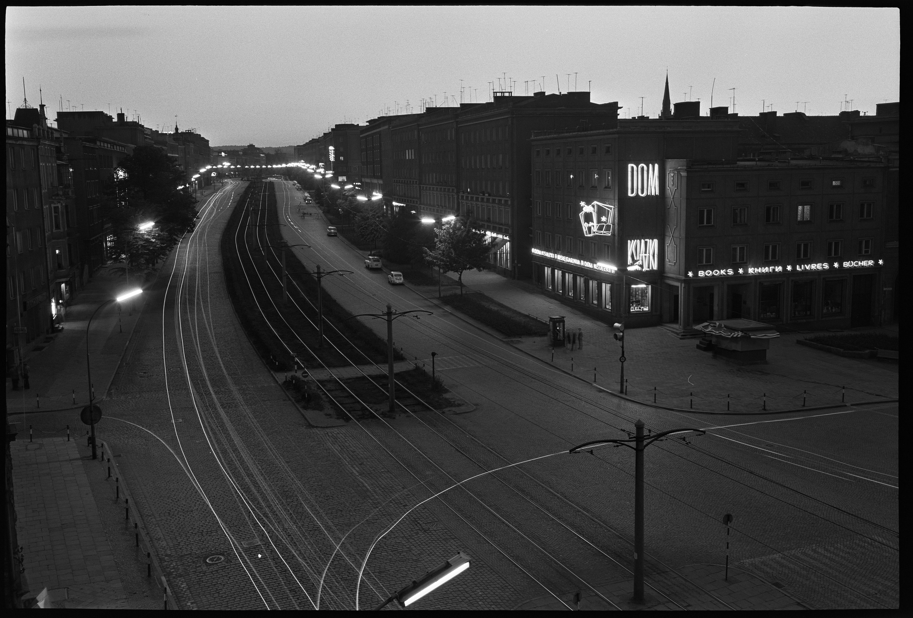

Slide 14
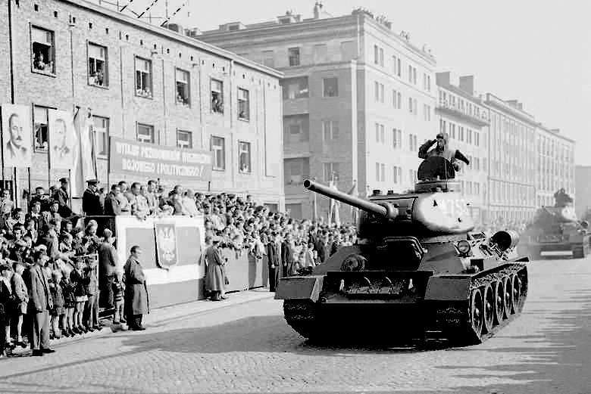
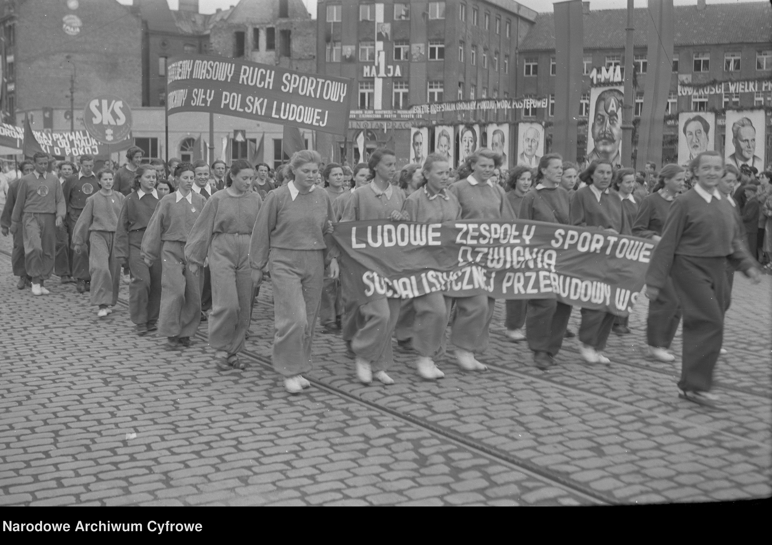
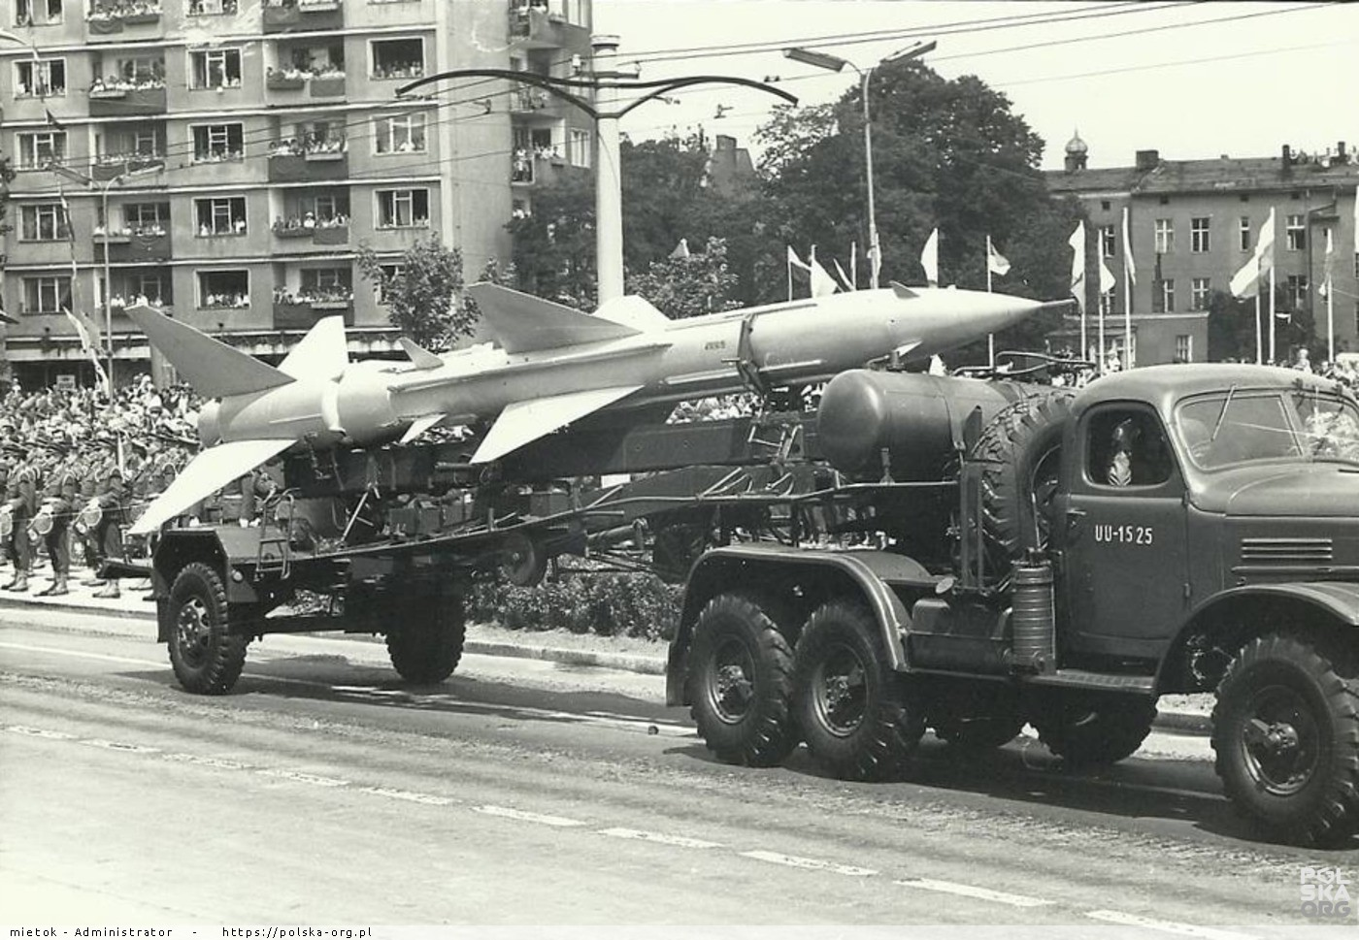

Slide 15
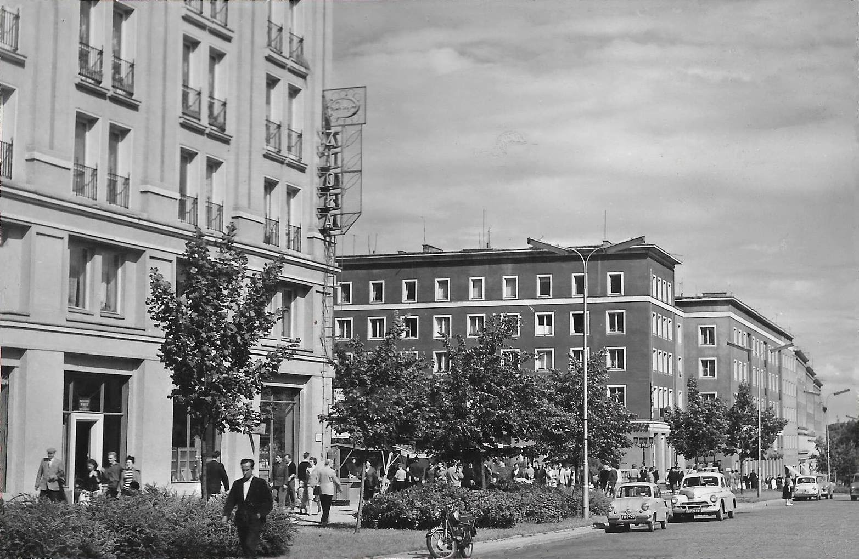

Slide 16
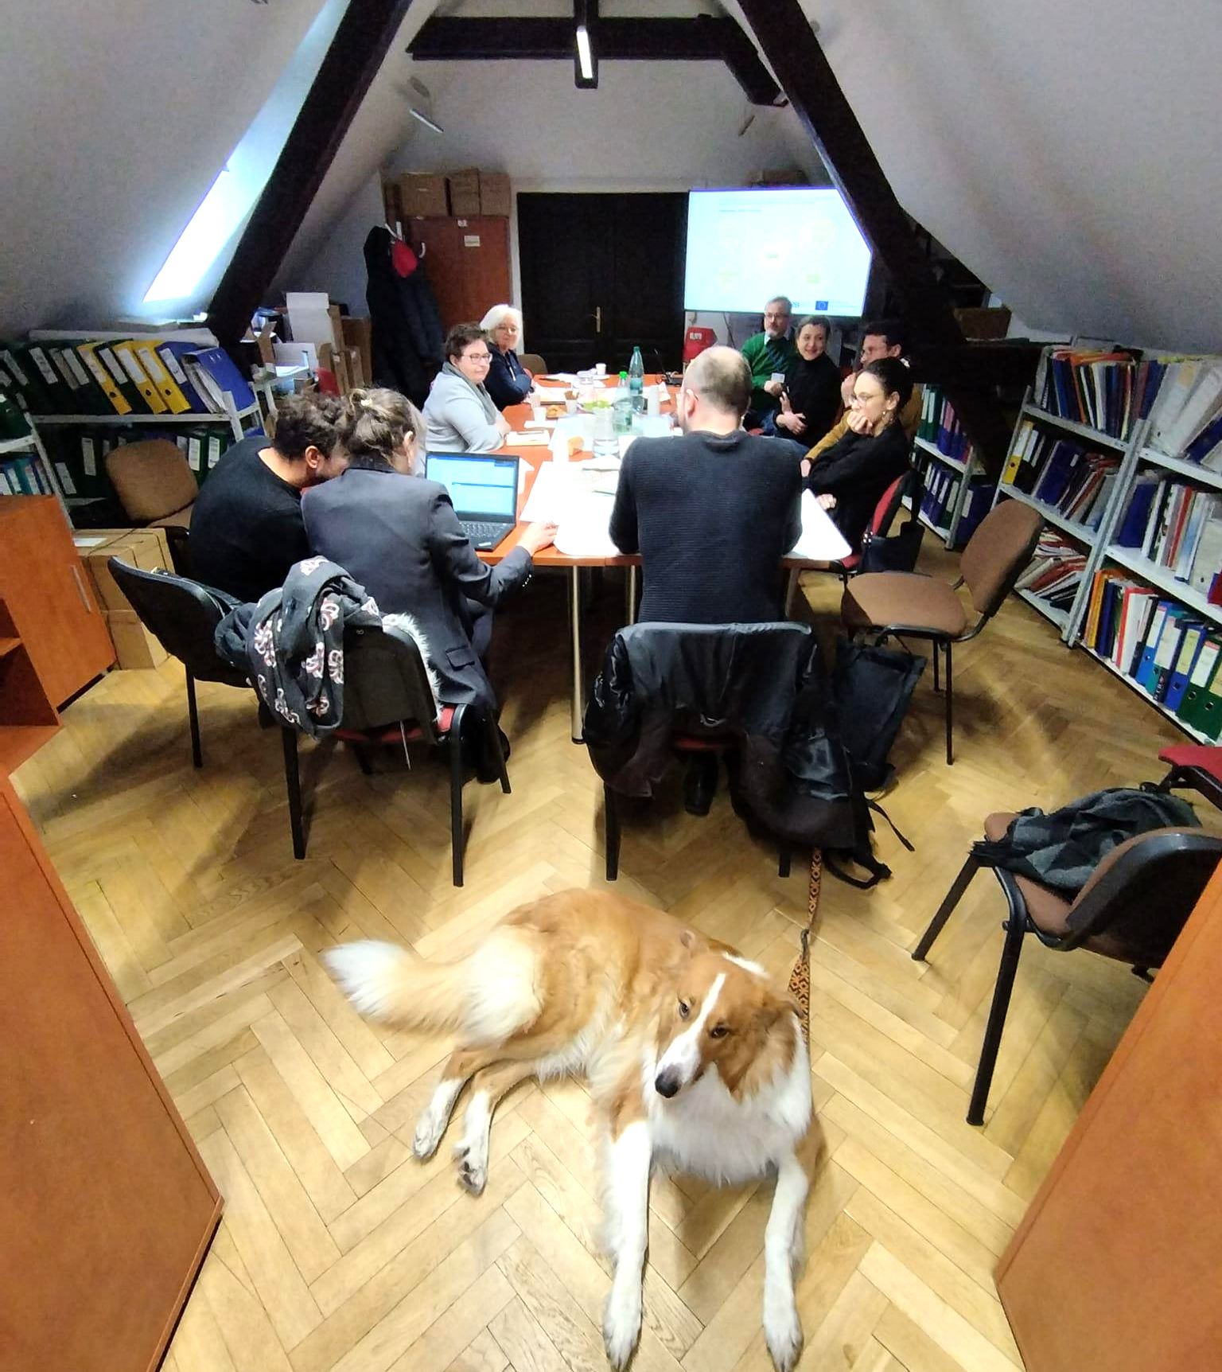
Process
Forming a Urban Local Group
Open workshops
Supporting activities
IAP Draft

Slide 17
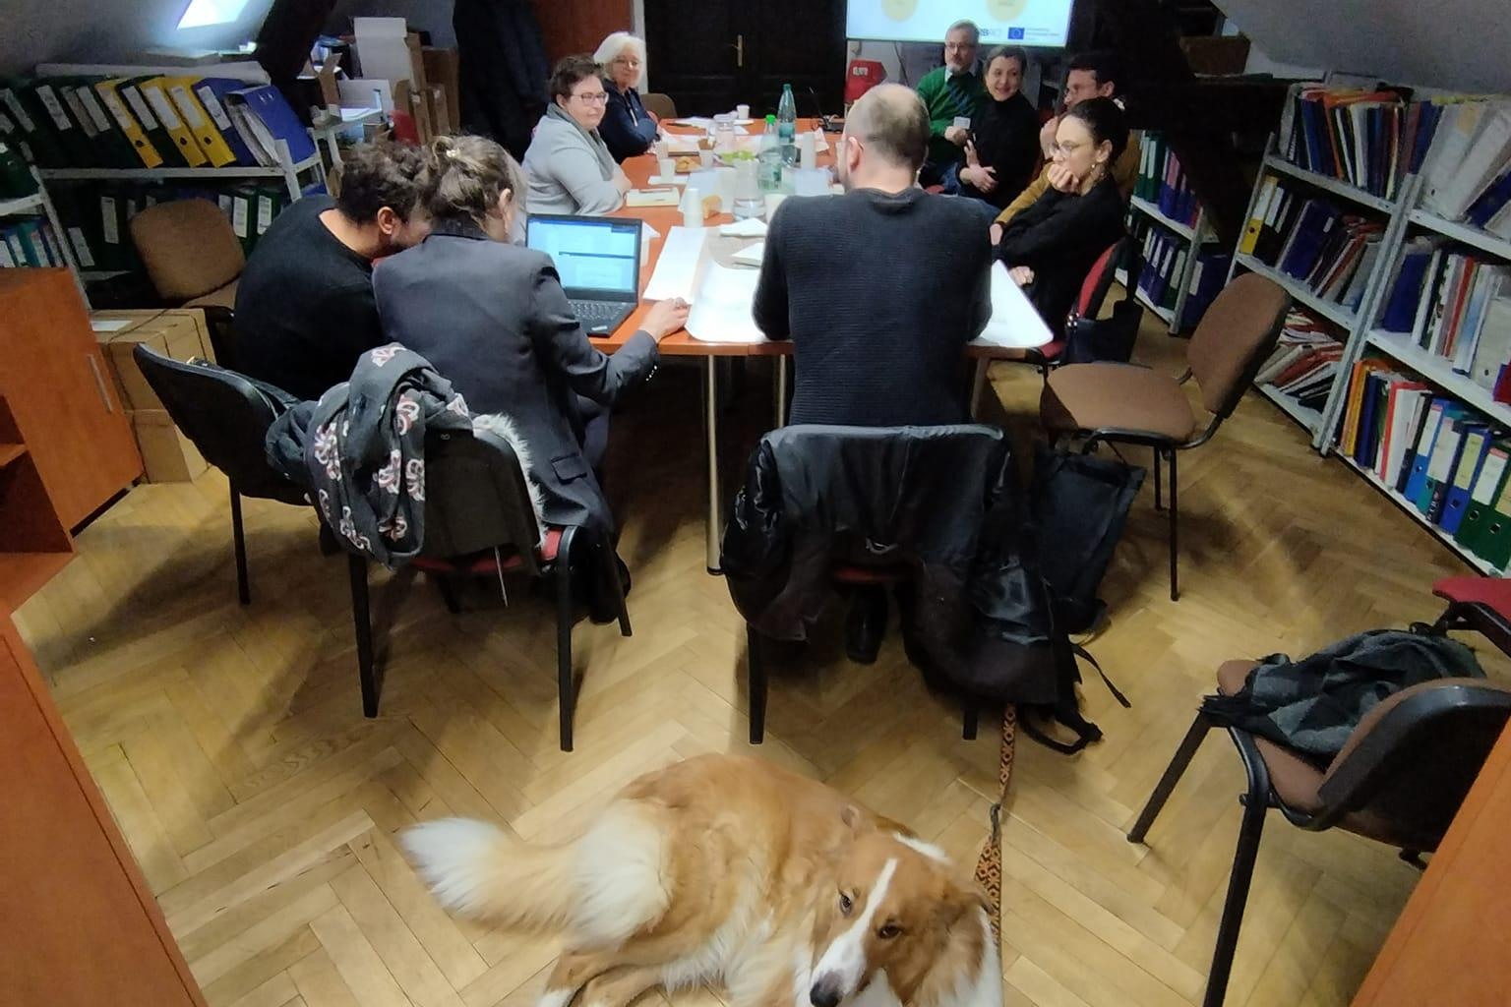

Slide 18
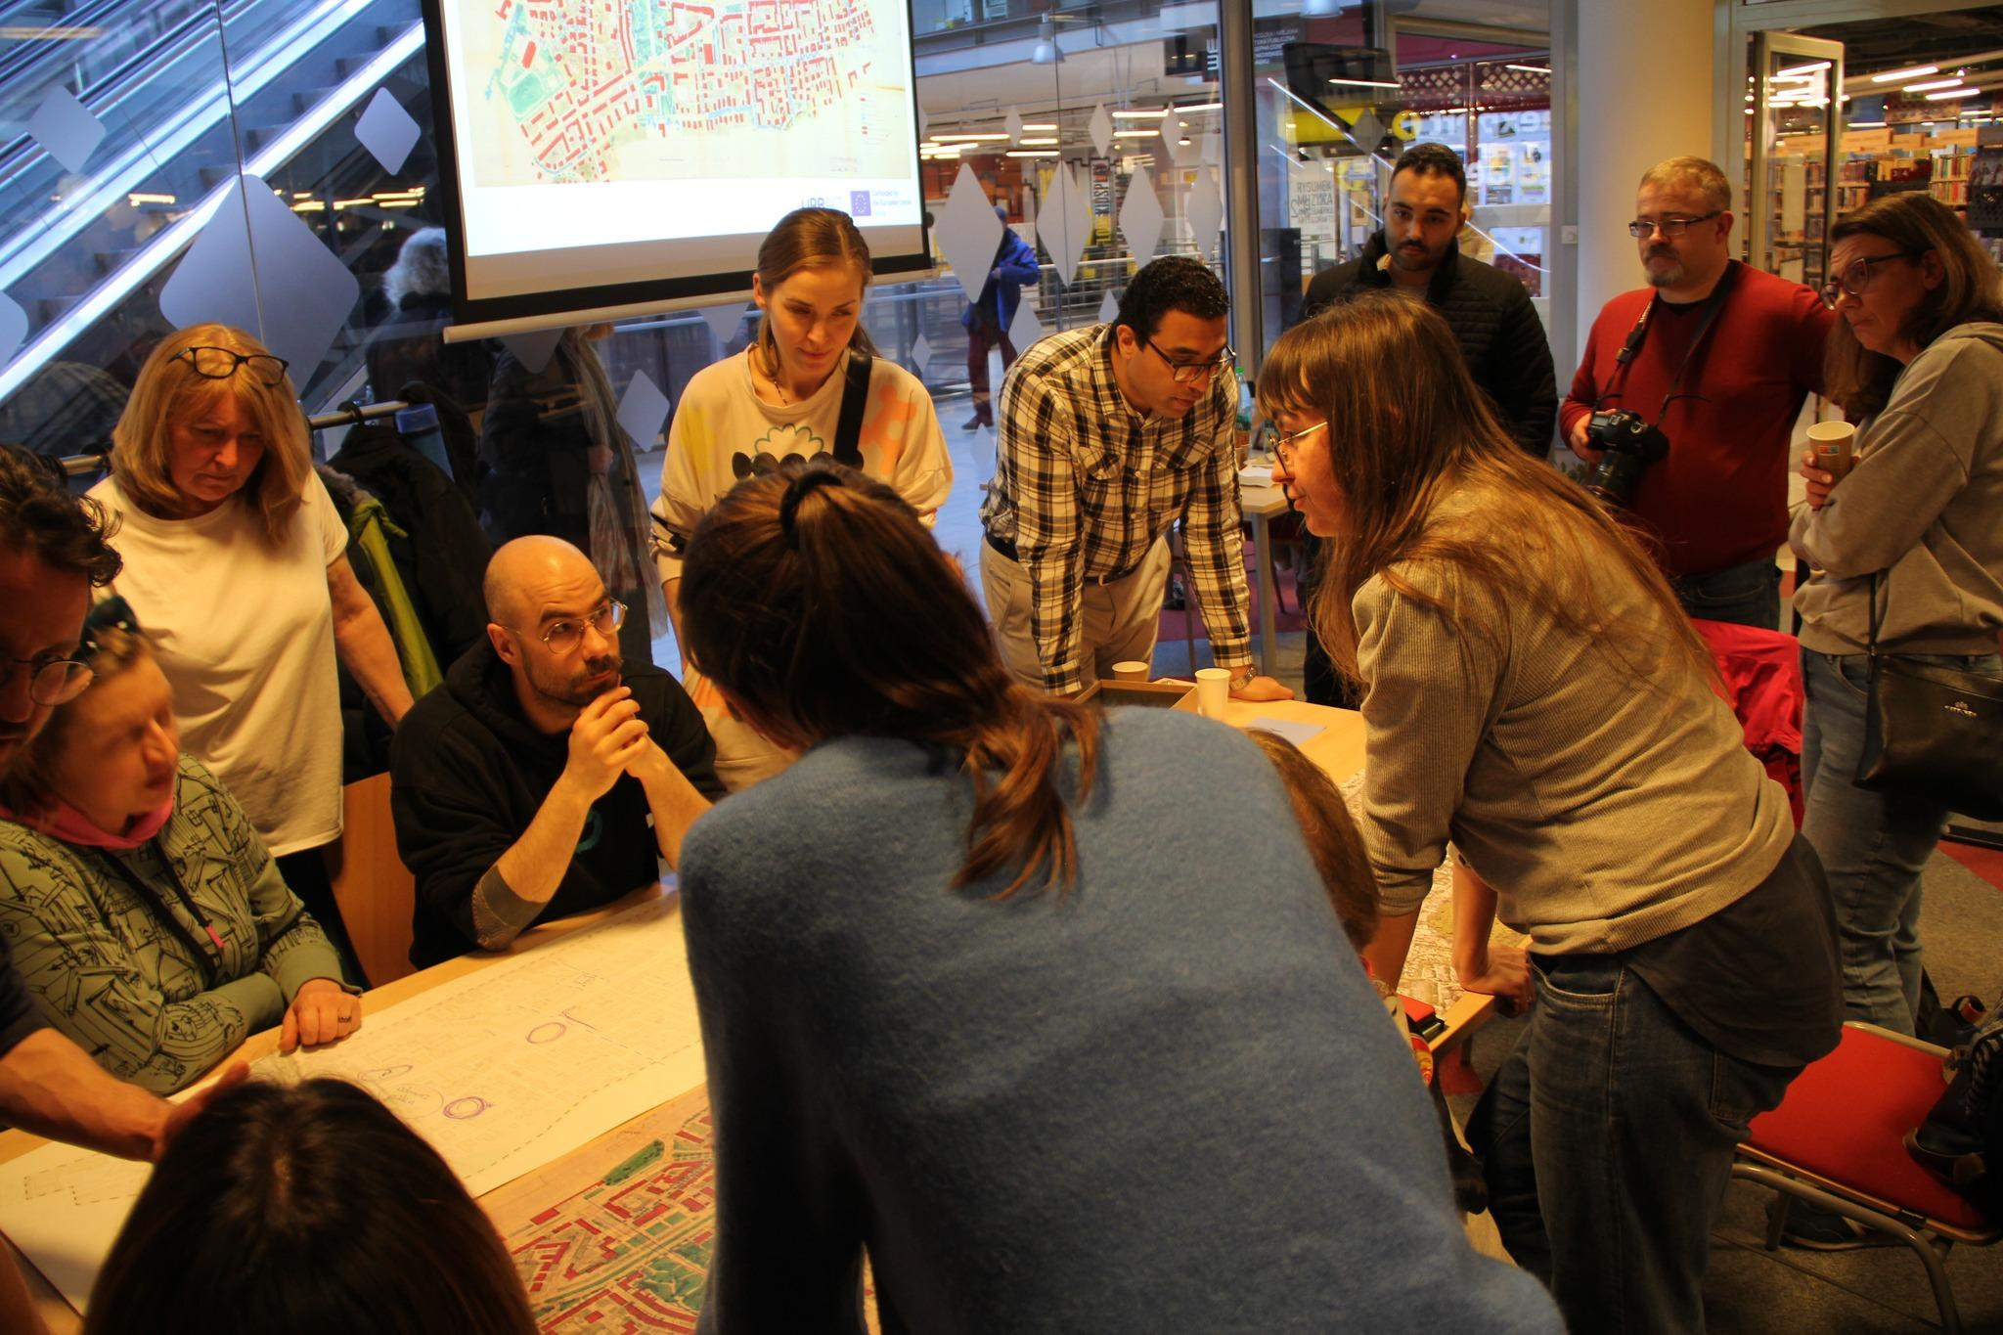

Slide 19
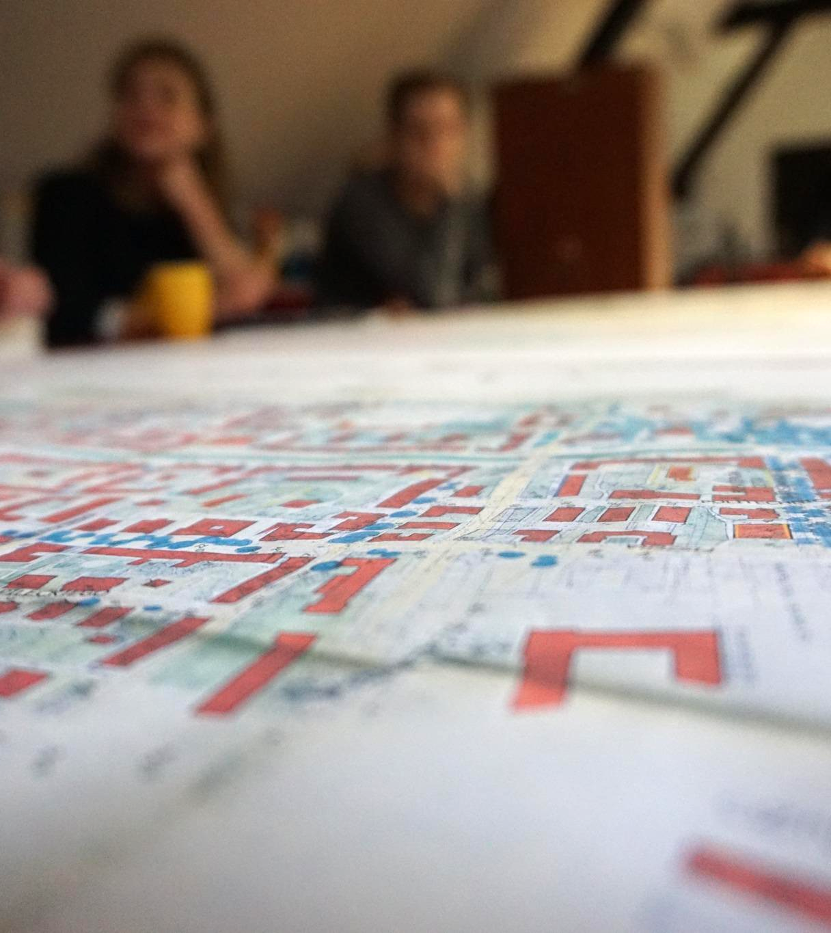
Workshops
Creating a mental map of Wrzeszcz
Mapping challenges and opportunities

Slide 20
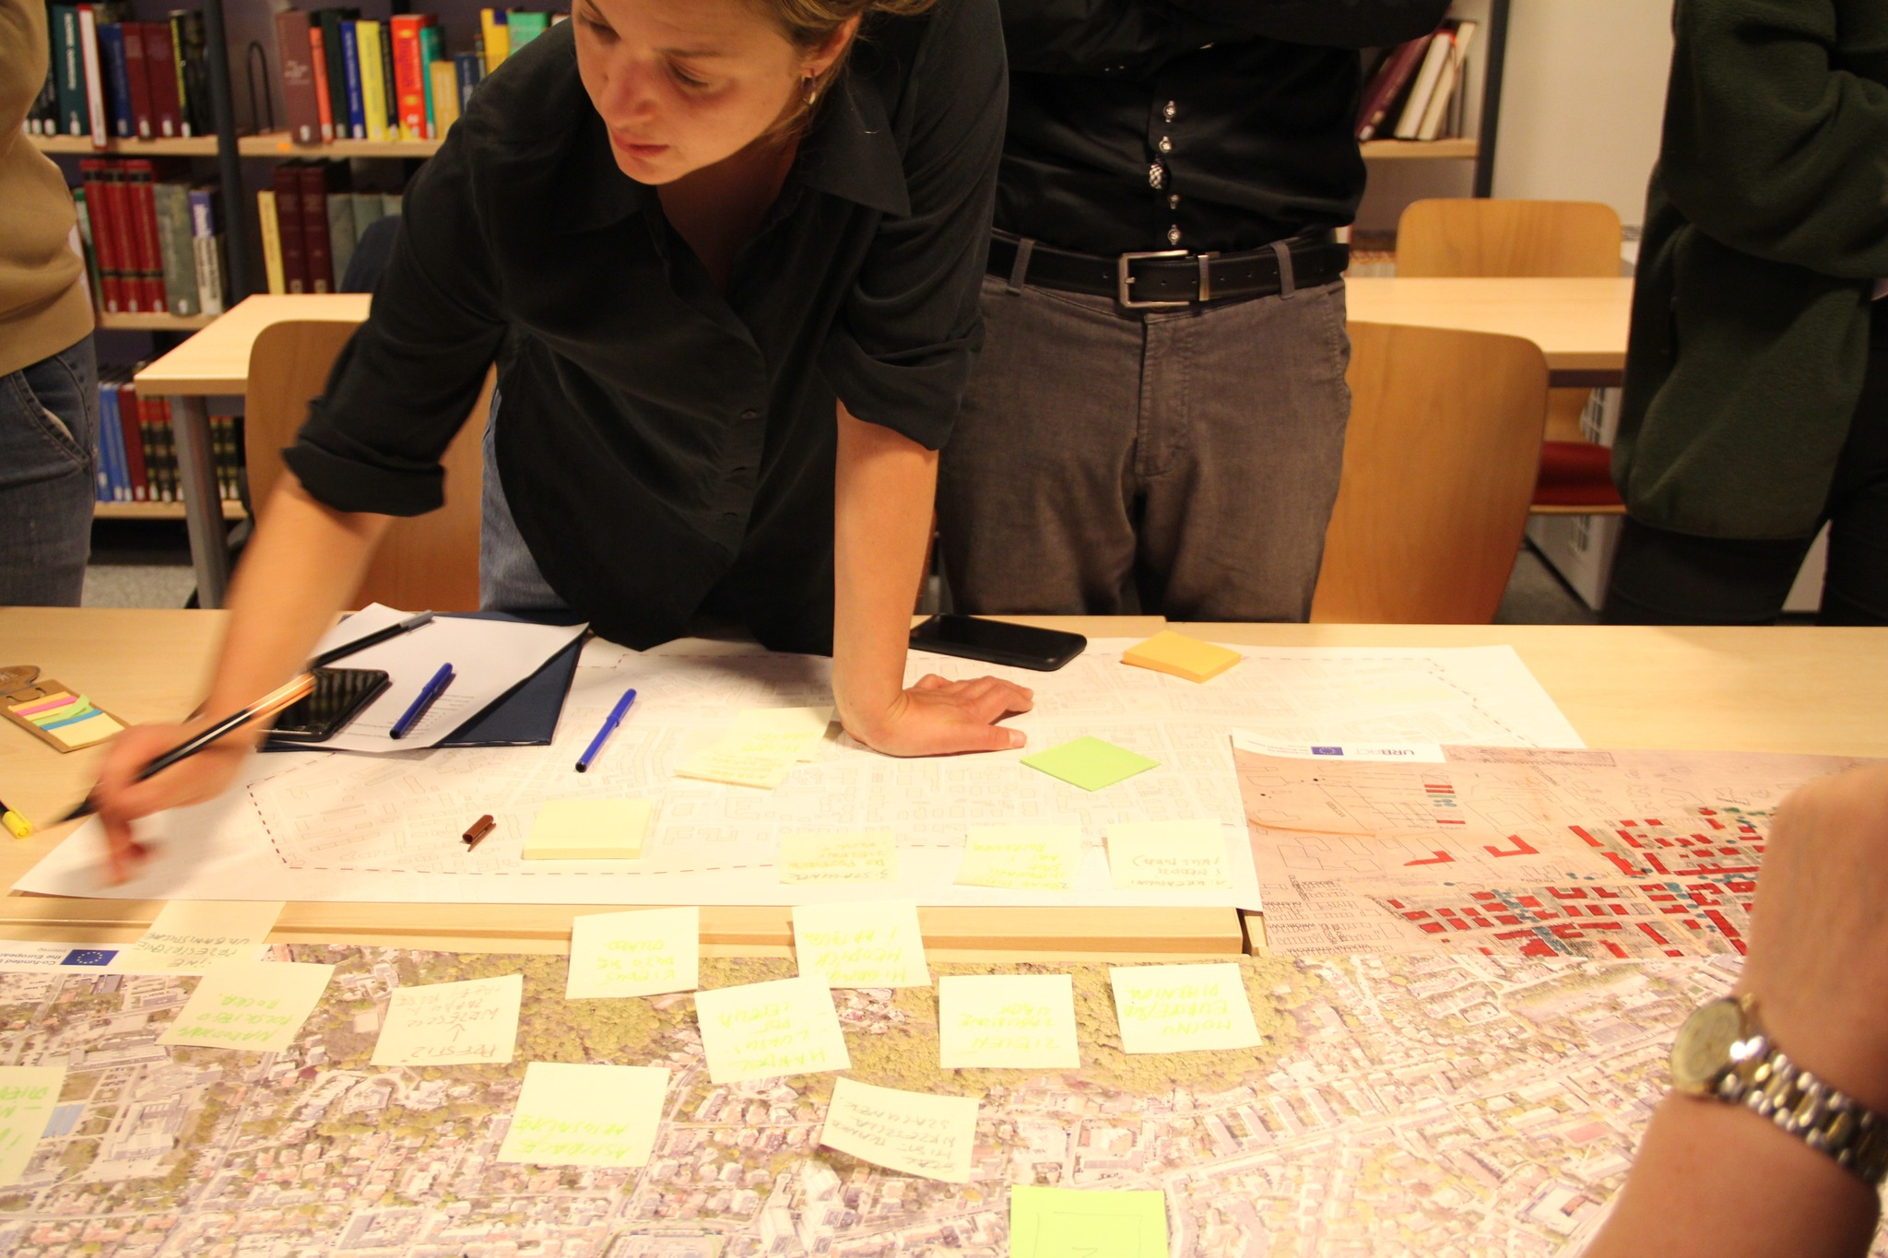
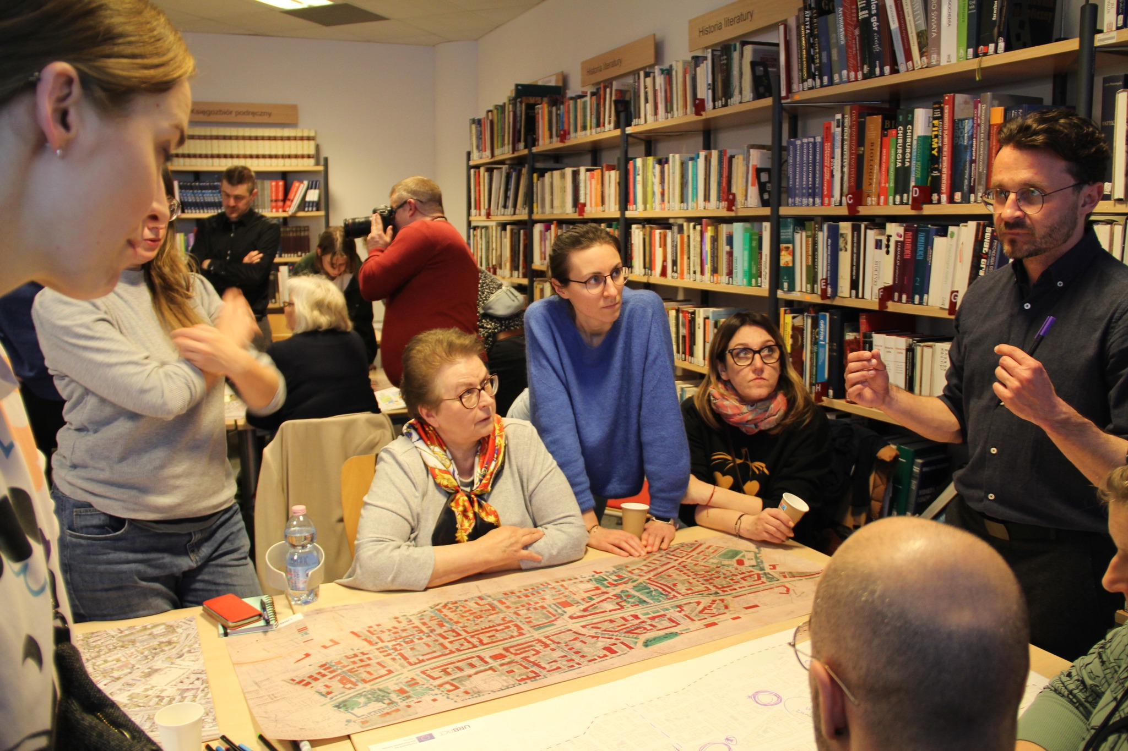
Workshops

Slide 21
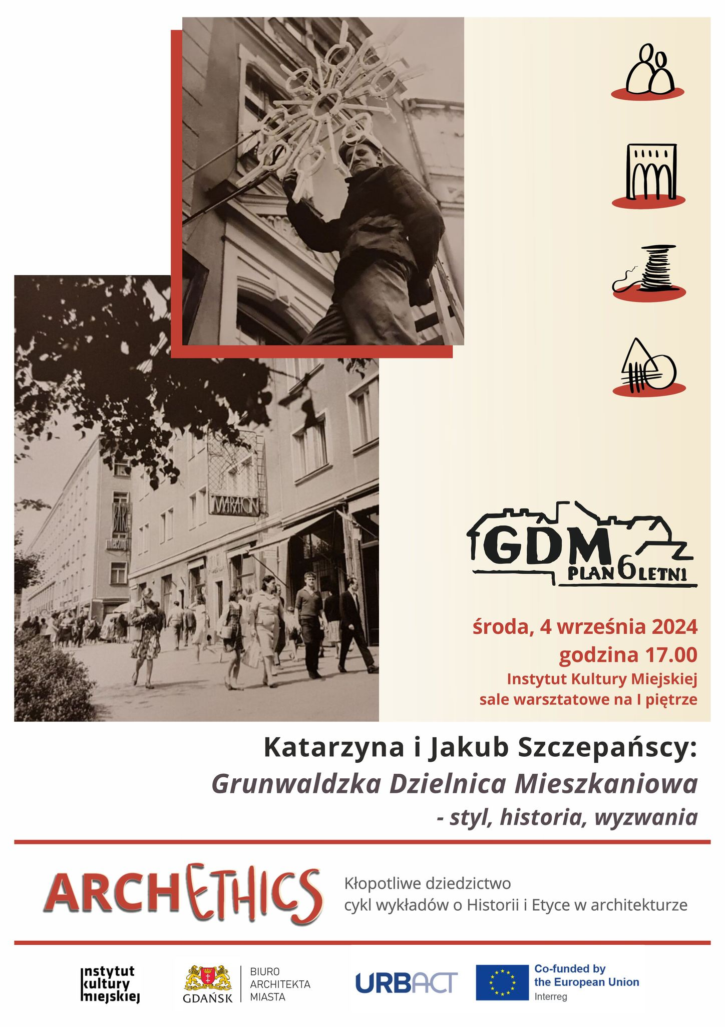
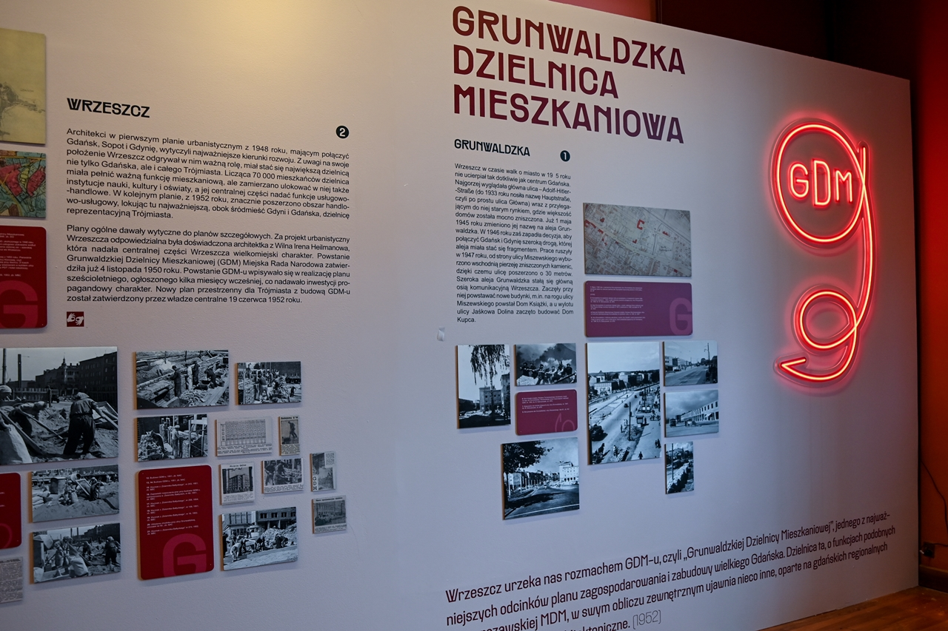
Supporting activities

Slide 22
Key findings
Challenges
Lack of spatial integration
Low quality of public and green spaces
Disappearance of third places
Low awareness of architectural/planning heritage
Lack of community ownership & appreciation
Poor condition of heritage buildings
Lack of “official” recognition and protection of architectural/planning heritage

Slide 23
Key findings
Opportunities
Sense of place & local identity
Tangible & intangible heritage
Appreciation of green & public spaces, architecture
Location & urban structure
NGO/ CommunityNGO/

Slide 24
Focus
Public & green spaces
Awareness building & Education
Policies & guidelines

Slide 25
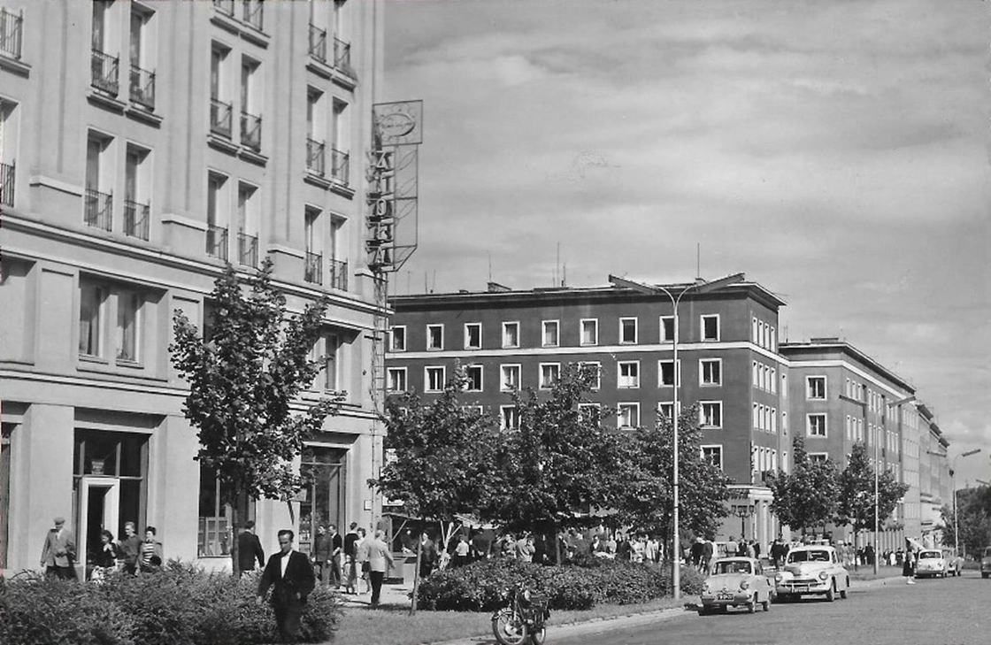
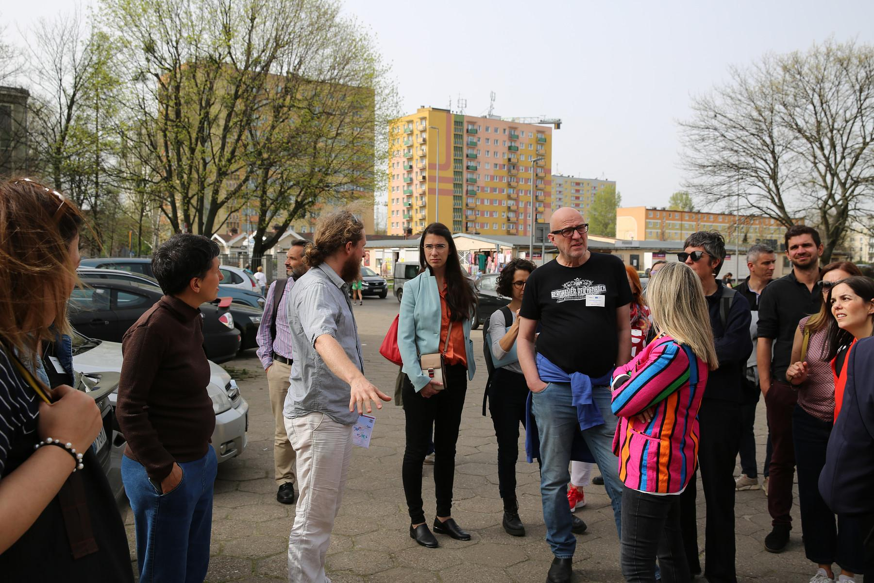
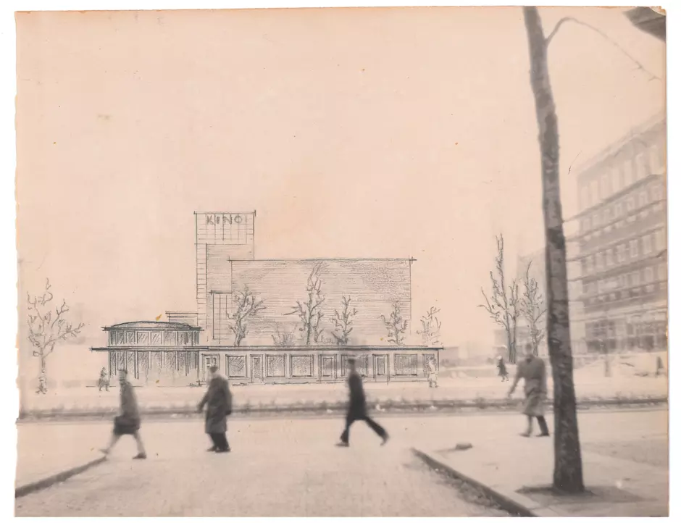
Heritage as a driver of change…

Slide 26
Objectives
To strengthen the role of architectural heritage in urban development & improving quality of life
To improve the liveability of the neighborhood by strengthening spatial and social integration
To raise awareness on socio-economic & cultural benefits of GDMs heritage

Slide 27
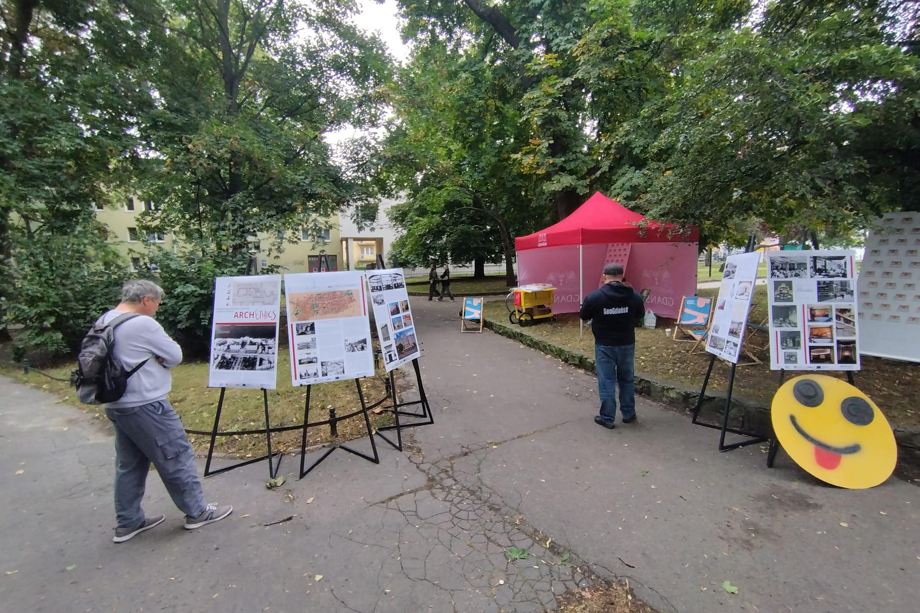
Next steps..

