Slide 1

Gdańskie Warsztaty Projektowe
Young City. Future of the District

Slide 2
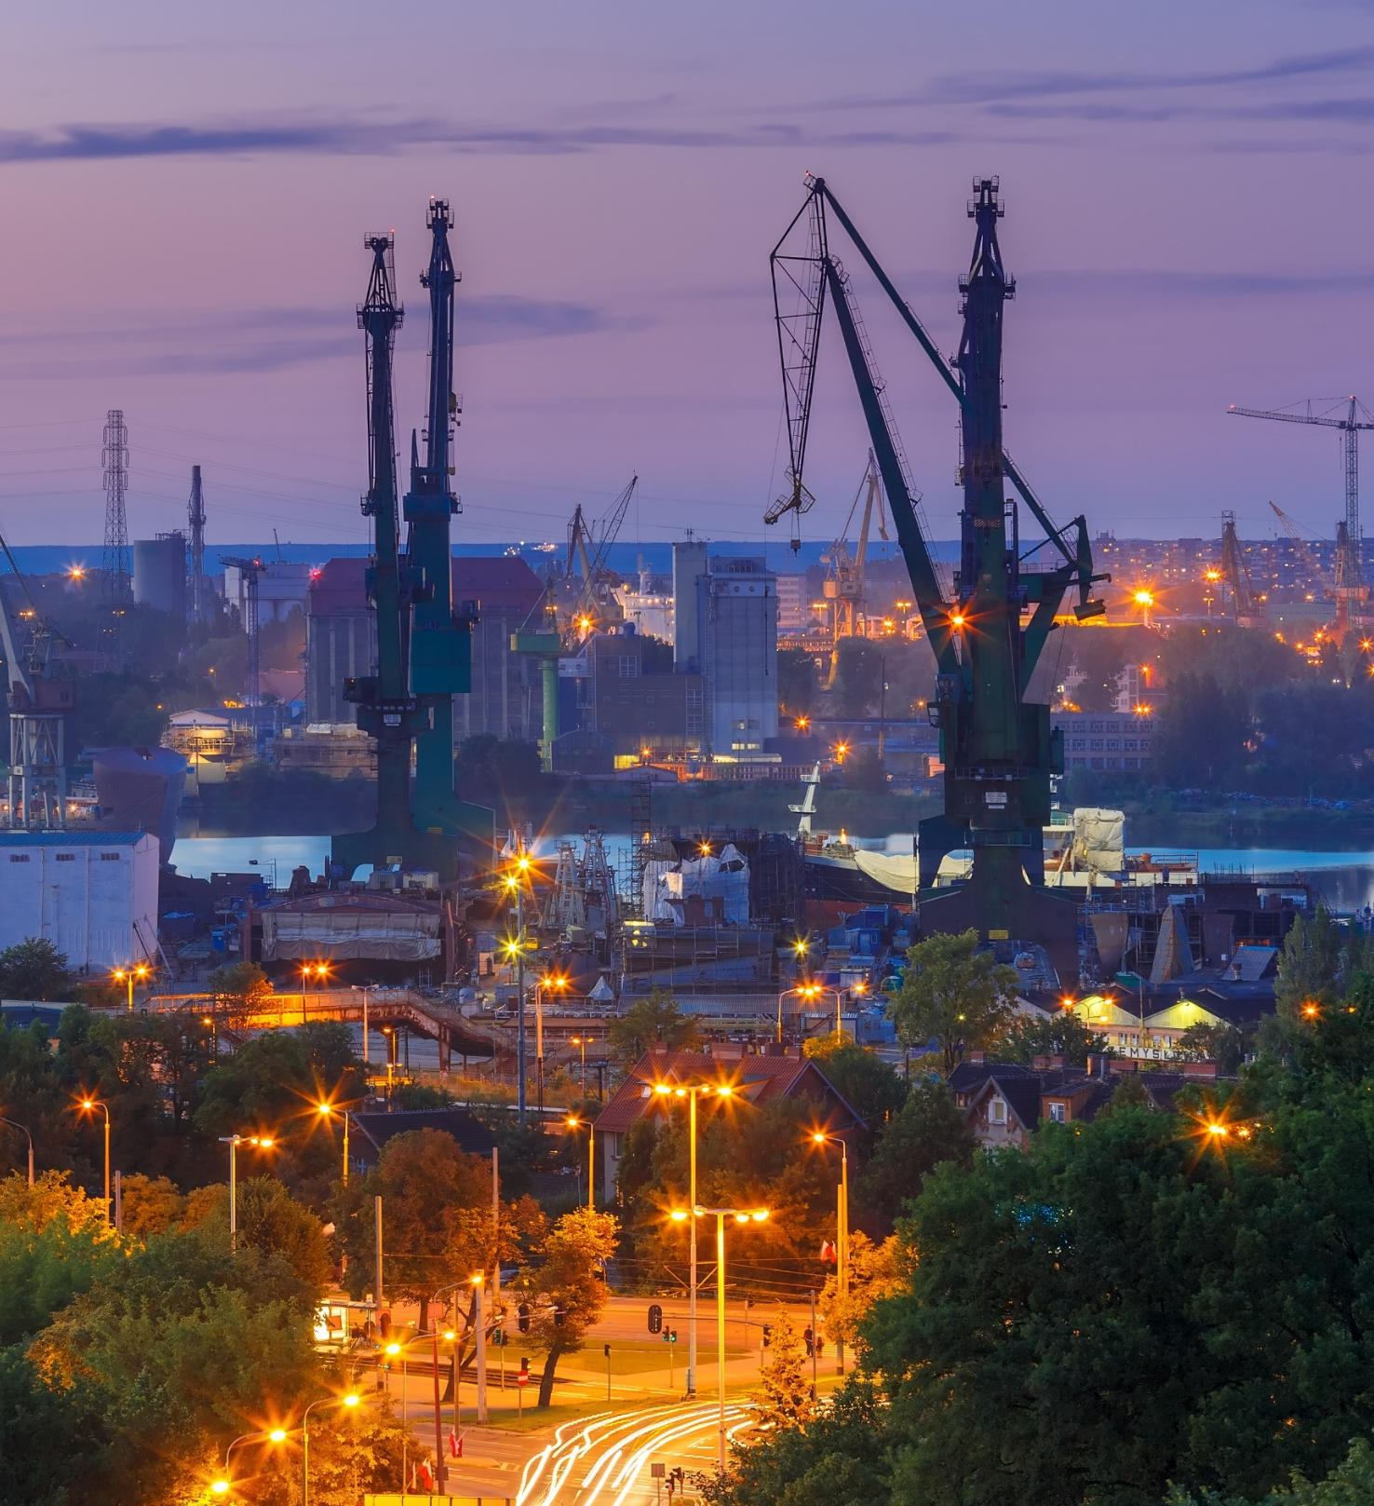
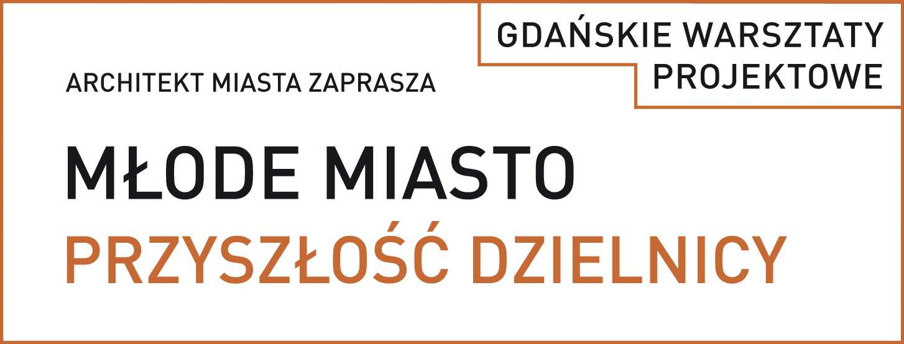

1.01 Aim.
Aim of the process:
Gather stakeholders’ opinions regarding the key factors driving the transformation of the district,
Create a catalogue of actions and activities,
Define the character of the area based on stakeholders’ expectations,
Define areas and issues requiring further studies.

Slide 3
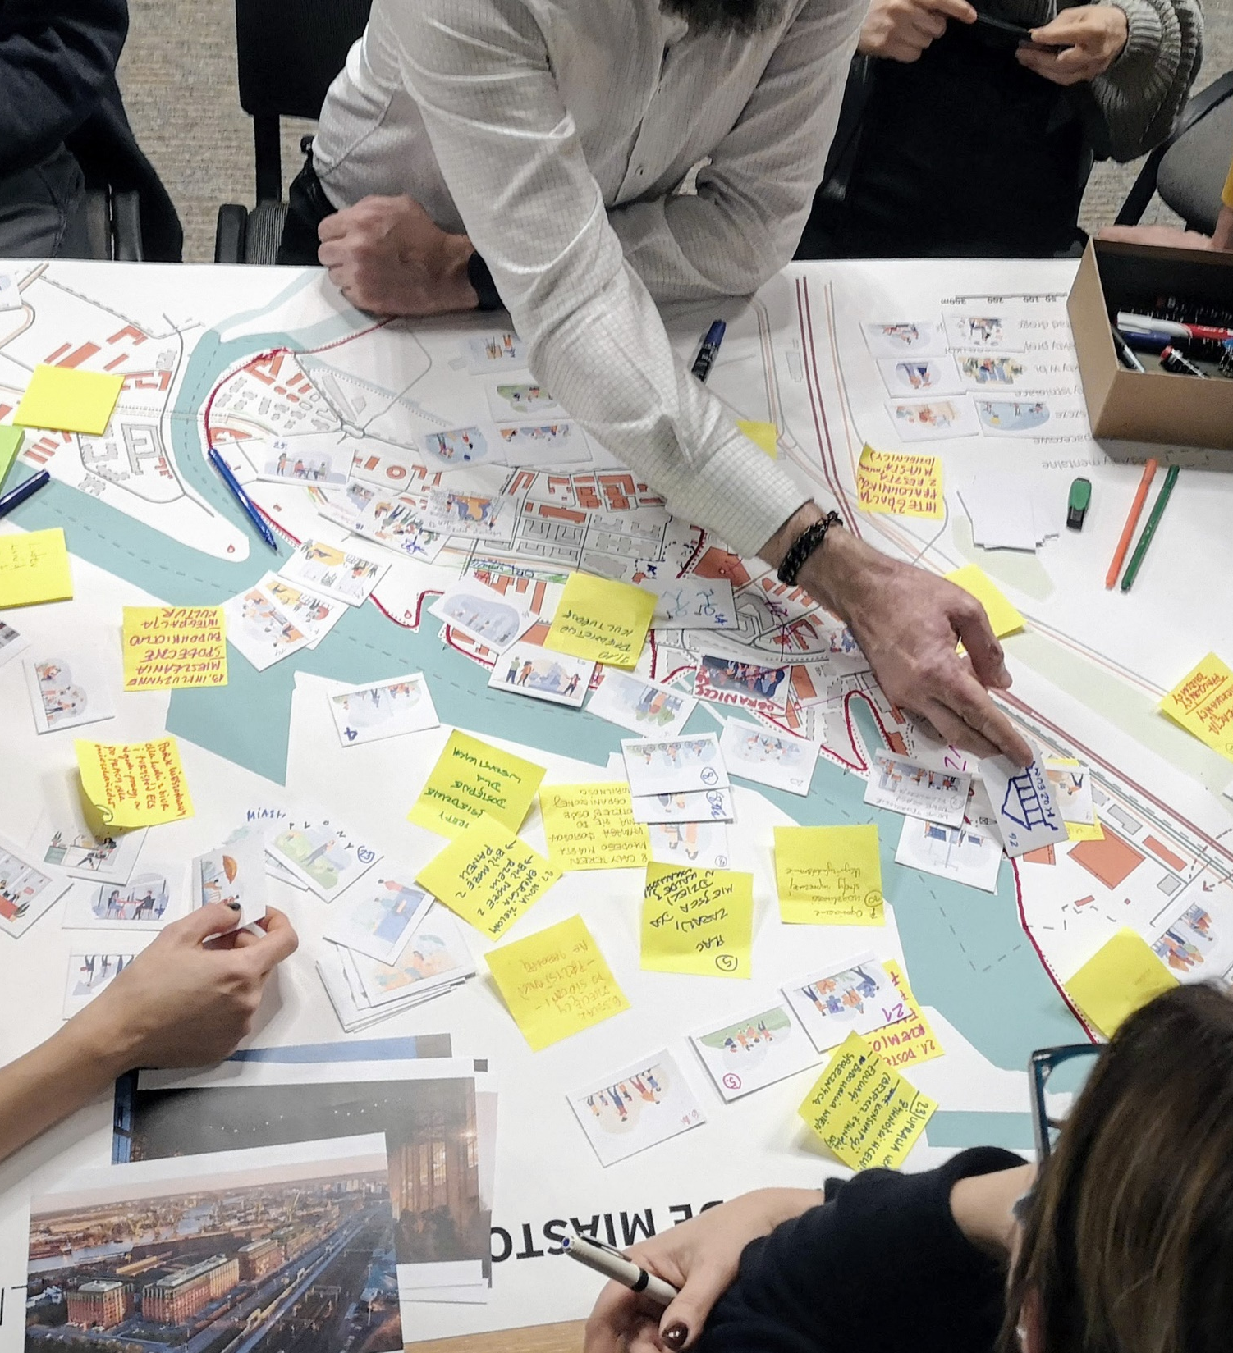
2.01 Process.
The process:
6 meetings in total
2 workshops
2 expert meetings and presentations, including:
12 experts
Over 100 participants, including:
Residents,
Local authorities,
Districts representatives,
Investors,
Artists and architects,
Representants of local NGO.

Slide 4
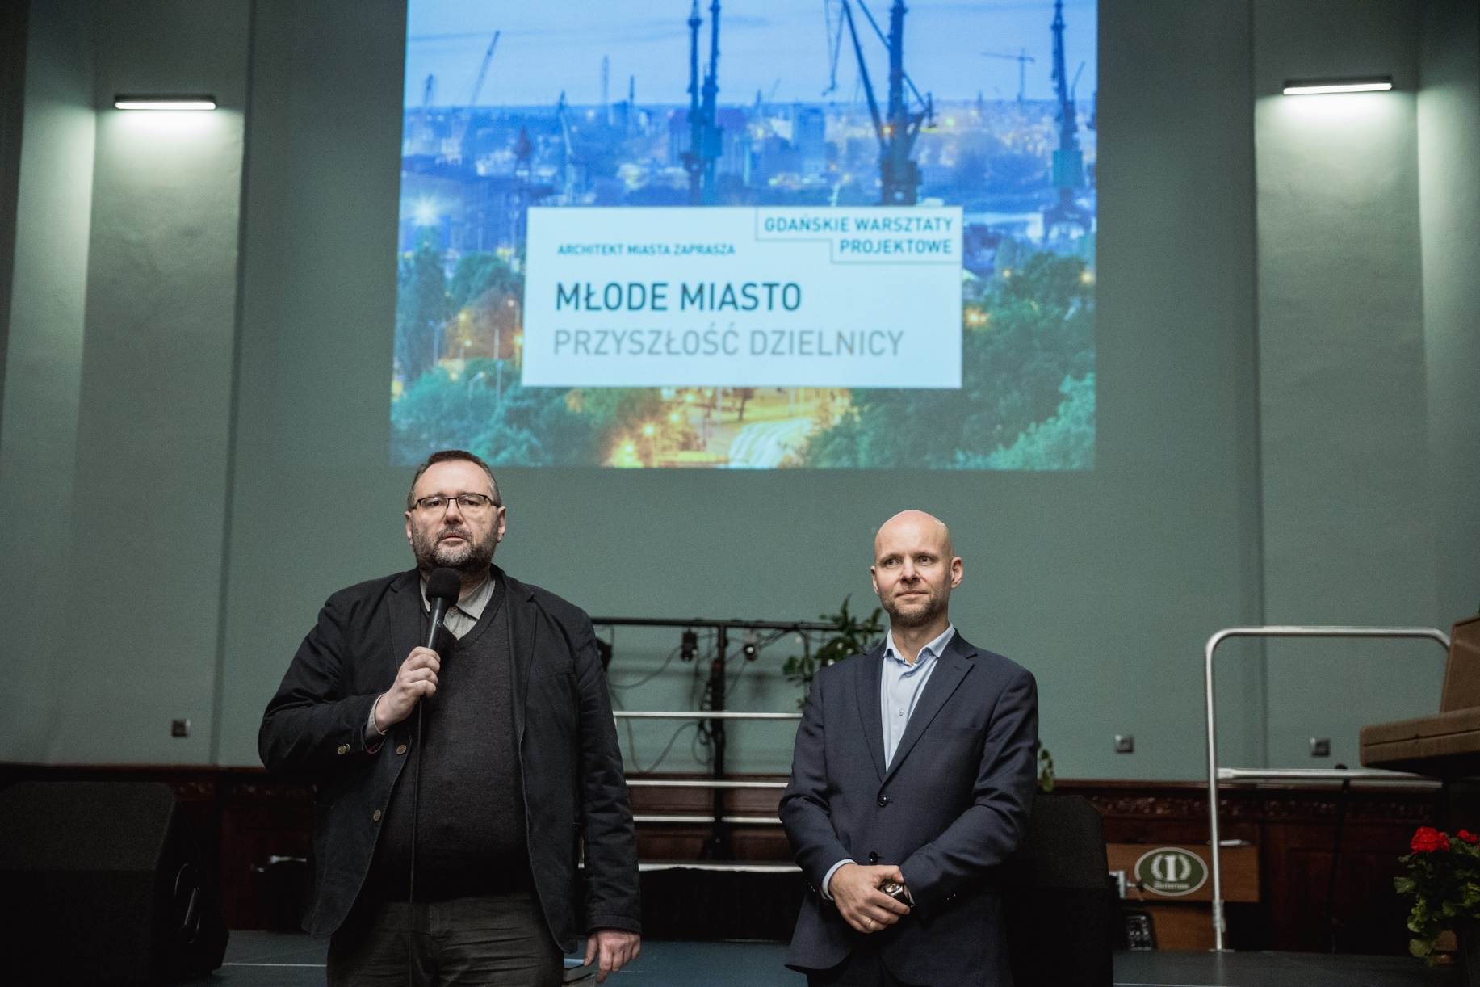
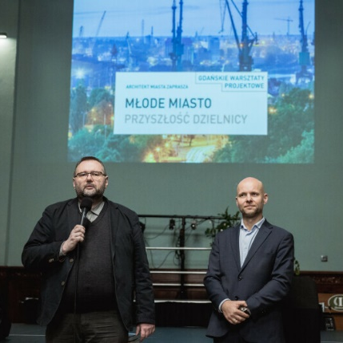
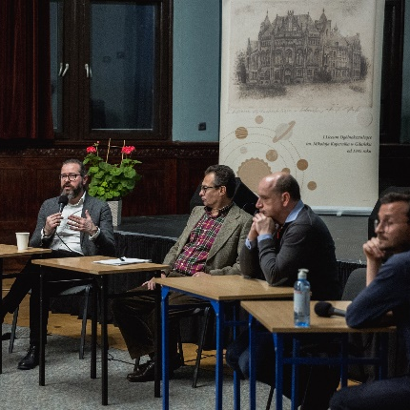
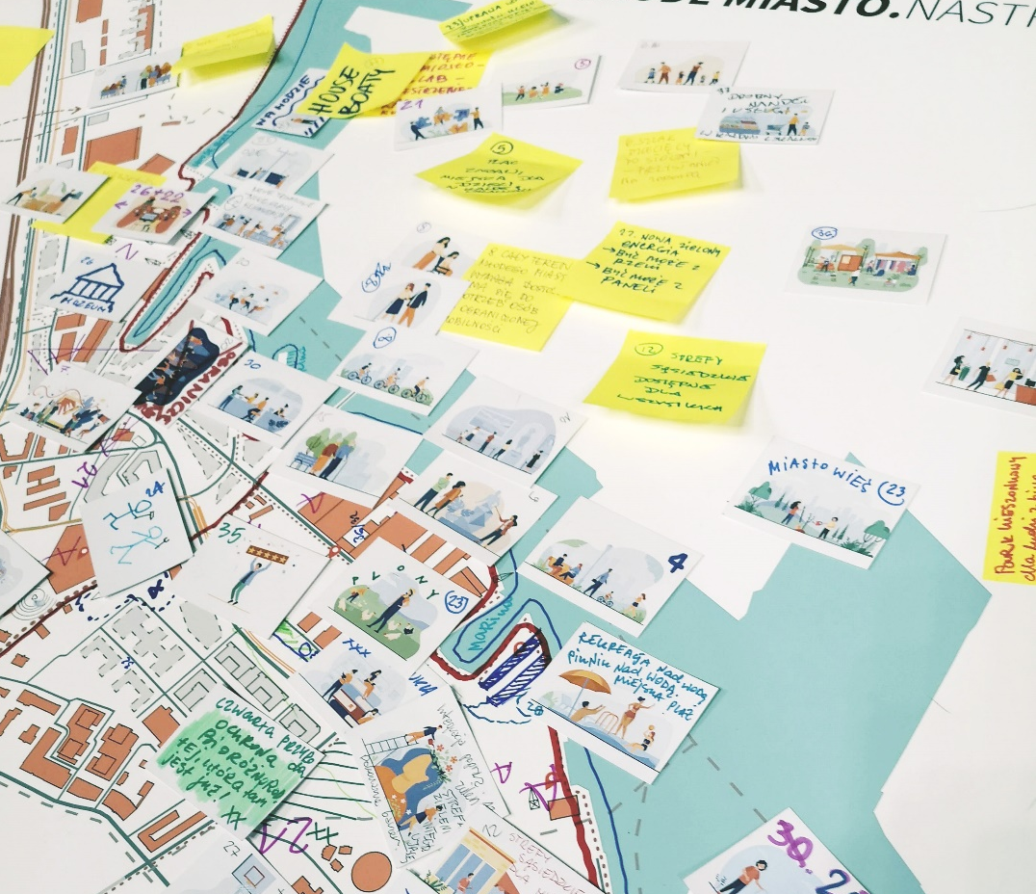
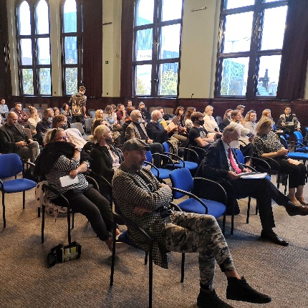
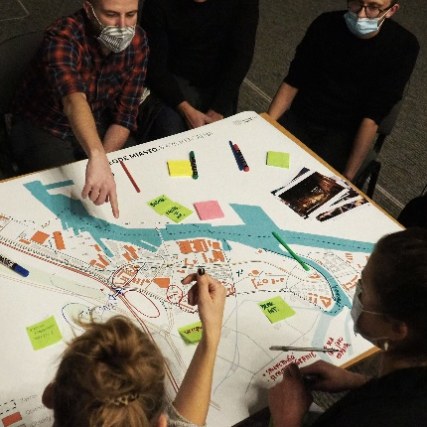

Slide 5
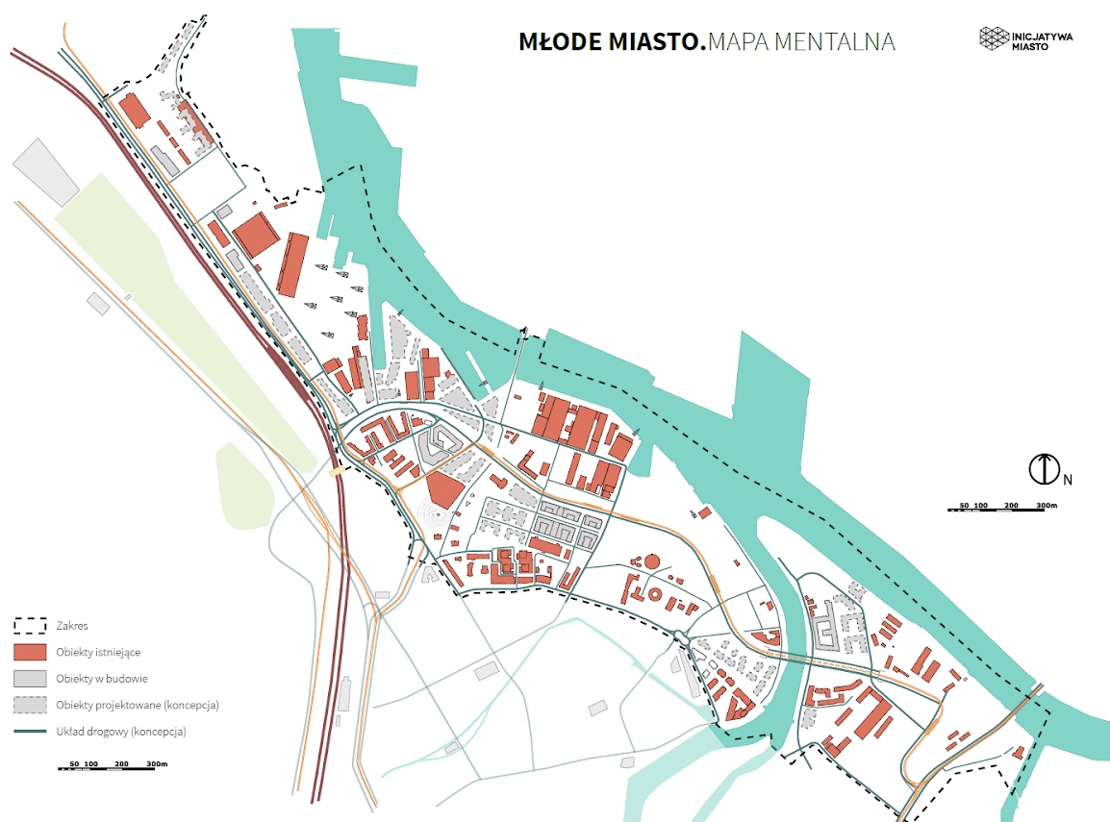

Slide 6
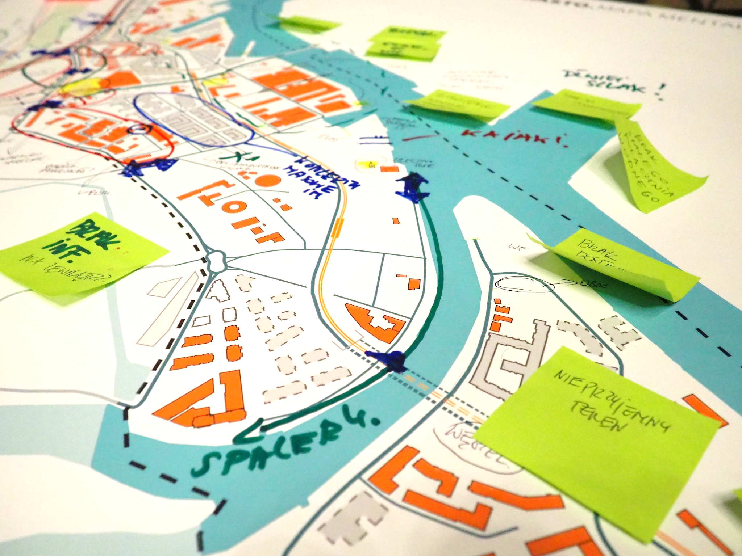

Slide 7
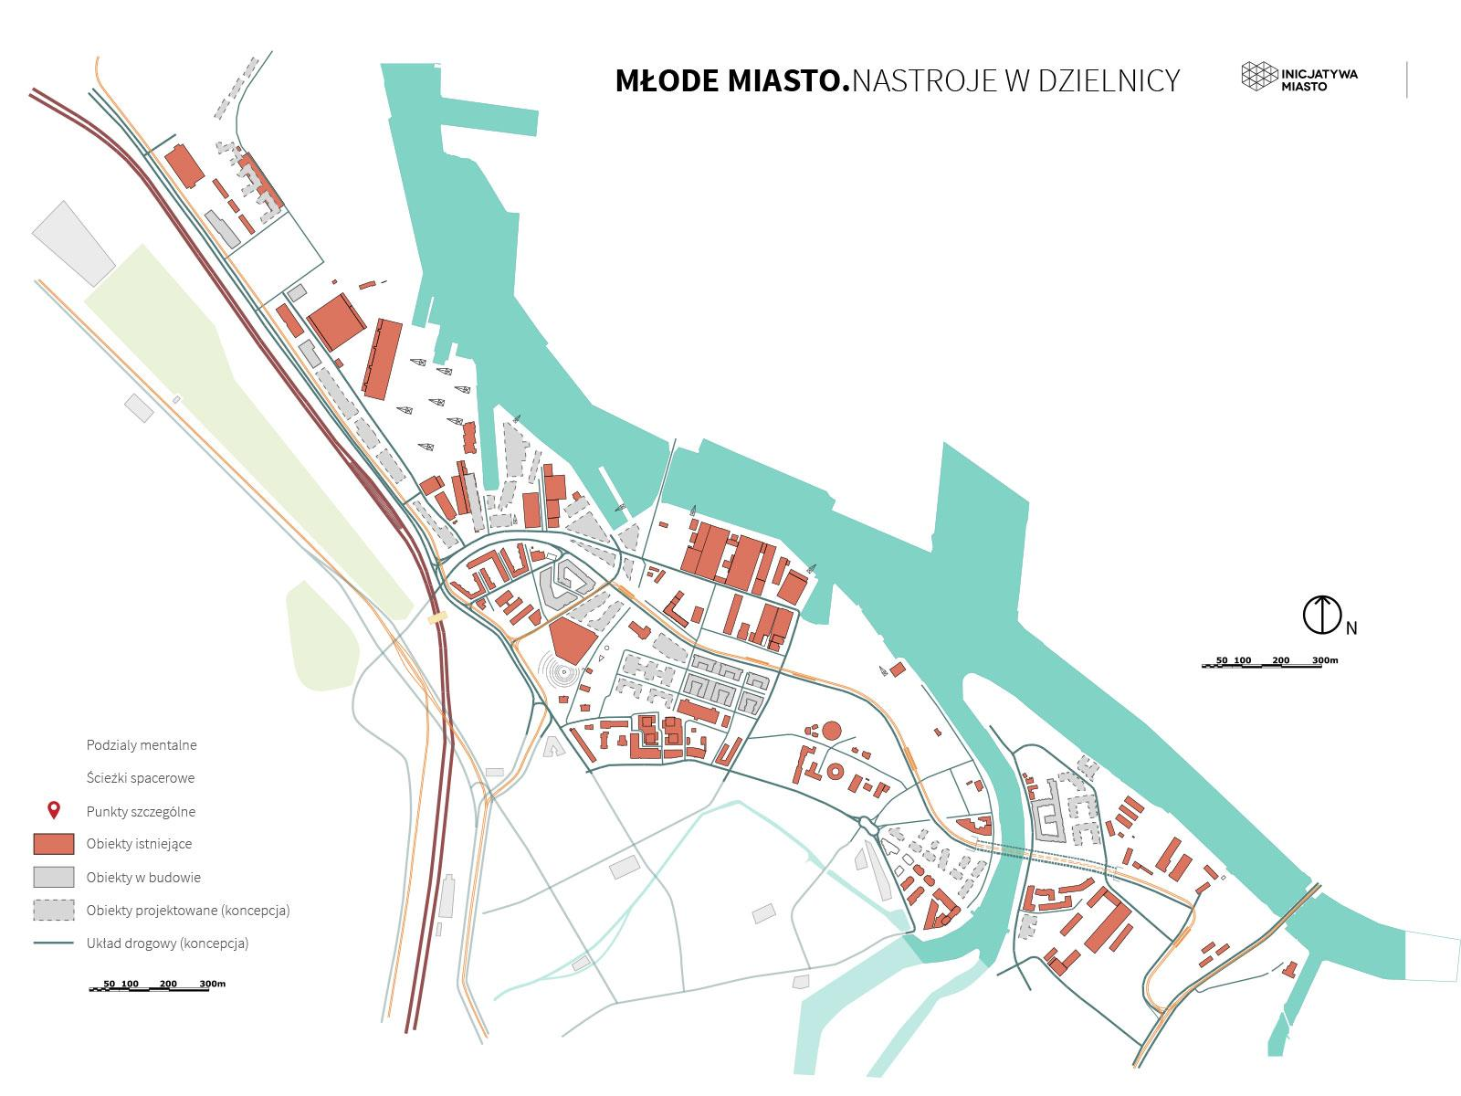

Slide 8


Slide 9
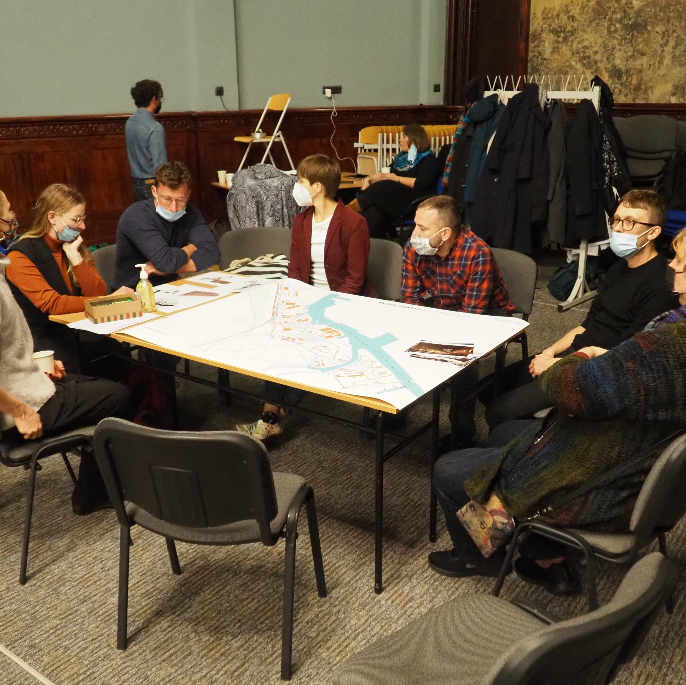

Slide 10

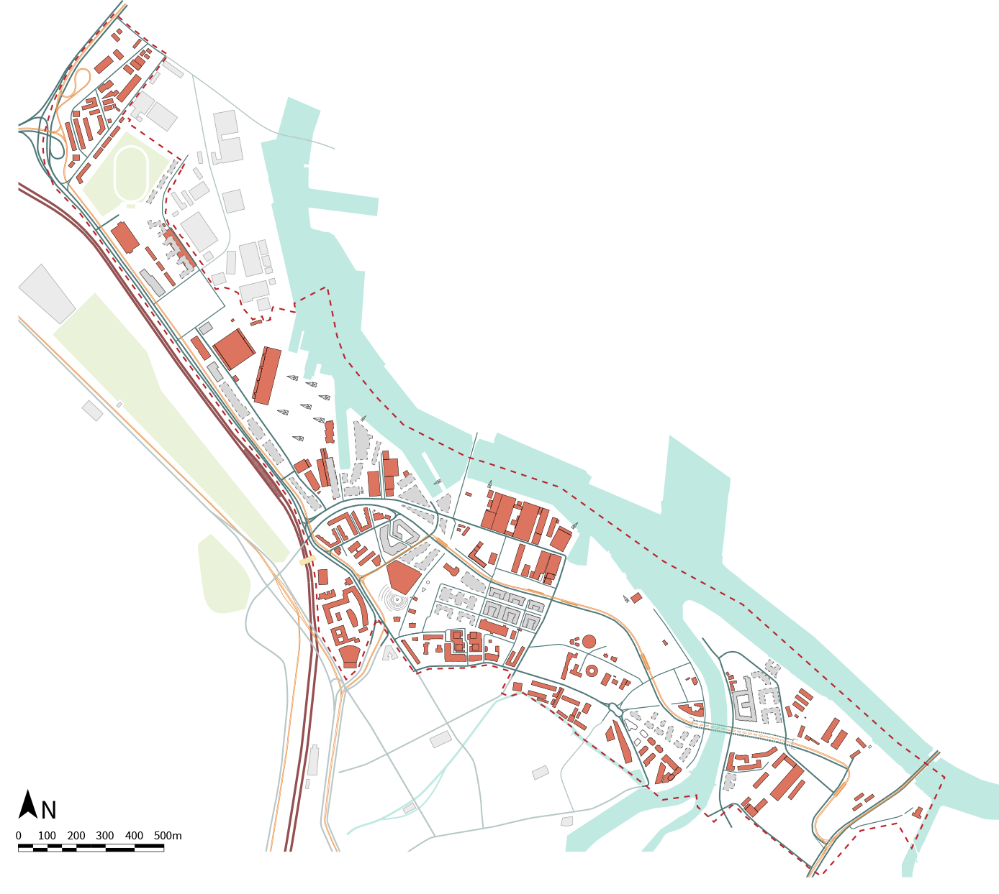
3.01 Study aerea.
Legend

Slide 11
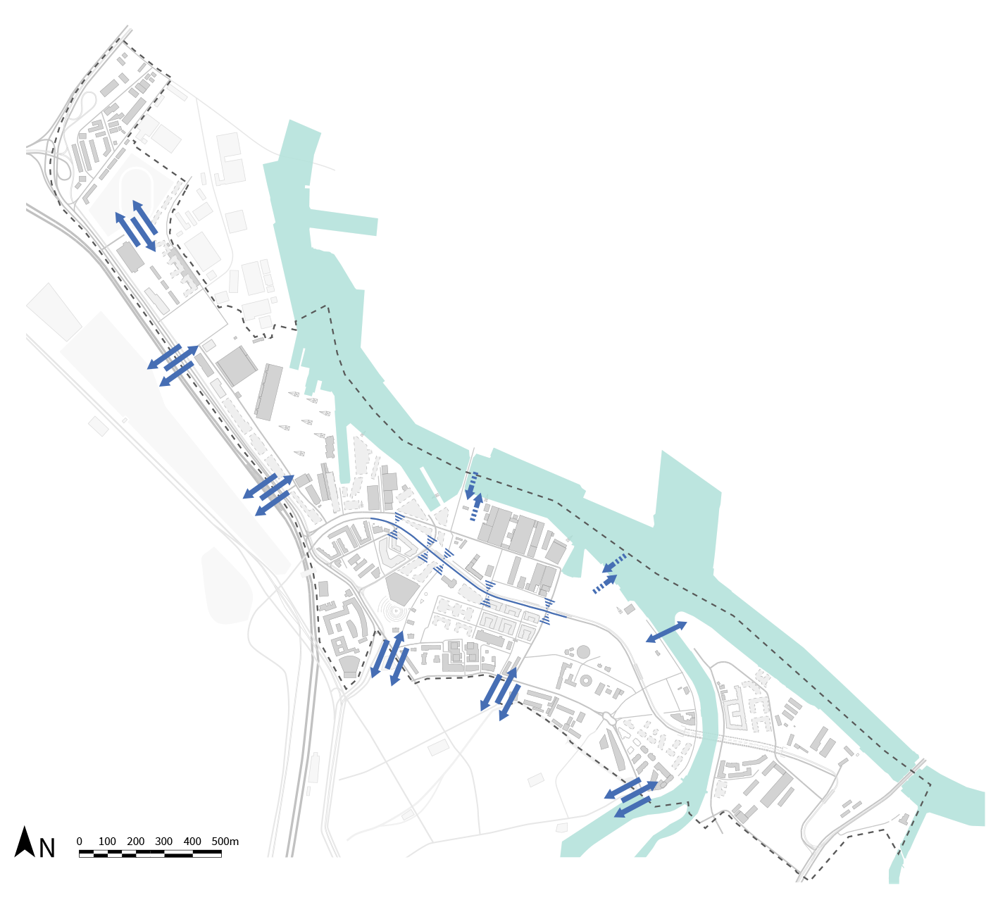
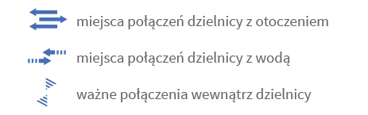
4.01 Findings. Connections
Key findings:
the need to increase the accessibility of pedestrian and bicycle traffic to the district
the need to create a pedestrian connection connecting the Aniołki district with Młode Miasto – e.g. a footbridge over the tracks and Jana z Kolna Street.
Legend:

Slide 12
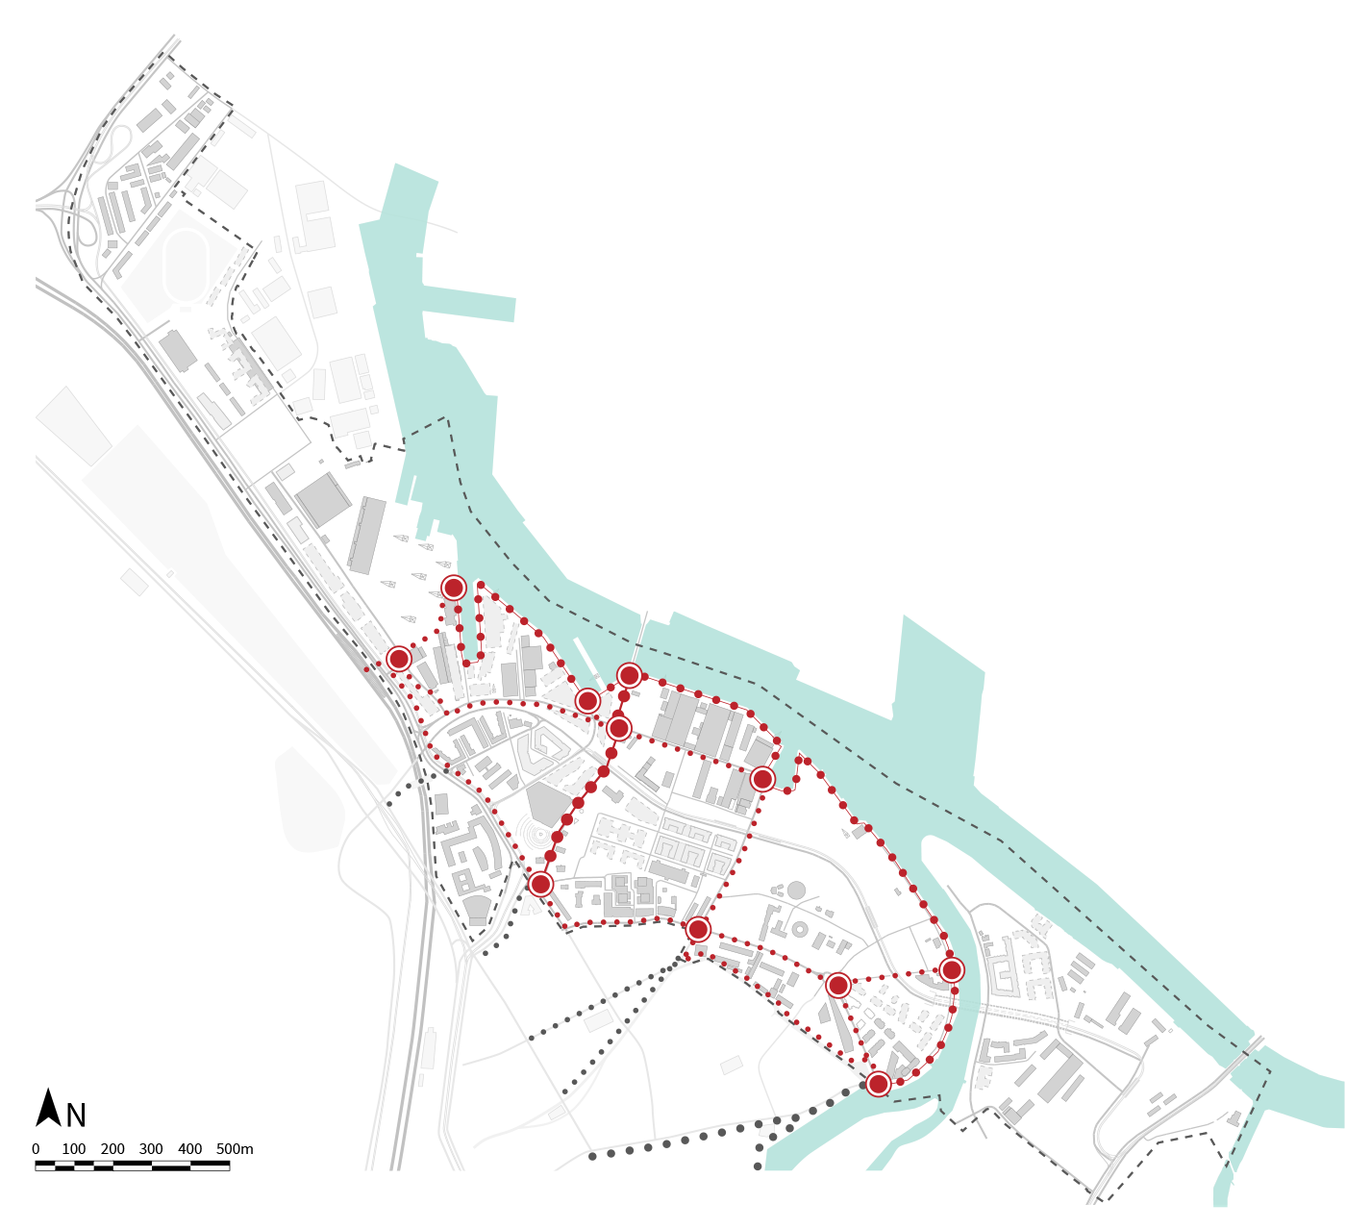
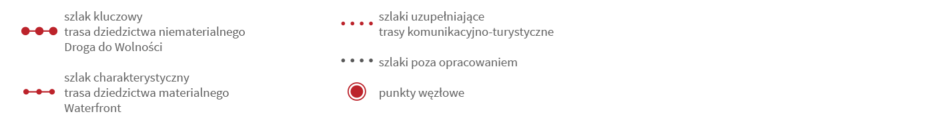
4.02 Findings. Views and nodal points
Key findings:
Most important views are along Droga do Wolności and the waterfront.
Legenda:

Slide 13
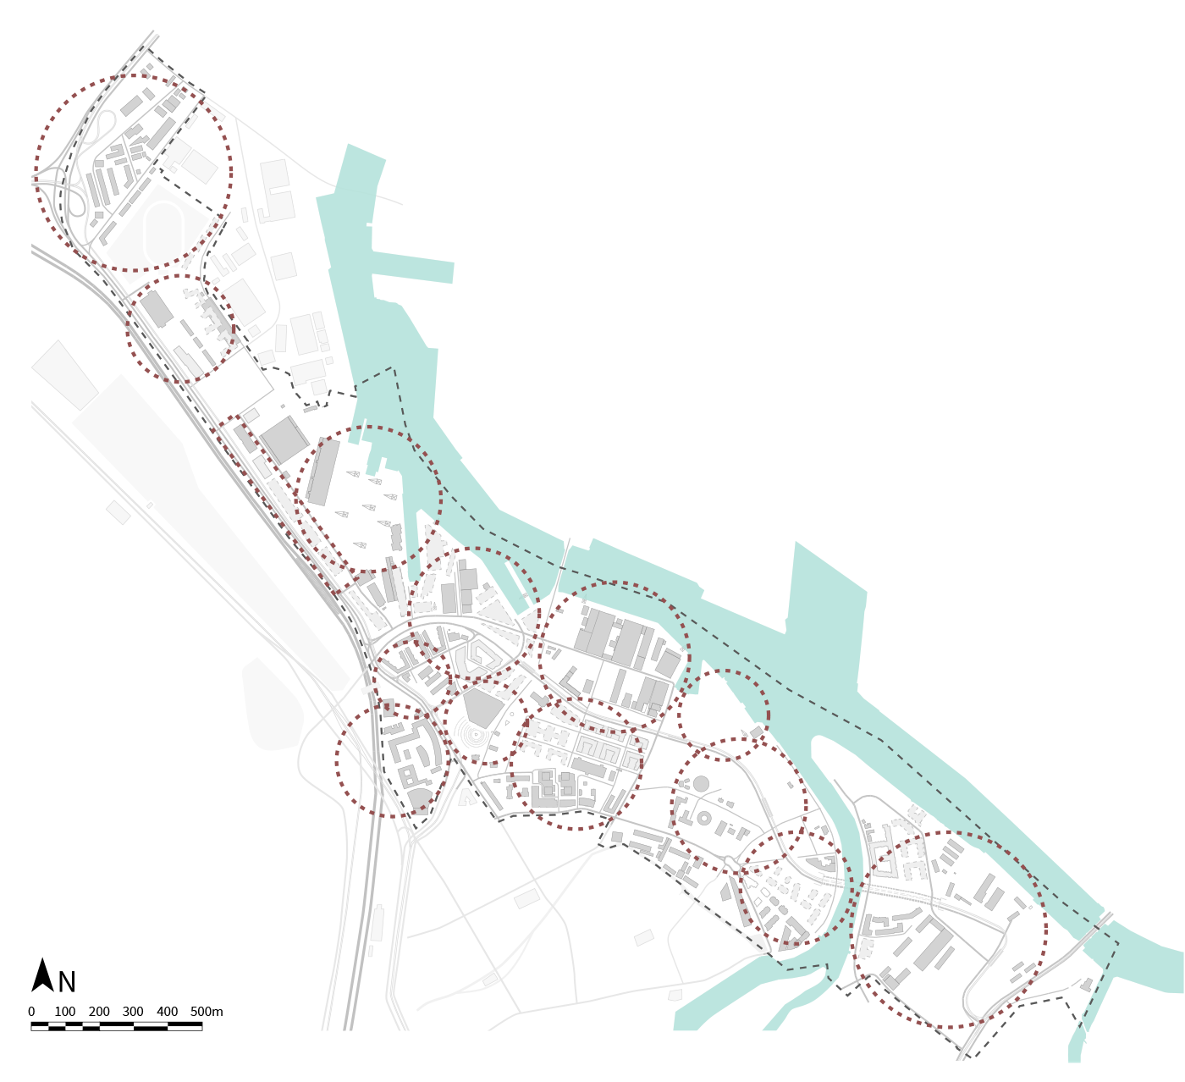
4.03 Findings. District polycentricity
Key findings:
The district consists of centres/ neighbourhood units with different characteristics and functions.
Legenda:

Slide 14
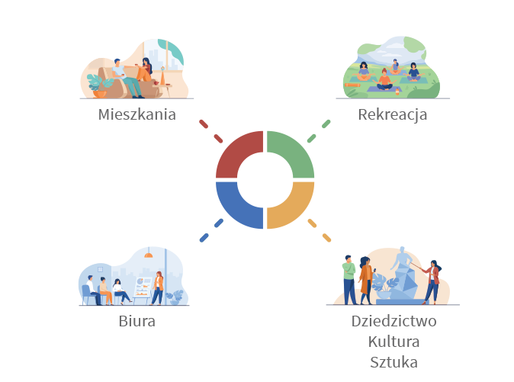
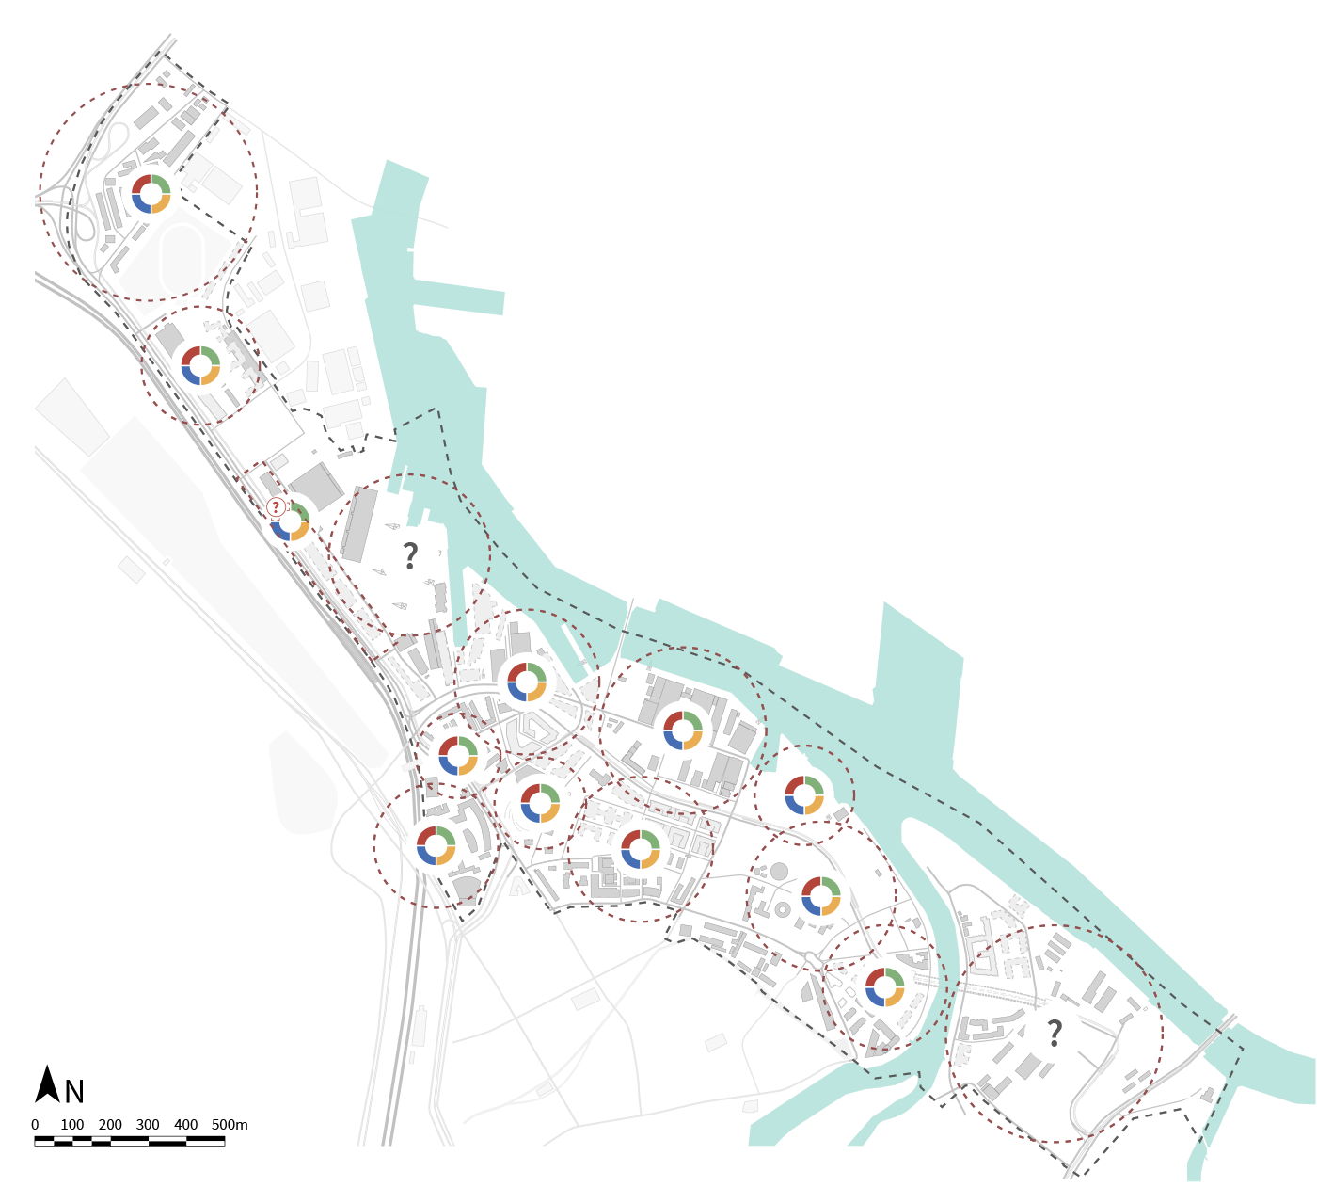
4.04 Findings. Sustainable programme
Key findings:
Młode Miasto as a multifunctional district with scattered basic functions.
Legenda:

Slide 15

4.05 Findings. Third places
To create a network of third places

Slide 16
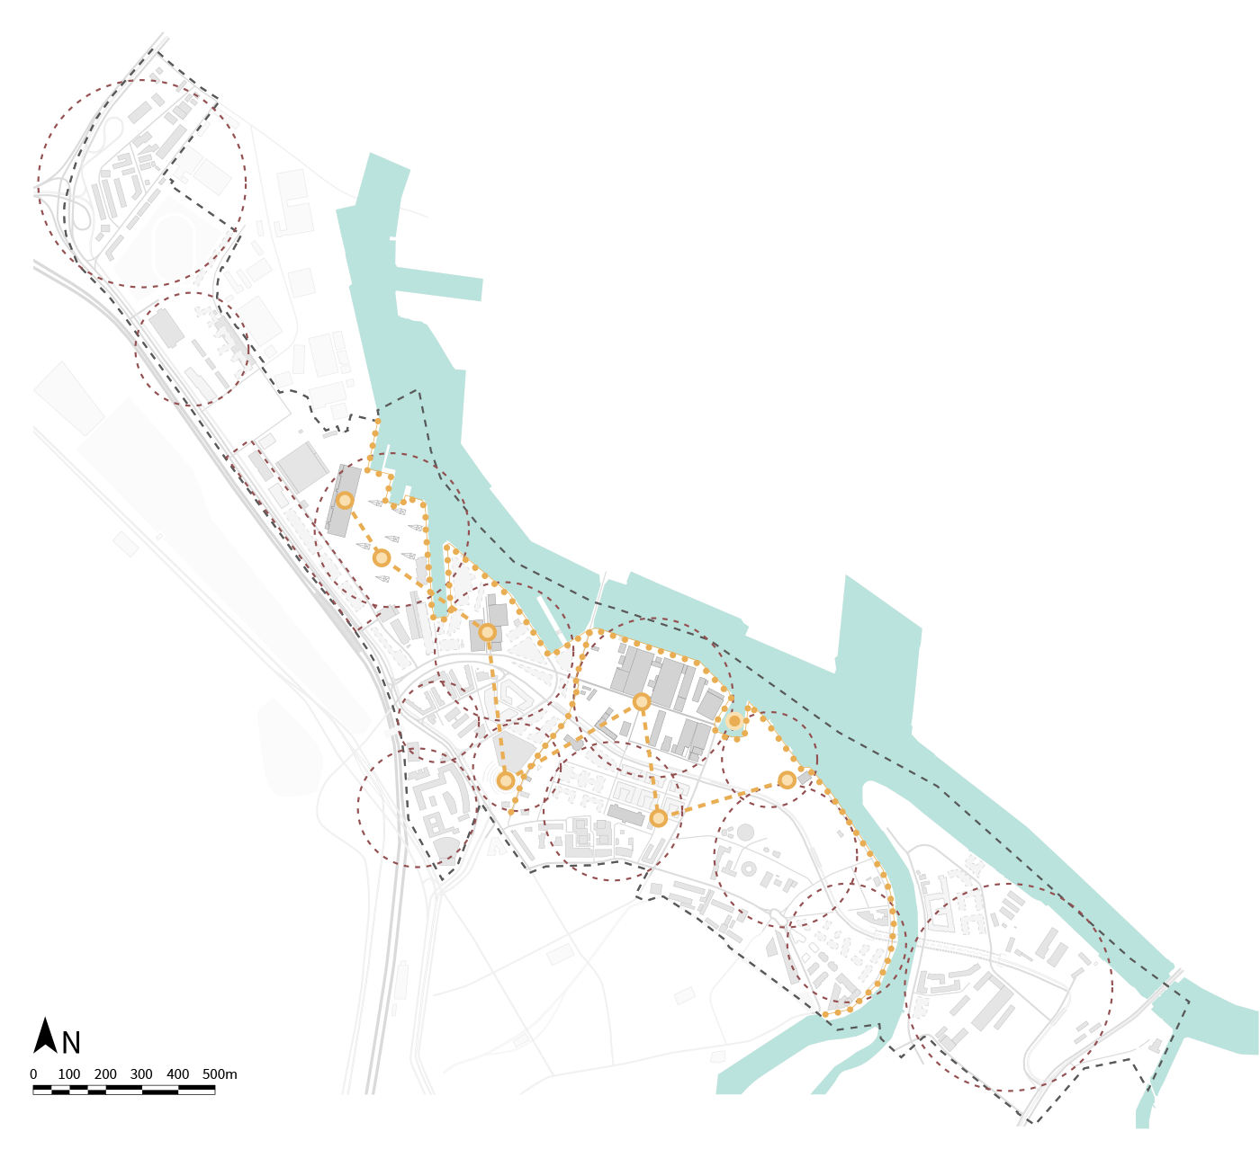
4.06 Findings. Heritage assets and sites of memory as a network of third places.
Noteworthy heritage sites: Plac Solidarności, Trasernię, Montownię U-bootów, zabudowania Stoczni Cesarskiej wraz z budynkiem Dyrekcji, otoczenie Ulicy Elektryków oraz Mlecznego Piotra. Do dziedzictwa odnosi się również budynek Europejskiego Centrum Solidarności.
suggestion: to create a Museum of Heriatge Industry and a memory park.
Legenda:

Slide 17
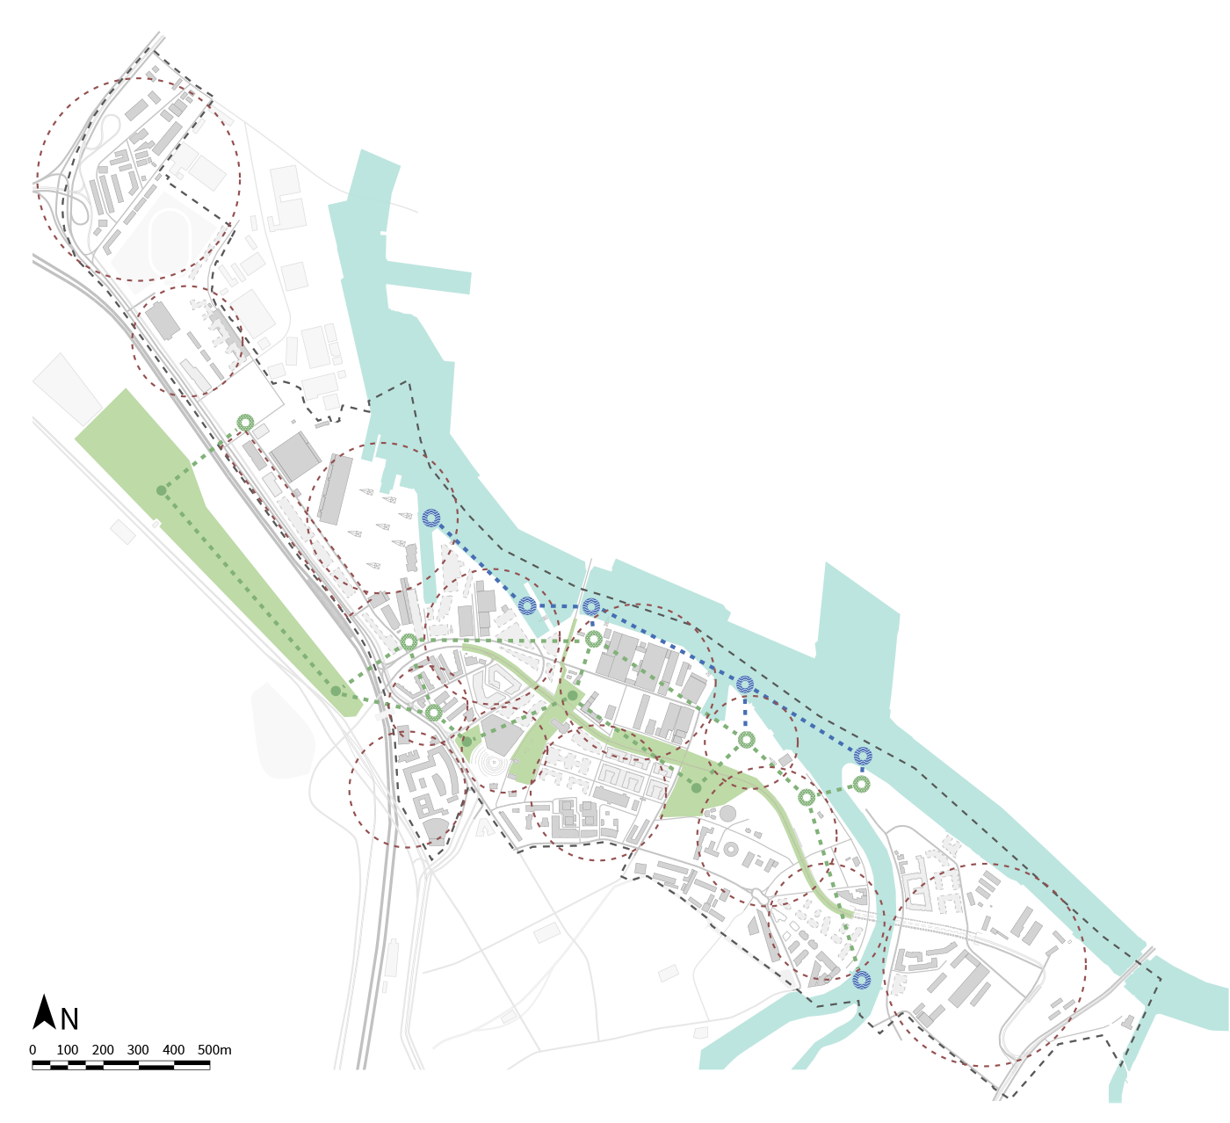
4.07 Findings. Existing and postulated sites of recreations as a network of third places
Noteworthy existing sites: open spaces by the Cesarska Shipyard, Park Steffensa and waterfront.
suggestion: to create a network of pocket spaces, social gardens and waterfront attractions.
Legenda:

Slide 18
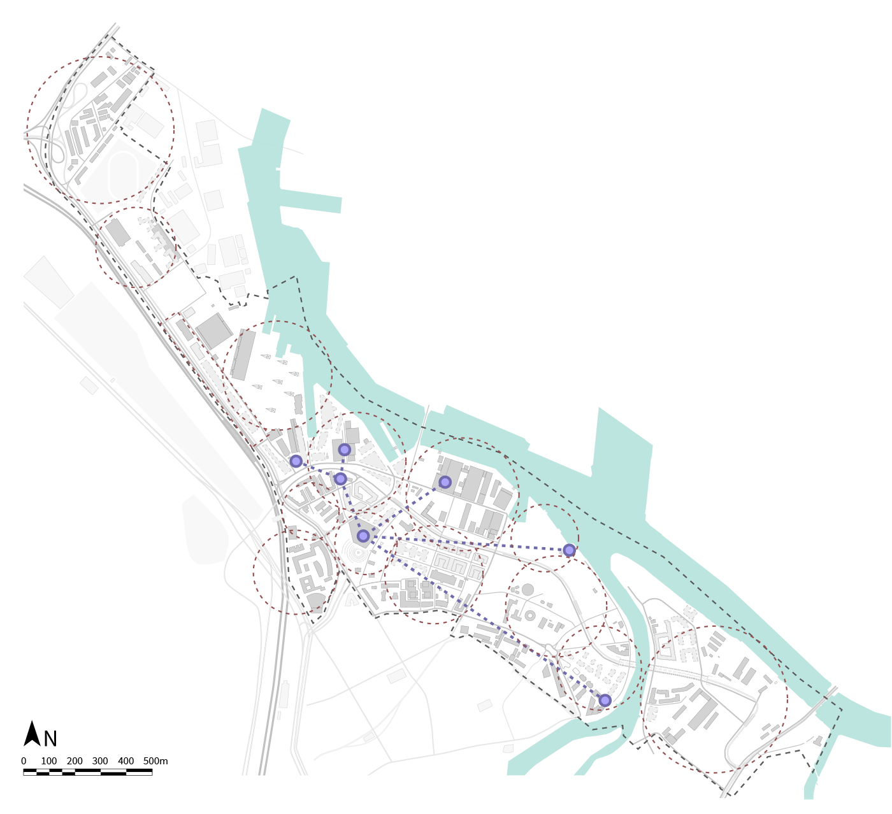
4.08 4.07 Findings. Existing and postulated cultural sites as a network of third places
Noteworthy existing cultural sites: 100cznia, NOMUS, ul. Elektryków, Stocznia Cesarskia, Europejskie Centrum Solidarności, Mleczny Piotr and services in the area of Brabank.
suggestion: to create a cultural centre for children.
Legend:

Slide 19
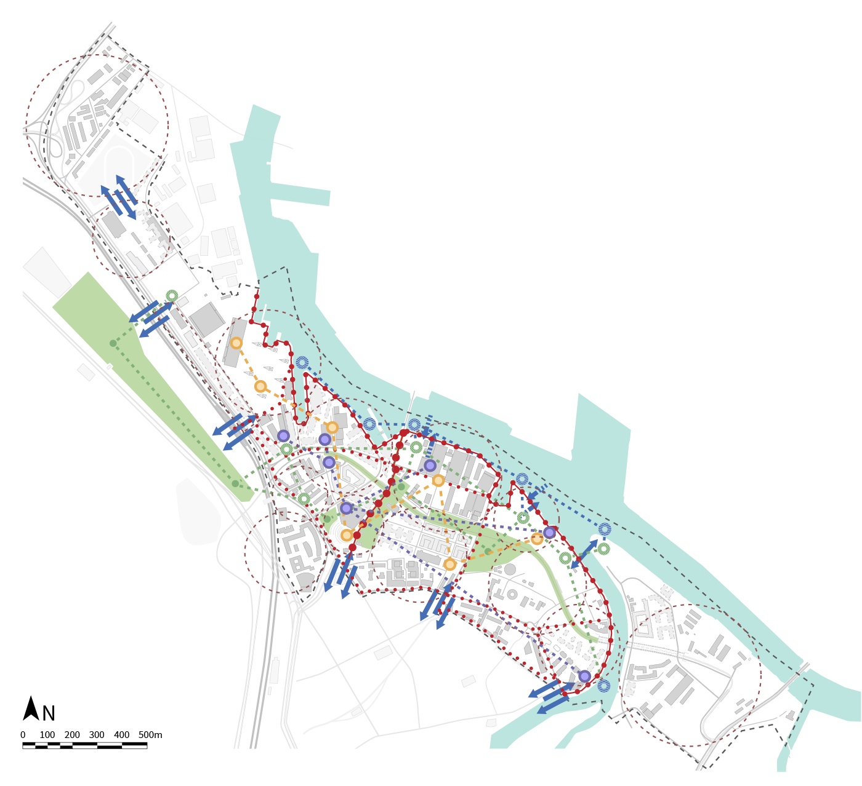
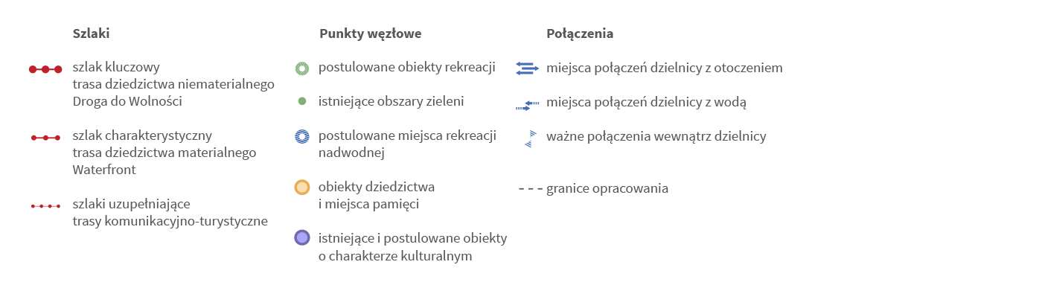
4.08 Findings. Overview
Legenda:

Slide 20
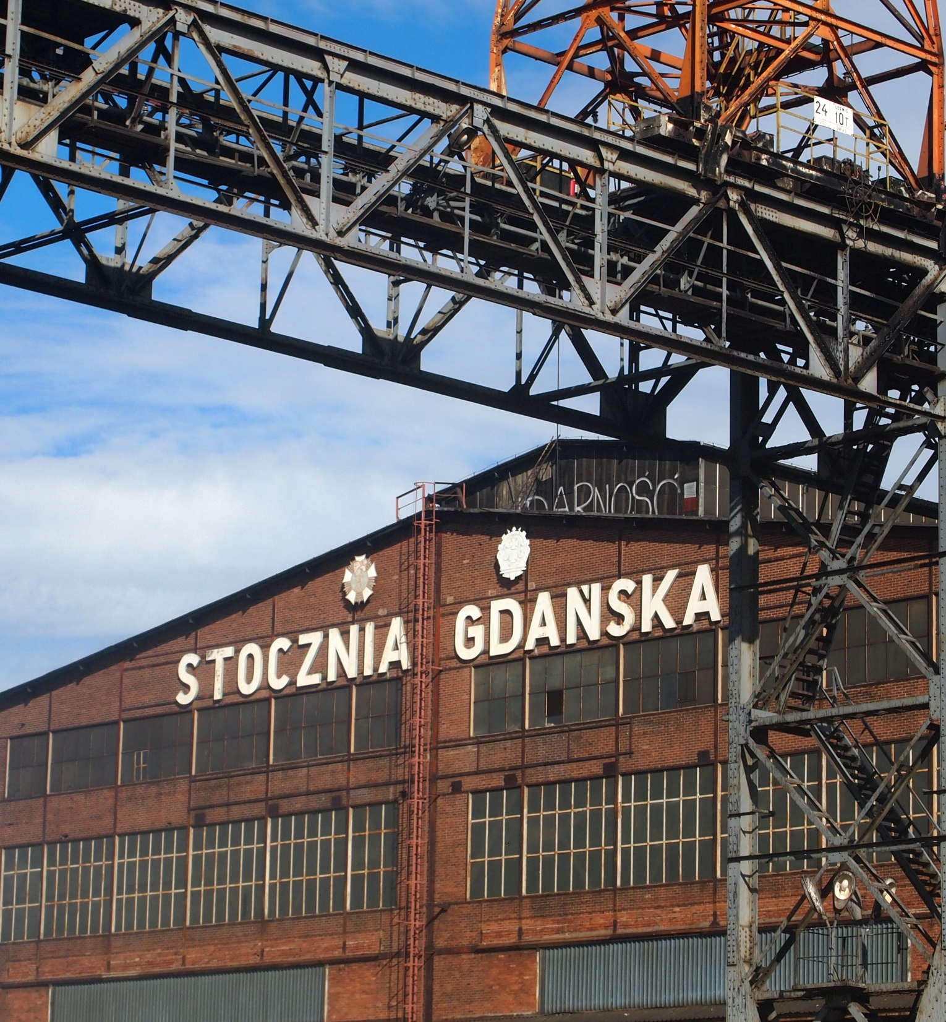
5.01 Findings and reccomendations.
Coordinated developemnt of the district.
Sustainable and multi-functinal programme.
Strategic development of green and reacrational areas
Mapping and coordinating social and cultural initatives.
Identify and investigate generational differences in the understanding of Młode Miasto .
Integration of Polski Hak.
To examine and resolve the semantic issues of proper names and concepts related to the area.

