Slide 1
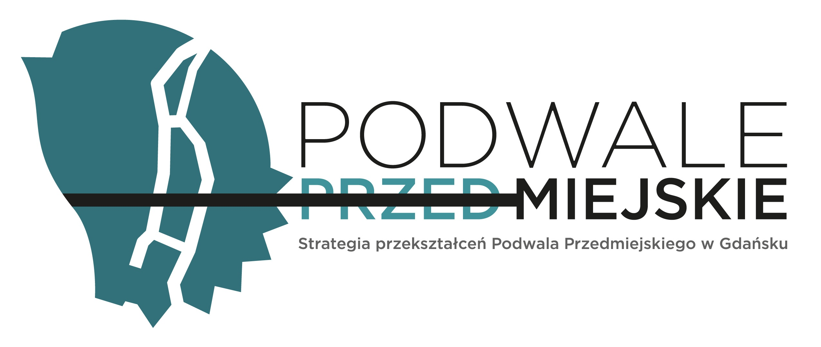
Revitalizing Podwale Przedmiejskie
A Participatory Transformation of Gdańsk's Historical Core
Paweł Mrozek, Vice President of the Forum Rozwoju Aglomeracji Gdańskiej

Slide 2
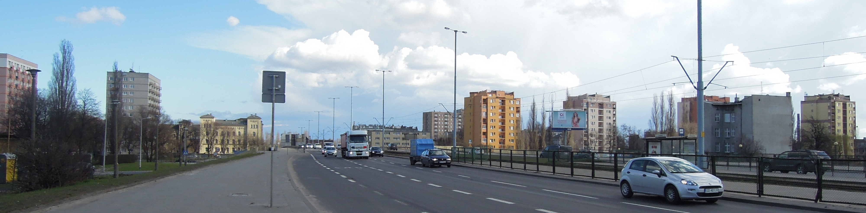
Introduction
Context: Podwale Przedmiejskie was a significant spatial and psychological barrier in Gdańsk's historical center, acting as a transit corridor with limited pedestrian connectivity.

Slide 3
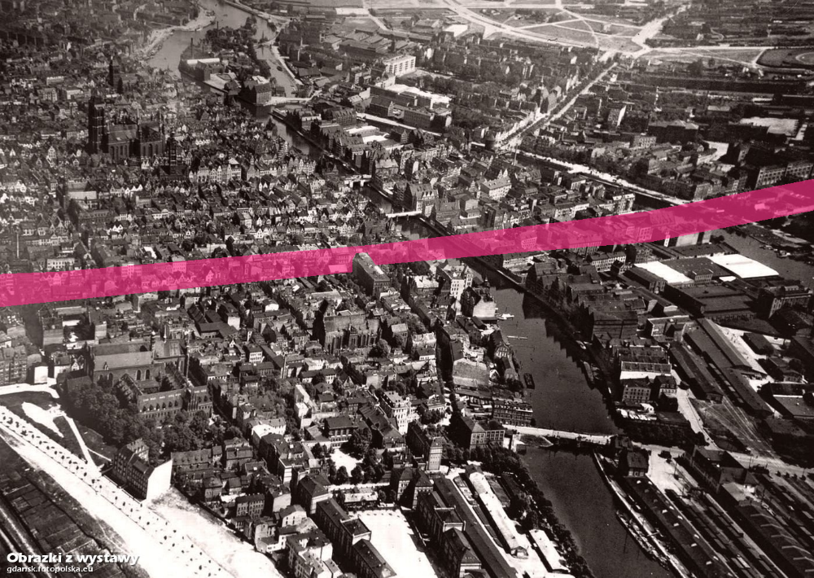
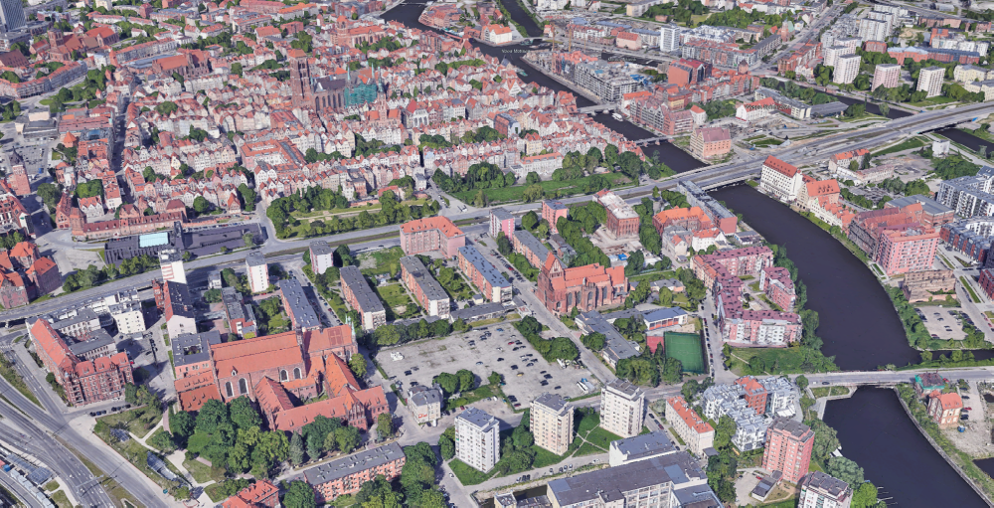

Slide 4
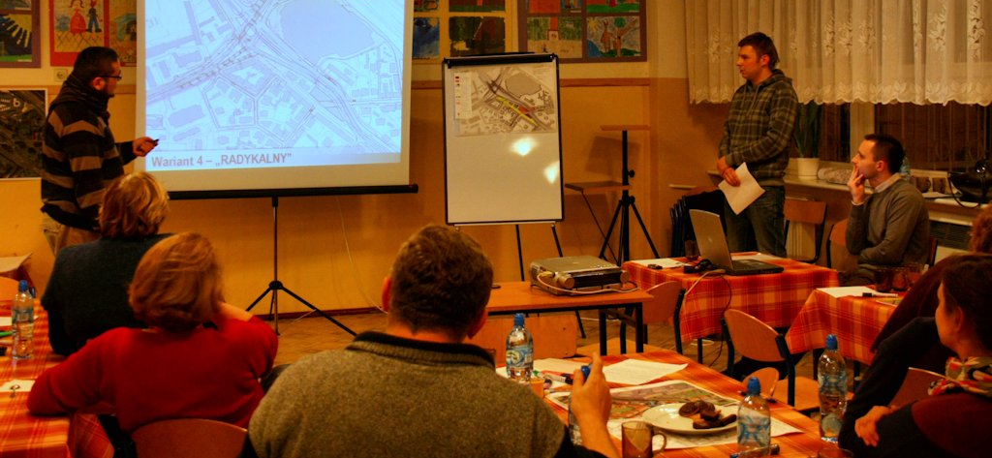
Project Goals and Methodology
Objective: Formulate a participatory strategy to transform Podwale Przedmiejskie into an integrated community space.
Approach: Collaborative work with residents through workshops, surveys, and stakeholder meetings.
Workshops demonstrated urgency and relevance of the issues, showing the critical significance to Śródmieście residents.

Slide 5
Key Findings
Issues Identified:
- Degradation of Green Spaces: Poorly maintained and underutilized.
- Spatial Disconnection: Reinforced socio-economic disparities between communities.
- Community Needs: Strong preference for improved pedestrian accessibility and enhanced social spaces.

Slide 6
Proposed Urban-Architectural Vision
Main Interventions:
- Pedestrian-Friendly Crossings: Two crossings implemented; more are needed for full integration.
- Revitalization of Green Spaces: Transform green areas into multifunctional community spaces.
- Restructuring the Street: Traffic calming and human-centric environment.
- Introducing new urban tissue: New investments alongside „Podwale” to bring more human scale urban street

Slide 7
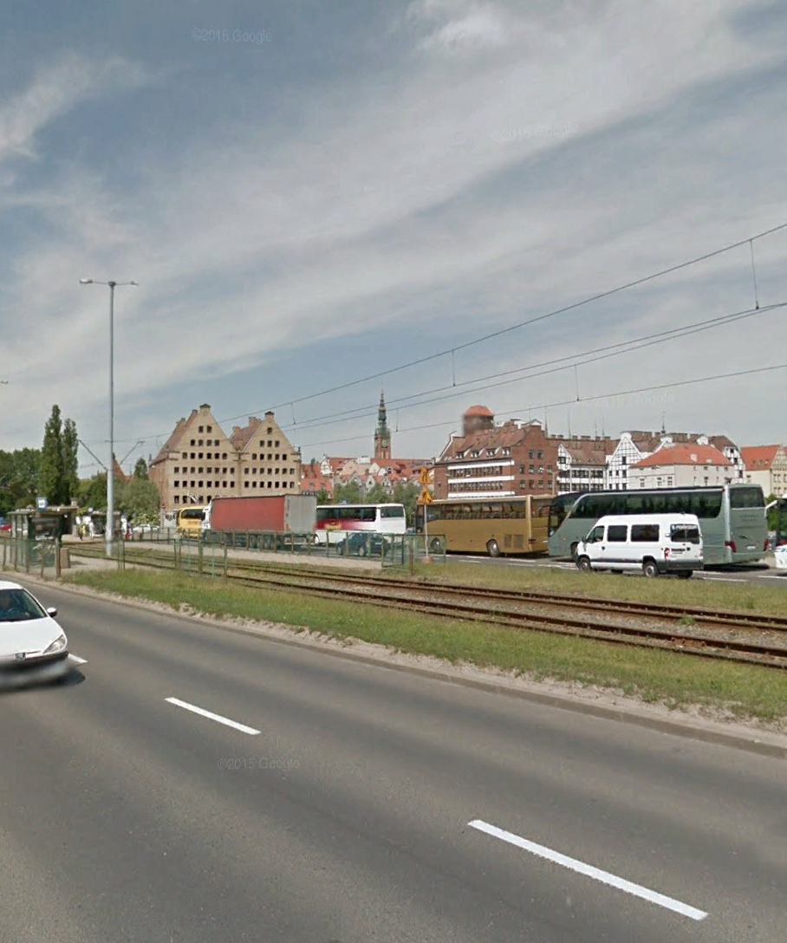
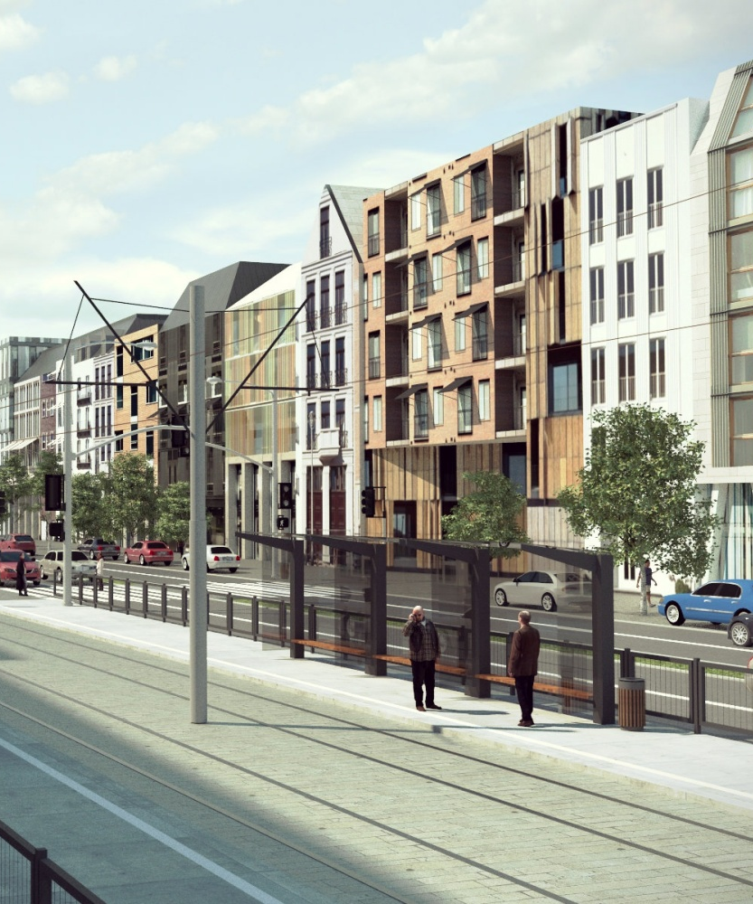

Slide 8
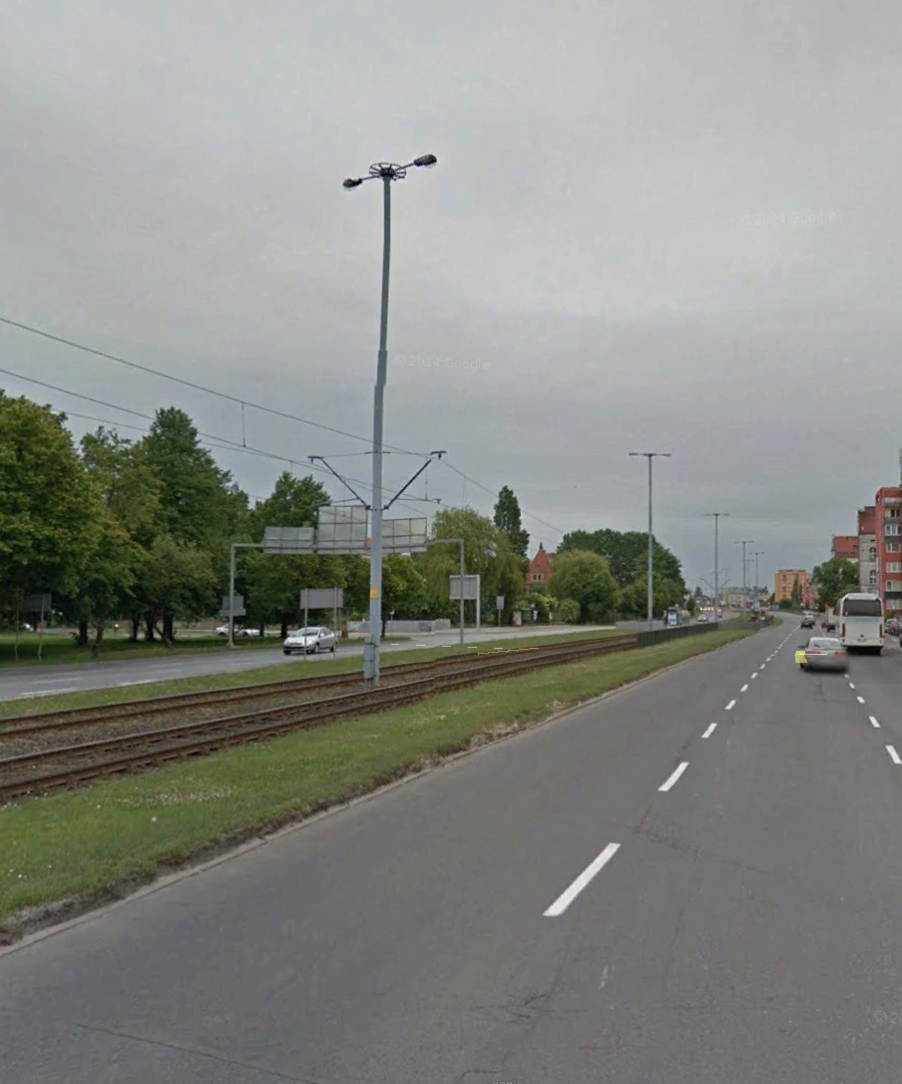
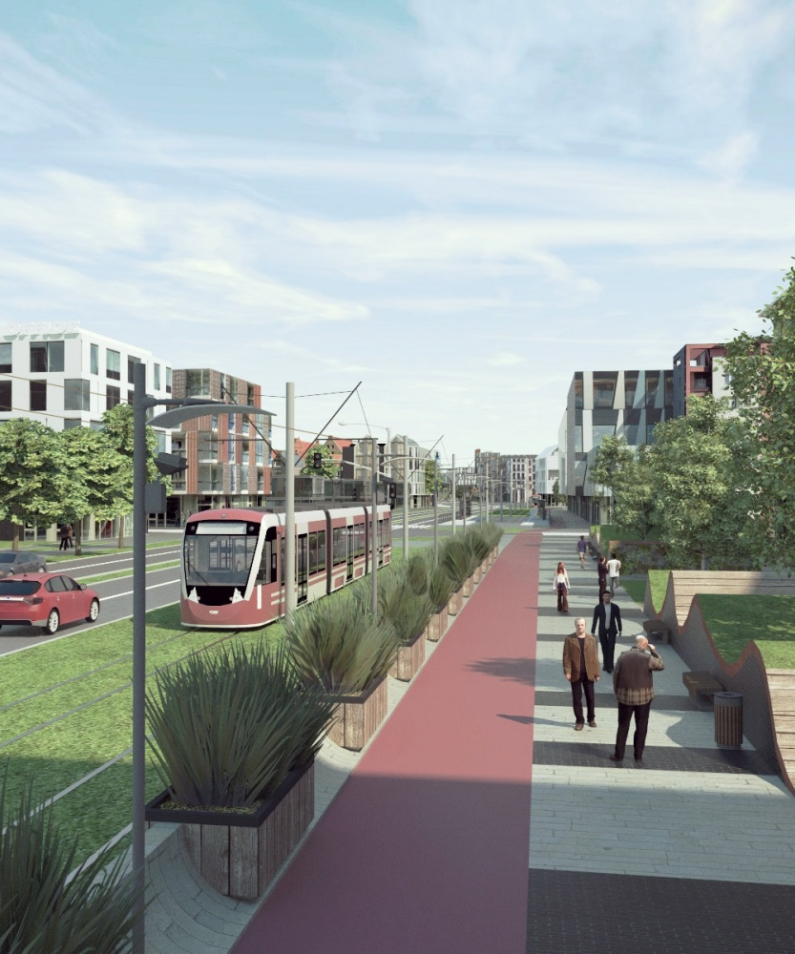

Slide 9
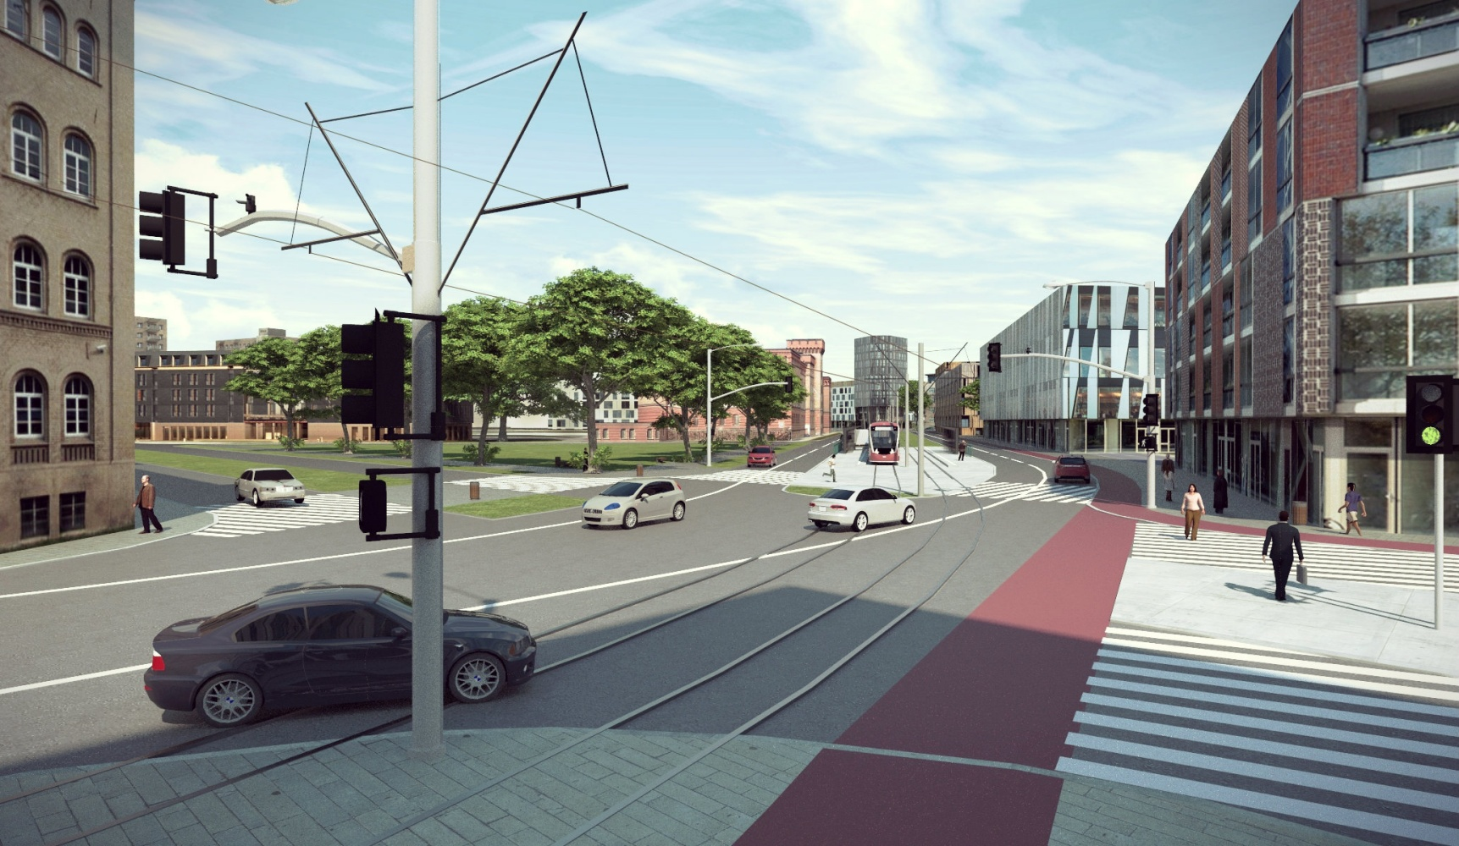

Slide 10
Hard Outcomes Achieved
Analyses and Reports: 20 graphical and descriptive boards covering urban evolution.
Recommendations: Strategic amendments for municipal authorities.
Engagement Results: Mobilized over 140 stakeholders, including officials and local NGOs.

Slide 13
Impact on Public Discourse and Recent Changes
Shift in Focus: Broad consensus on the necessity of changes beyond superficial fixes.
Recognition: Participatory approach cited as a best practice for urban redevelopment.
Recent Changes: New sidewalks, green spaces and pedestrian crossings implemented.

Slide 14
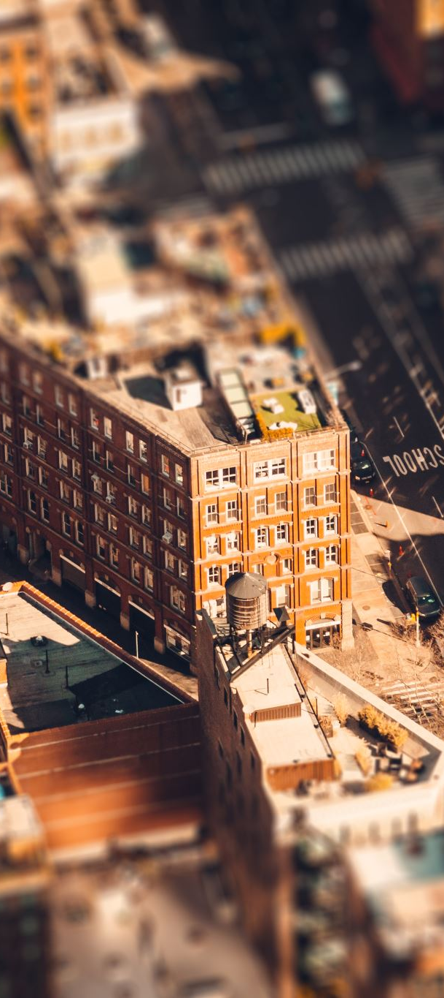
Conclusion and Next Steps
Current Status: Progress achieved but more work needed, including removal of viaducts and urban regeneration.
Call to Action: Remain engaged to ensure revitalization serves as a model for sustainable renewal in Gdańsk.

